Slide 1
COVID-19 in Europe
Nina Vidová, kvarta

Slide 2
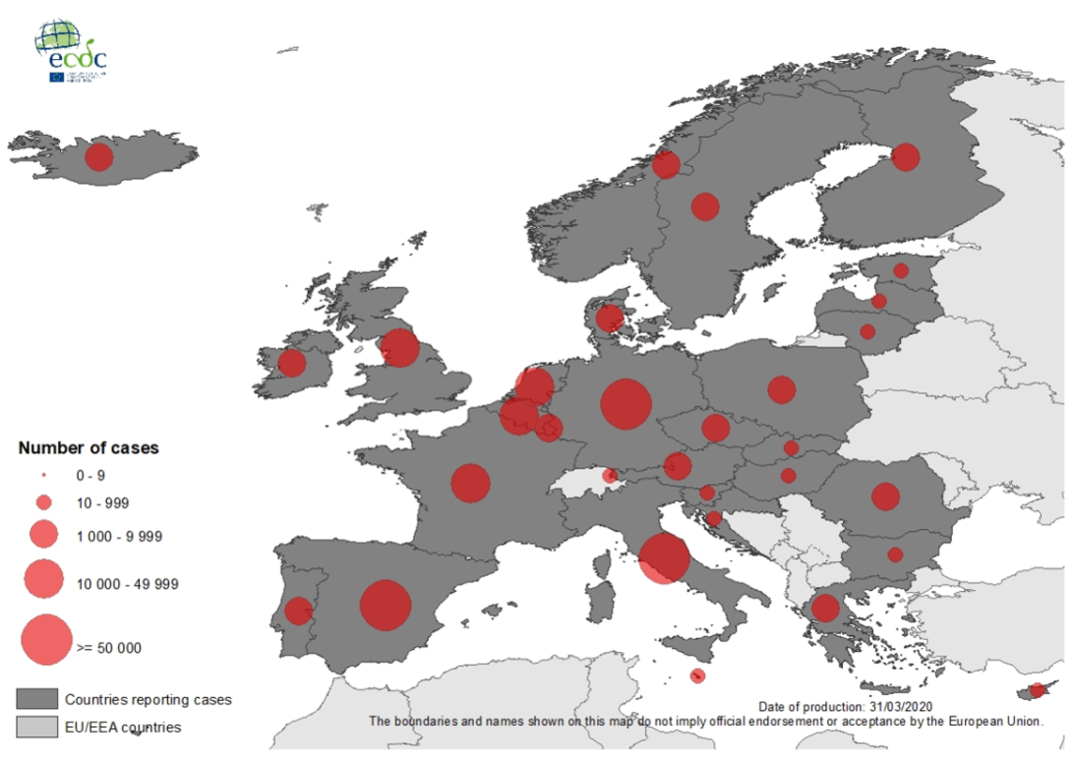
Situation in Europe
As of 31 March 2020, 386 282 cases and 26 110 deaths have been reported in the EU/EEA and the UK
Countries in Europe have been affected by COVID-19, the disease caused by the coronavirus responsible for the 2019–20 pandemic first recorded in Wuhan, China
As of 17 March 2020, all countries within Europe had a confirmed case of COVID-19, with Montenegro the last European country to
report at least one case. In 18 countries, at
least one death has been reported
Europe was considered the active centre of
COVID-19 according to the World Health
Organization as of 13 March 2020
The worst-affected counties in Europe are:
Italy, Spain, Germany, France, United Kingdom,
Switzerland and Belgium

Slide 3
Italy
The worst-affected country all over the world is now USA, Italy is the worst-affected country in Europe and it’s at the epicenter of Europe’s coronavirus outbreak with its entire 60 million population under lockdown and having to stay indoors
It has 101.739 confirmed cases and 11.591 deaths – which exceeds China's death toll, despite having fewer confirmed infections and a far smaller population
In the Northern province of Bergamo, the area hardest hit by the virus, the crematorium has started operating 24 hours a day. Funerals have been put on hold; churches are lined with coffins, as local morgues are full. Residents describe Bergamo as a ghostly place where only ambulances and hearses are on the road at night

Slide 4
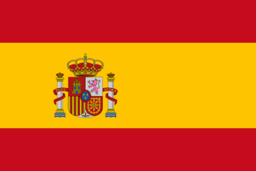
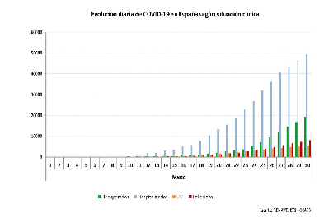
Spain
The 2019–20 coronavirus pandemic was confirmed to have spread to Spain on 31 January 2020, when a German tourist tested positive for SARS-CoV-2 in La Gomera, Canary Islands
It has 87.956 confirmed cases and 7.716 deaths. At least 5,231 hospitalised people are in intensive care
Tuesday saw a rise in the number of deaths recorded in the last 24 hours – 849. It marked a new record in the highest number of daily deaths and also a grim milestone of over 8,000 deaths

Slide 5
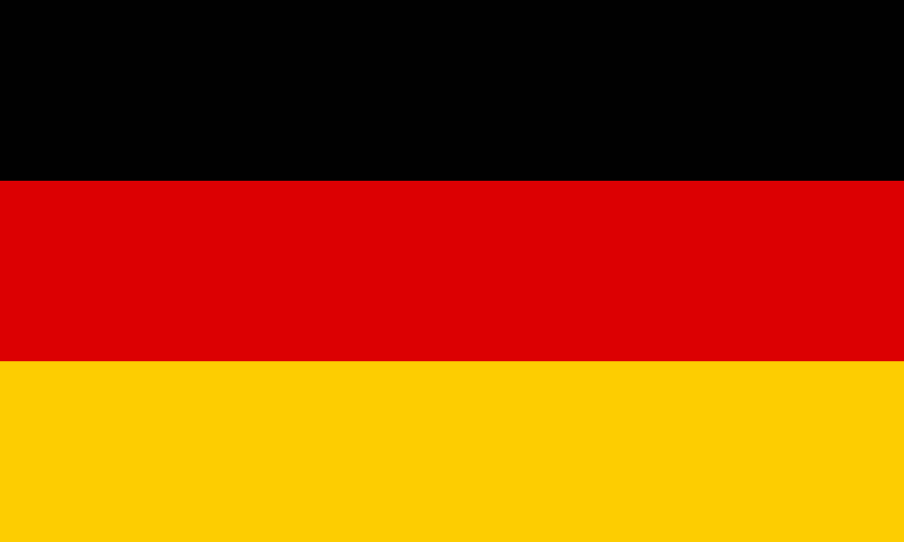
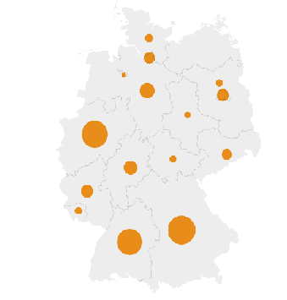
Germany
It has 67,051 confirmed cases and 650 deaths, which is a surprisingly small figure compared to the number of confirmed cases. In mathematical terms, this is a lethality rate of around 0.8%, significantly smaller than in many other countries including Italy and Spain, both of which are grappling with rates around 10%
According to Christian Drosten, Germany's leading coronavirus expert and a government adviser, the high number of tests carried out in the country may provide a possible explanation for the comparatively low death rate

Slide 6
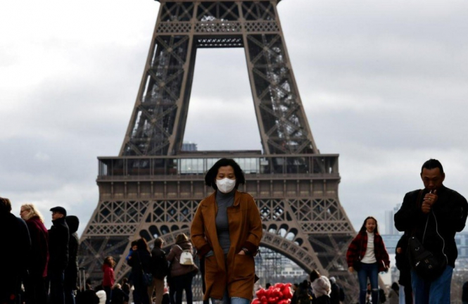
France
It has 45,232 confirmed case and 3,024 deaths
The 2019–20 coronavirus pandemic was confirmed to have spread to France on 24 January 2020, when the first COVID-19 case in Europe and France was confirmed in Bordeaux. It involved a 48-year-old French citizen who arrived in France from China. Two more cases were confirmed by the end of the day; all of the individuals had recently returned from China. A Chinese tourist was admitted to a hospital in Paris on 28 January and died on 14 February, marking the first death from COVID-19 outside of Asia
France reported on 31st March 418 deaths in one day, its highest one-day death toll yet

Slide 7
Thank You for Your Attention

