Slide 1
Corona virus and its effect on the environment
Eliška rusnáková
kvarta

Slide 2
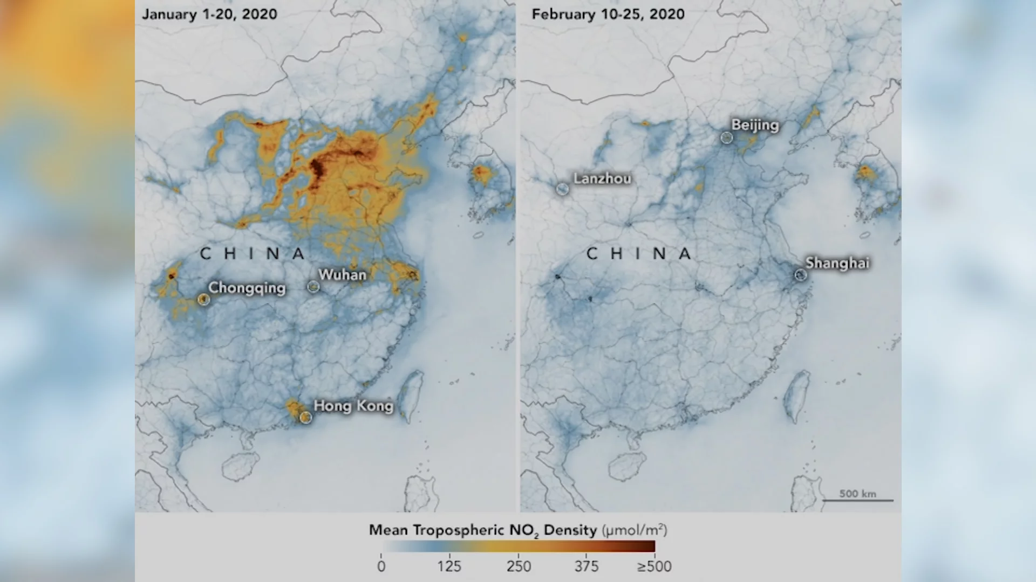
Improvements in air quality
Drop in air pollution was first observed by NASA in China
“This is the first time I have seen such a dramatic drop-off” said one of the NASA workers from China
In Madrid, Spain was recorded 14% drop in rush-hour traffic

Slide 3
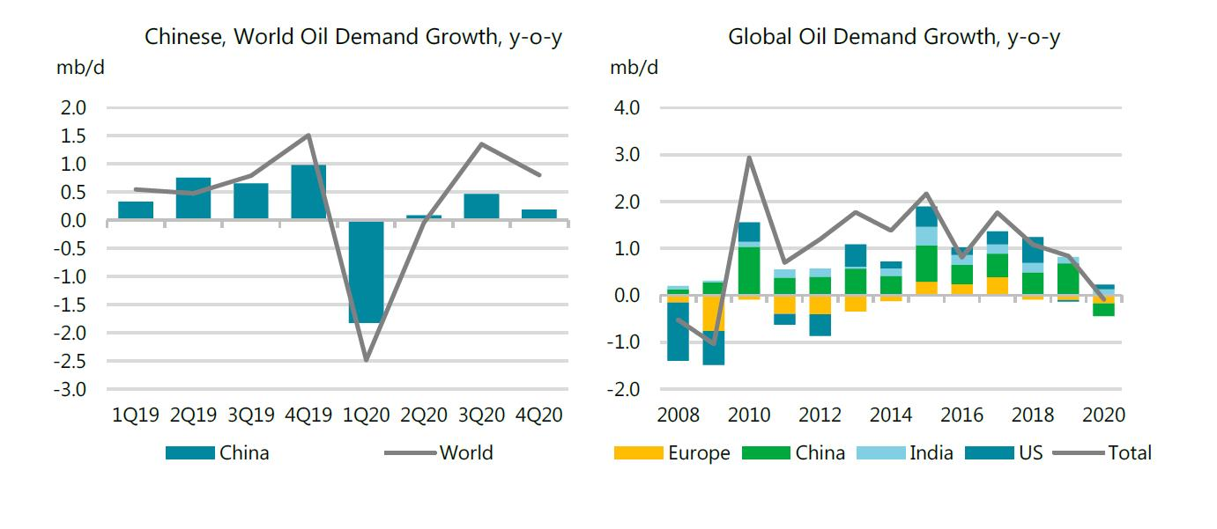
Greenhouse gas emissions
Slowing economy also drives down emissions- closedown of schools, shops, factories
A study by specialist outlet Carbon Brief found that in China, carbon dioxide emissions have fallen by around 25%
Oil demand is also expect to decline due to restriction of travelling and other economical aspects

Slide 4
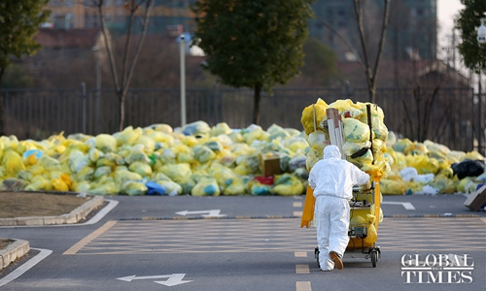
loads of waste
Starbucks decided to stop accepting reusable cups- they accept only single use cups to prevent from the virus
Warnings to not buy pre-packaged foods, the food may be a route or source of virus transmission
China is drowning under medical waste of hospitals (single-use tissues, face masks)
The volume of medical waste in Wuhan, China is reported to be more than 200 tons a day

Slide 5
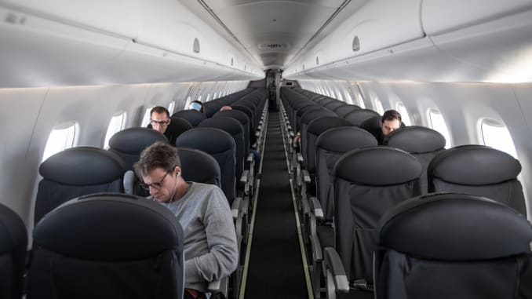
Airlines
67 million fewer passengers flew in the first three months of 2020 compared to 2019
Airlines are canceling increasing number of flights as the virus spreads more and more
Airline lobby IATA predicts the global industry could lose up to $113 billion this year
“ghost flights”

Slide 6
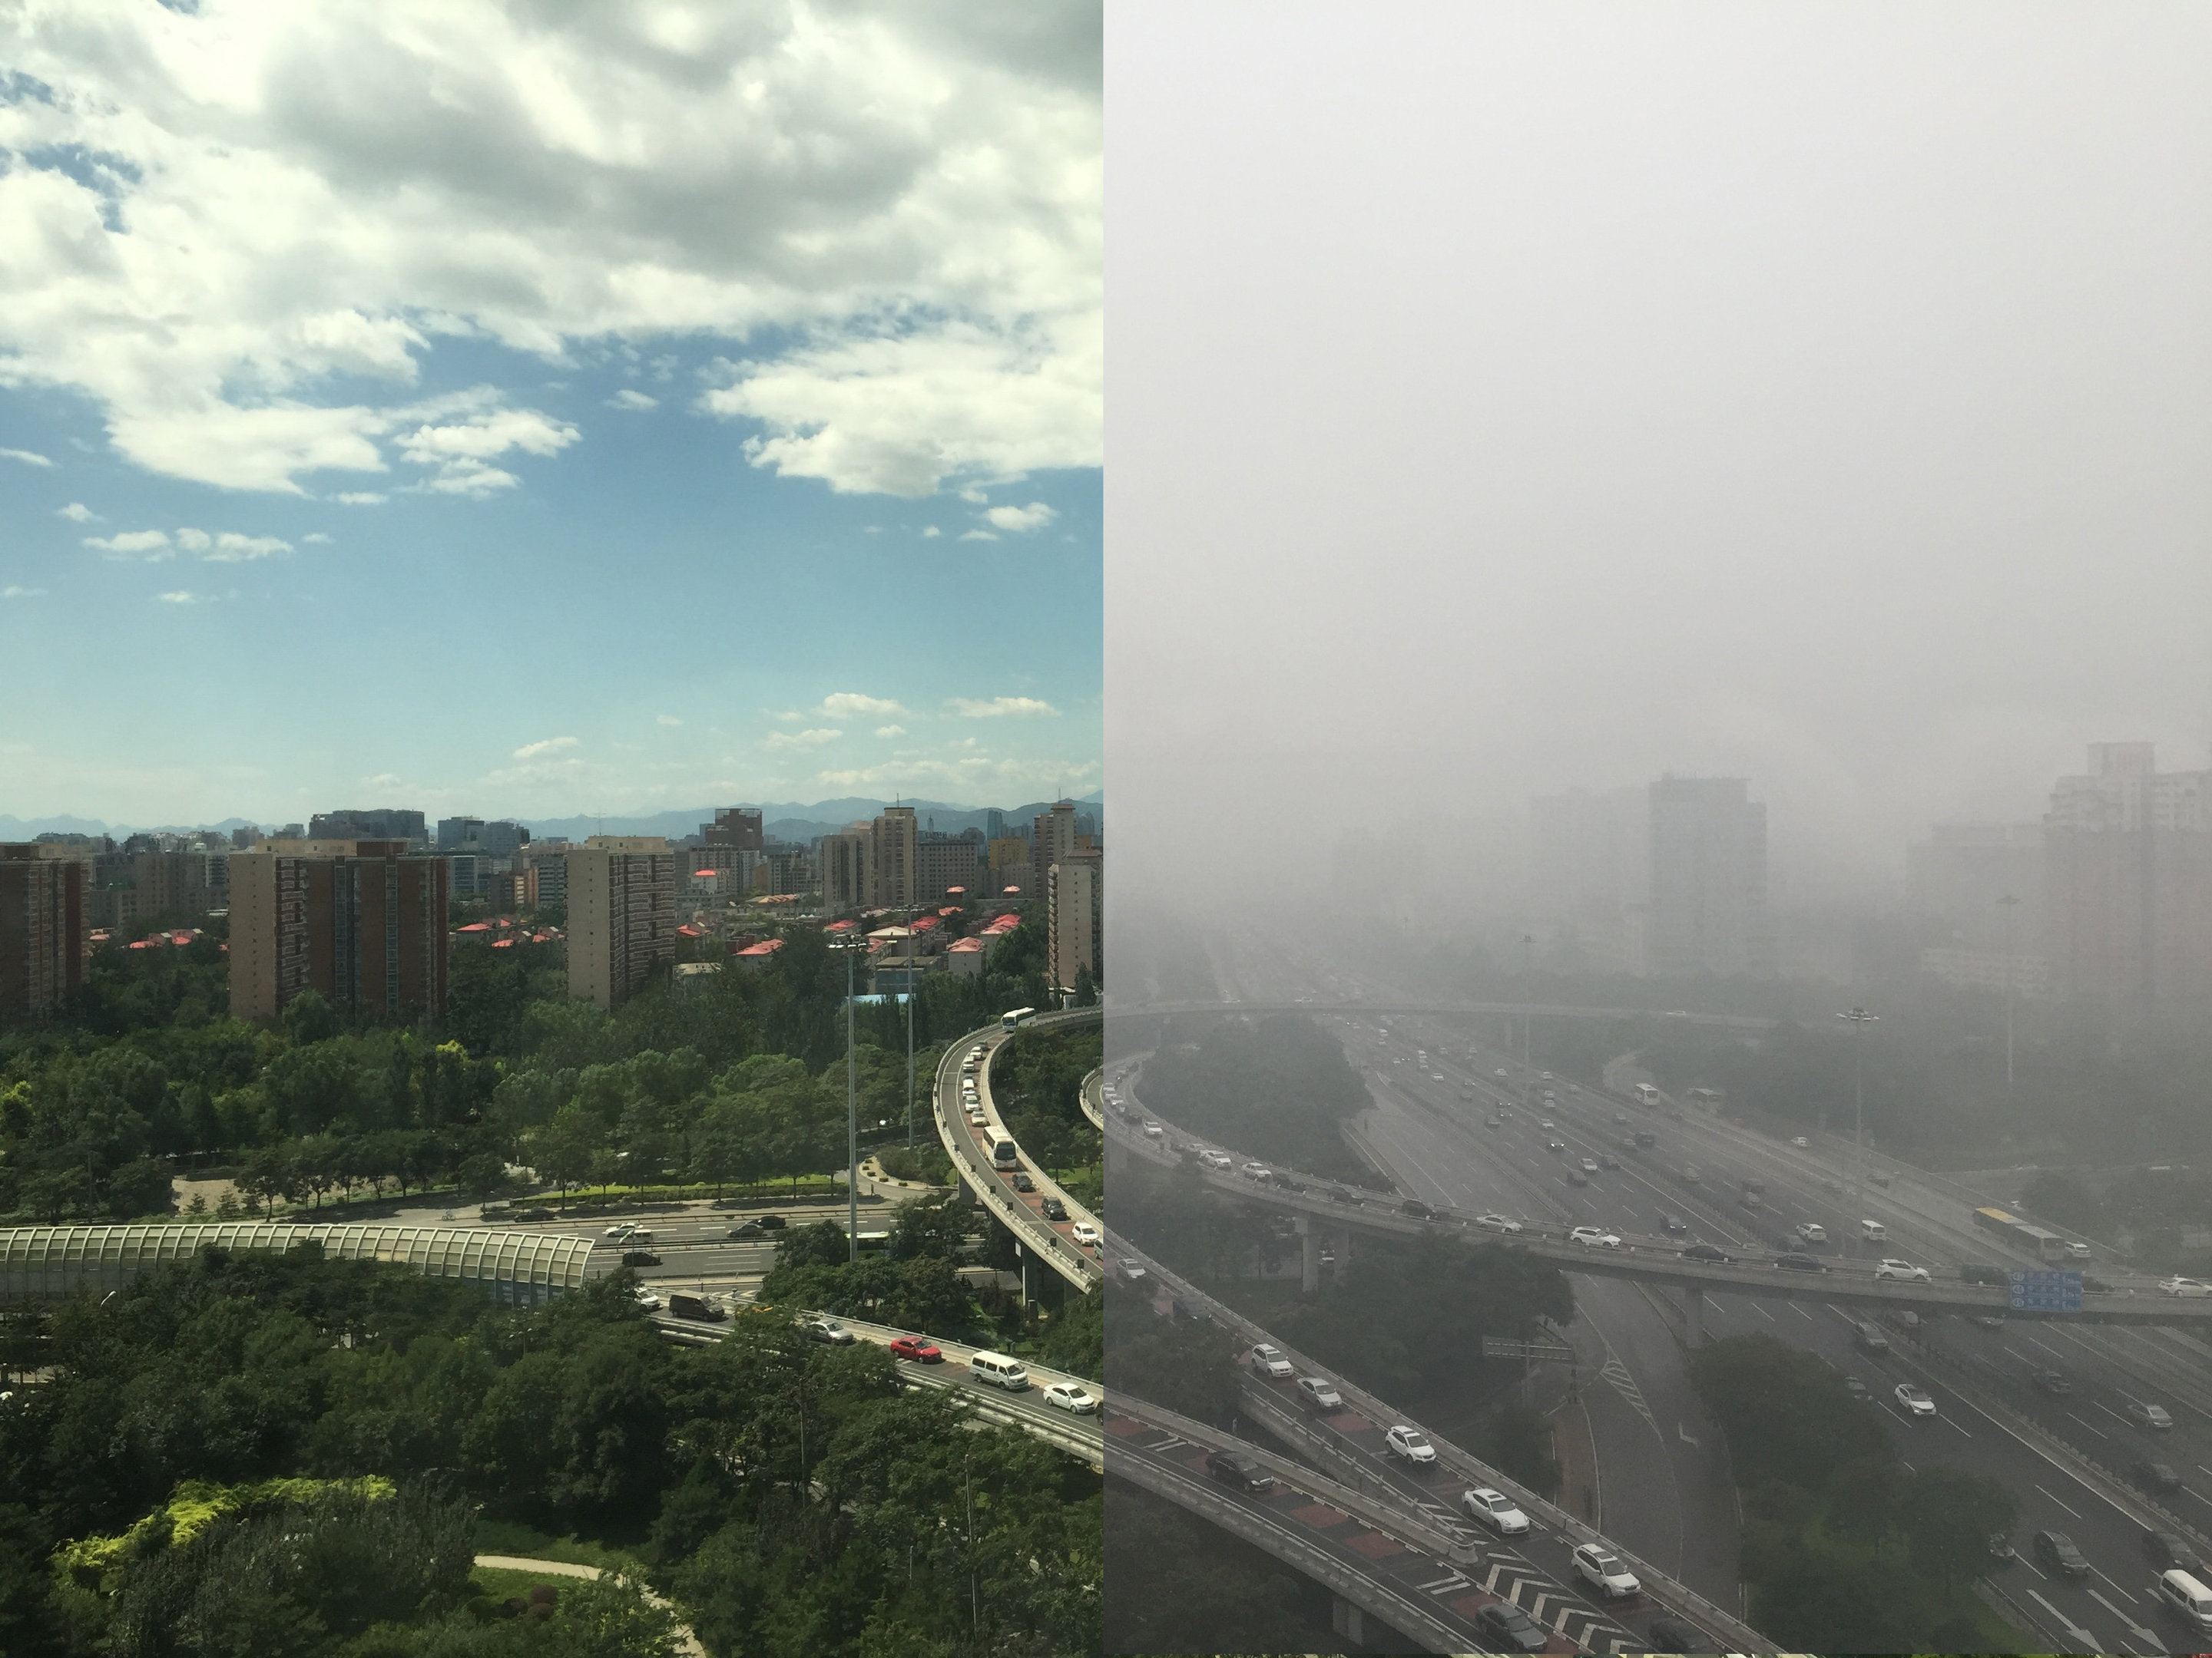
Thank you for your attention!

Slide 7
Sources: https://www.politico.eu/article/6-ways-coronavirus-is-changing-the-environment/
https://www.google.com/search?q=cleaned+air+in+china+coronavirus&rlz=1C1PRFC_enBE697SK709&sxsrf=ALeKk00AZdug0lOSWdWIMDHlsvoij-_k5w:1585218657868&source=lnms&tbm=isch&sa=X&ved=2ahUKEwj_hPnX97foAhXOa8AKHTNqA7kQ_AUoAXoECAsQAw&biw=1366&bih=657#imgrc=WhfUIYH23jvQ-M
https://www.globaltimes.cn/content/1182866.shtml
https://www.google.com/search?q=airlines+and+coronavirus&rlz=1C1PRFC_enBE697SK709&sxsrf=ALeKk00nVlLNG4zJYKy8UasorcR54rUv6A:1585221575579&source=lnms&tbm=isch&sa=X&ved=2ahUKEwjWiJzHgrjoAhVUi1wKHSeYDwYQ_AUoAnoECAsQBA&biw=1366&bih=657#imgrc=OPtjoM9nbyT6GM
https://phys.org/news/2018-10-clearer-path-air-china.html

