Slide 1
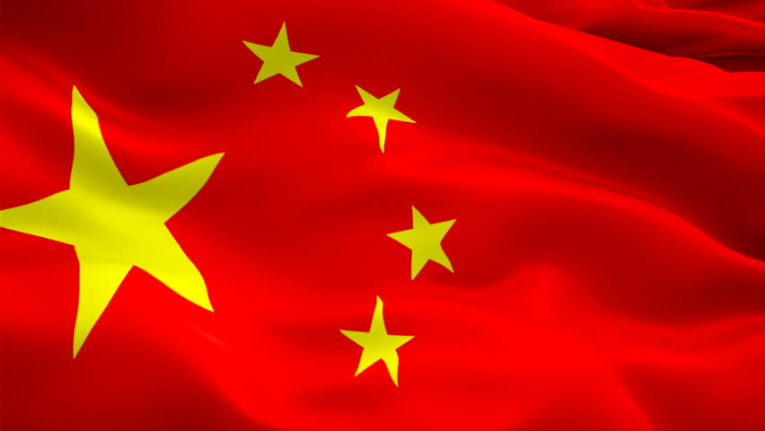
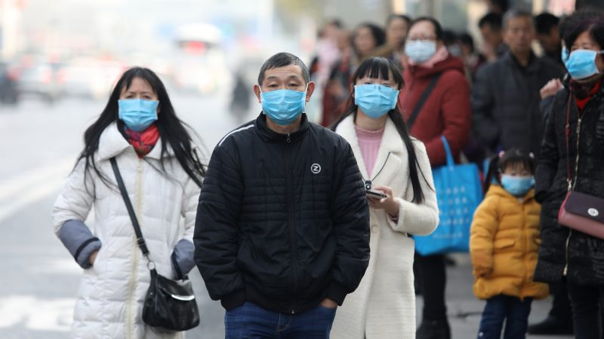
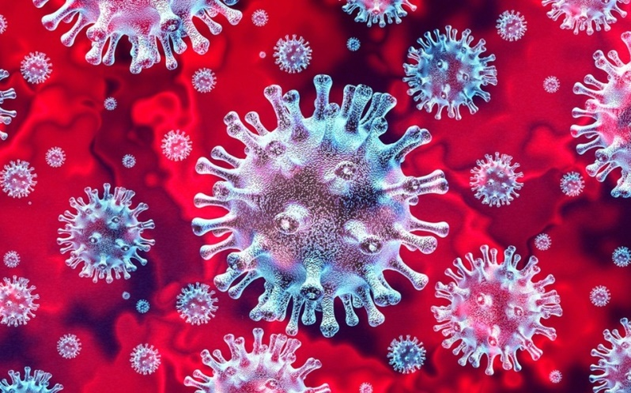
Covid-19 in China
©Michal Monček, Kvarta 2020

Slide 2
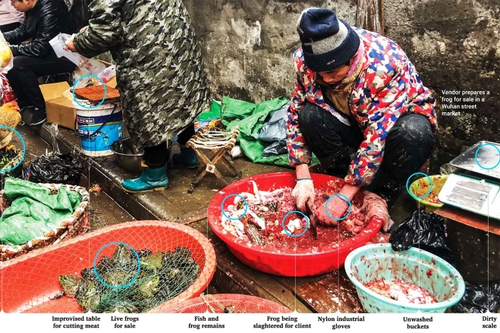
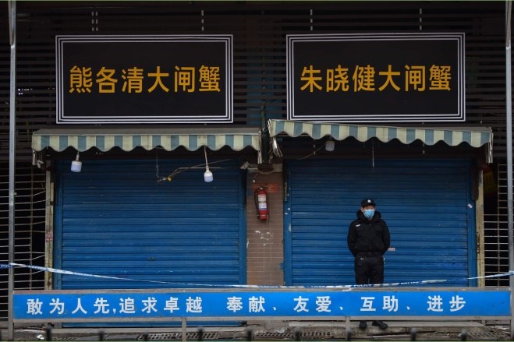
How did Covid-19 start?
The disease appears to have originated from a Wuhan seafood market where wild animals are traded illegally
The hunt for the animal source of Covid-19 is still unknown, although there are some strong contenders
A team of virologists at the Wuhan Institute for Virology released a detailed paper showing that the new coronaviruses' genetic makeup is 96 per cent identical to that of a coronavirus found in bats
The Wuhan market was shut down for inspection and cleaning on January 1, but by then it appears that Covid-19 was already starting to spread beyond the market itself
On January 21, the WHO Western Pacific office said the disease was also being transmitted between humans – evidence of which is apparent after medical staff became infected with the virus
Since then, evidence of widespread human-to-human transmission outside of China has been well established, making chances of containing the virus much harder

Slide 3
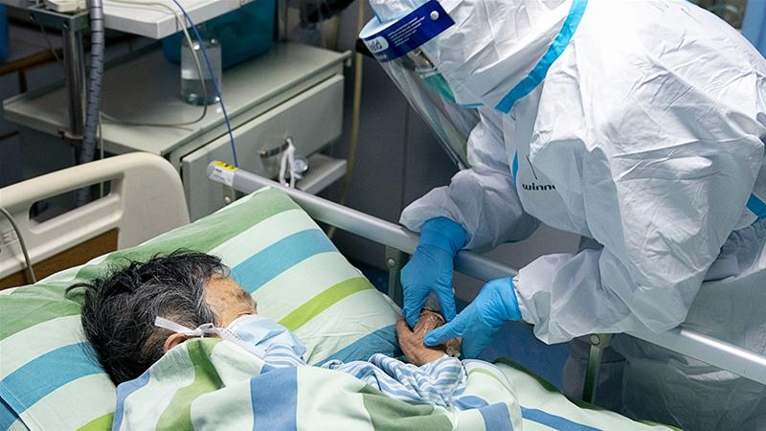
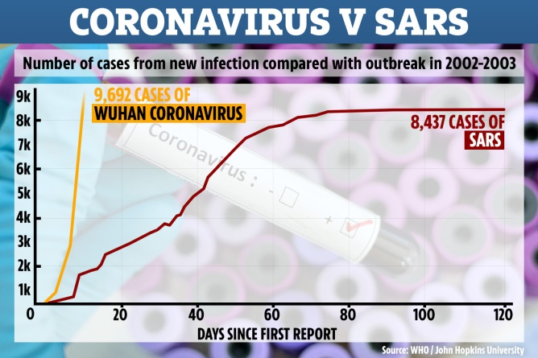
What exactly is Covid-19?
Coronaviruses are a large group of viruses that are known to infect both humans and animals
The most well-known case of a coronavirus epidemic was SARS, which, after first being detected in southern China in 2002, went on to affect 26 countries and resulted in more than 8,000 cases and 774 deaths
On January 7 Chinese health authorities identified that it was caused by to a strain of coronavirus that hadn’t been encountered in humans before
Five days later the Chinese government shared the genetic sequence of the virus so that other countries could develop their own diagnostic kits
Symptoms of coronaviruses are often mild – the most common symptoms are a fever and dry cough – in some cases they lead to more serious respiratory tract illness including pneumonia and bronchitis
These can be particularly dangerous in older patients, or people who have existing health conditions
A study of 44,415 early Chinese Covid-19 patients found that 81 per cent of people with confirmed infections experienced only mild symptoms, 14 per cent were in a severe condition while five per cent of people were critical cases

Slide 4
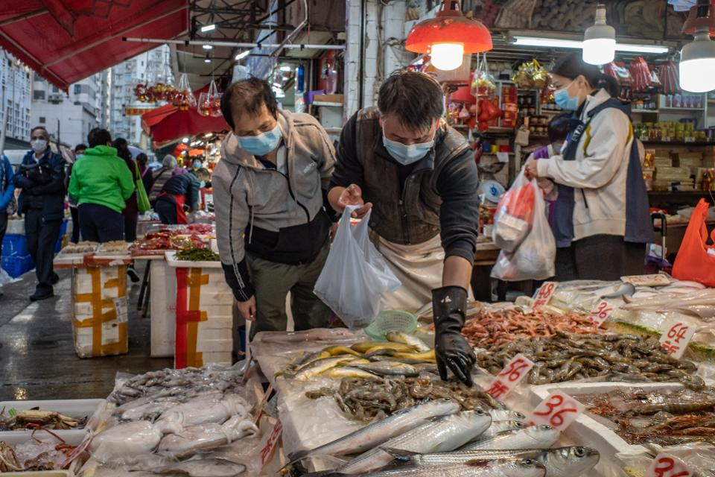
A timeline of Covid-19 pandemic
1 December
The first known patient started experiencing symptoms
He had not been to the Huanan Seafood Wholesale Market of Wuhan
No epidemiological link could be found between this case and later cases
10 December
57-year-old Wei Guixian, a seafood merchant working at the Huanan Seafood Wholesale Market, might be patient zero
18 - 29 December
Members of The Wuhan Institute of Virology alongside others published a report of seven cases of people with severe pneumonia who were admitted to the intensive care unit of Wuhan Jin Yin-Tan Hospital at the beginning of the outbreak
Their samples were sent to the laboratory for the diagnosis of the causative pathogen
Patient ICU-01 was not proven to be linked in to the Wuhan Seafood Market however, the remaining six were either sellers or deliverymen at the market
31 December
China contacts the WHO and informs them of "cases of pneumonia of unknown etiology (unknown cause) detected in Wuhan"

Slide 5
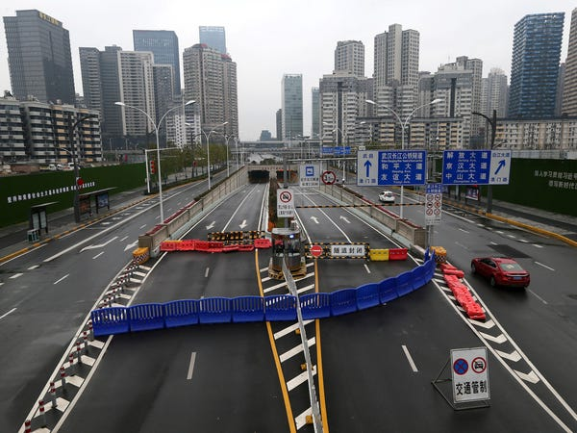
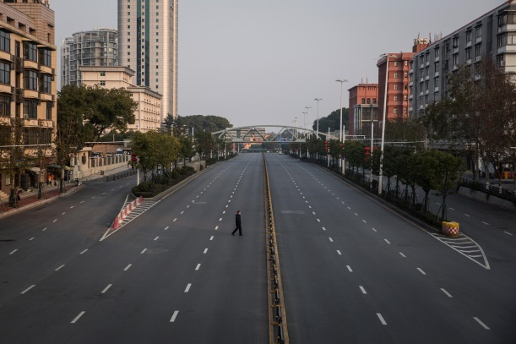
A timeline of Covid-19 pandemic
1 January
Chinese authorities had, by that date, identified 266 people who had been infected before the beginning of 2020
11 January
Chinese state media reported the first known death from an illness caused by the virus
The 61-year-old man who died was a regular customer at the market in Wuhan, and he had previously been found to have abdominal tumors and chronic liver disease.
20 January
The first confirmed cases outside mainland China occurred in Japan, South Korea and Thailand
The first confirmed case in the United States came the next day in Washington State, where a man in his 30s developed symptoms after returning from a trip to Wuhan
23 January
The Chinese authorities closed off Wuhan by canceling planes and trains leaving the city, and suspending buses, subways and ferries within it.
At this point, at least 17 people had died and more than 570 others had been infected, including in Taiwan, Japan, Thailand, South Korea and the United States

Slide 6
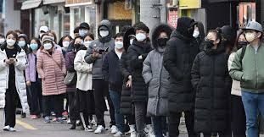
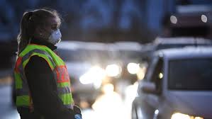
A timeline of Covid-19 pandemic
31 January
The Trump administration suspended entry into the United States by any foreign nationals who had traveled to China in the past 14 days, excluding the immediate family members of American citizens or permanent residents
By this date, 213 people had died and nearly 9,800 had been infected worldwide
2 February
A 44-year-old man in the Philippines died after being infected, officials said, the first death reported outside China

Slide 7
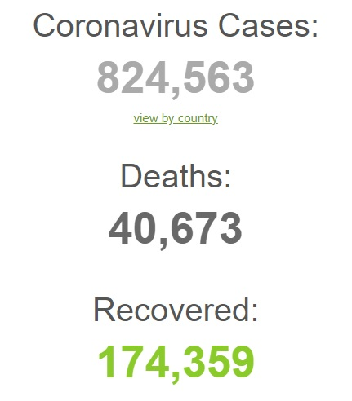
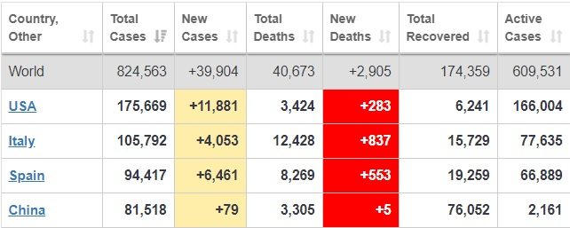
How far has it spread?
As of March 31, Chinese health authorities had acknowledged over 81,510 cases and 3,300 deaths – most of them within the province of Hubei
On March 17, China recorded just 39 new cases of the virus – a remarkable slowdown for a country which, at the peak of its outbreak in mid-February, saw more than 5,000 cases in a single day
Most of the country's new cases are imported from elsewhere in the world – for now at least, it appears that China has its outbreak under control
But while things were slowing down in China, the outbreak started picking up in the rest of the world
There are now confirmed cases in at least 200 countries and territories
Outside of China, the US has seen the highest number of cases
Italy has seen the highest number of cases in Europe, with 105,792 confirmed infections, mostly in the north of the country, and 12,428 deaths – more than in China
While the number of new cases continues to rise sharply, people are also recovering from the infection. Globally, about 174,000 people have recovered from Covid-19

Slide 8
Sources:
https://www.wired.co.uk/article/china-coronavirus?fbclid=IwAR2BPu8-su8sHqbE5LP3ssQCKfi6Kbr72_DapgdDNBEcjM189B1j4rLuFmU
https://www.nytimes.com/article/coronavirus-timeline.html?fbclid=IwAR3gvk25qy8_quEyGrZr8RD_BUyxXbRx6ySFkpUszlirsghwTQ79bFeQ41Q
https://en.wikipedia.org/wiki/Timeline_of_the_2019%E2%80%9320_coronavirus_pandemic_in_November_2019_%E2%80%93_January_2020
https://en.wikipedia.org/wiki/Coronavirus_disease_2019
https://en.wikipedia.org/wiki/2019%E2%80%9320_coronavirus_pandemic_in_mainland_China#Early_response_by_Wuhan
https://en.wikipedia.org/wiki/2019%E2%80%9320_coronavirus_pandemic#China
https://www.google.com/imghp?hl=en

