Slide 1
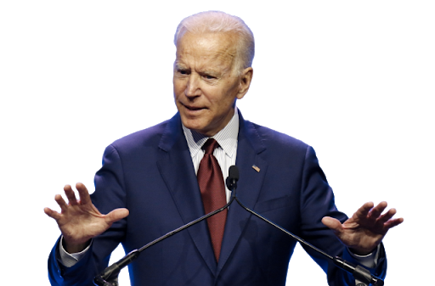
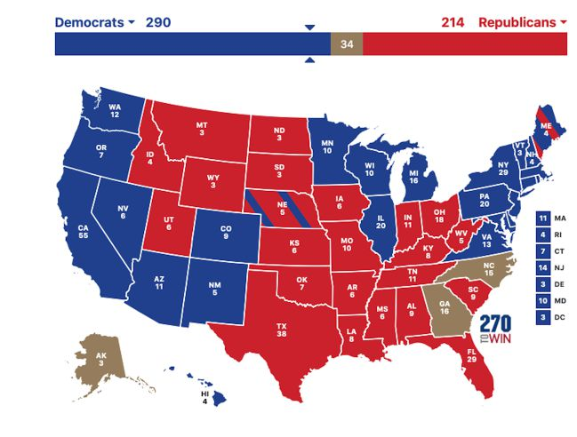
Trump vs Biden
Mark Petromán
II.B

Slide 2
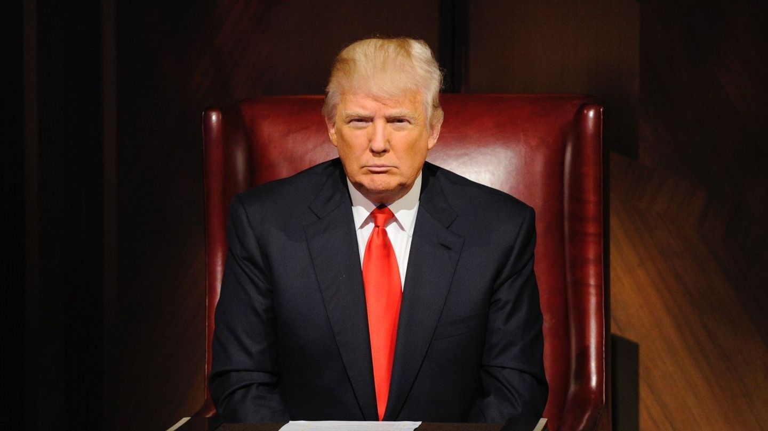
Basic Facts about Donald Trump
His full name is Donald John Trump
Born 14th June 1946 in New York City
He has 5 children
He was the president of the United States for 4 years
He has been married 3 times through his whole life
Trump is the second youngest of five children
He owned a TV Show The Apprentice

Slide 3
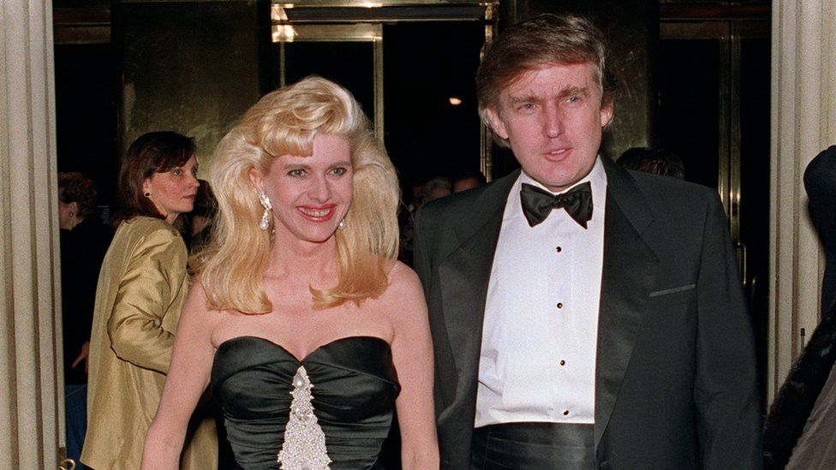
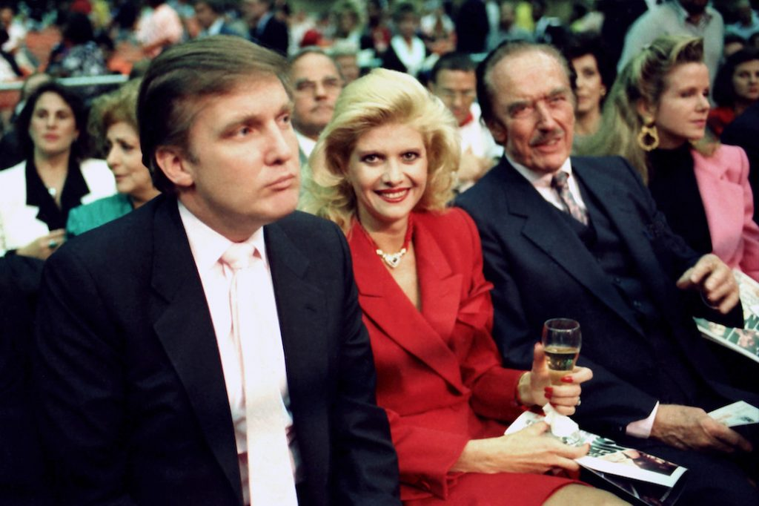
Early years of life
He was born at Jamaica hospital in the borough of Queens
As a kid in high school he loved to play football and basketball
He attended Fordham University for 2 years and received a degree from Wharton School of the University of Pennsylvania
In 1971 he became a president of real estate business which was owned by his father
After that he renamed it The Trump organization and started renovating hotels, skyscrapers, casinos…

Slide 4
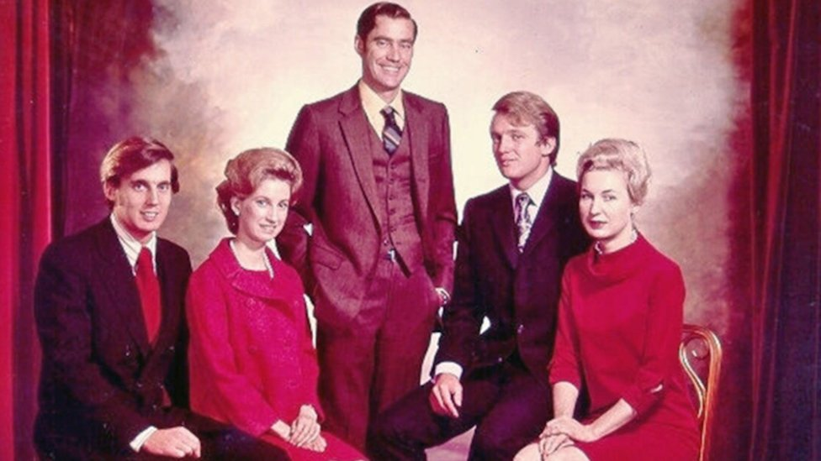
Donalds parents and siblings
His mother Mary Anne MacLeod Trump was a Scottish-born house wife
Trumps father was Bronx-born real estate developer whose parents were German immigrants
He had 4 siblings Robert Trump, Elizabeth Trump Grau, Maryanne Trump Barry and Fred Jr. trump but Fred suddenly died because of his unhealthy lifestyle

Slide 5
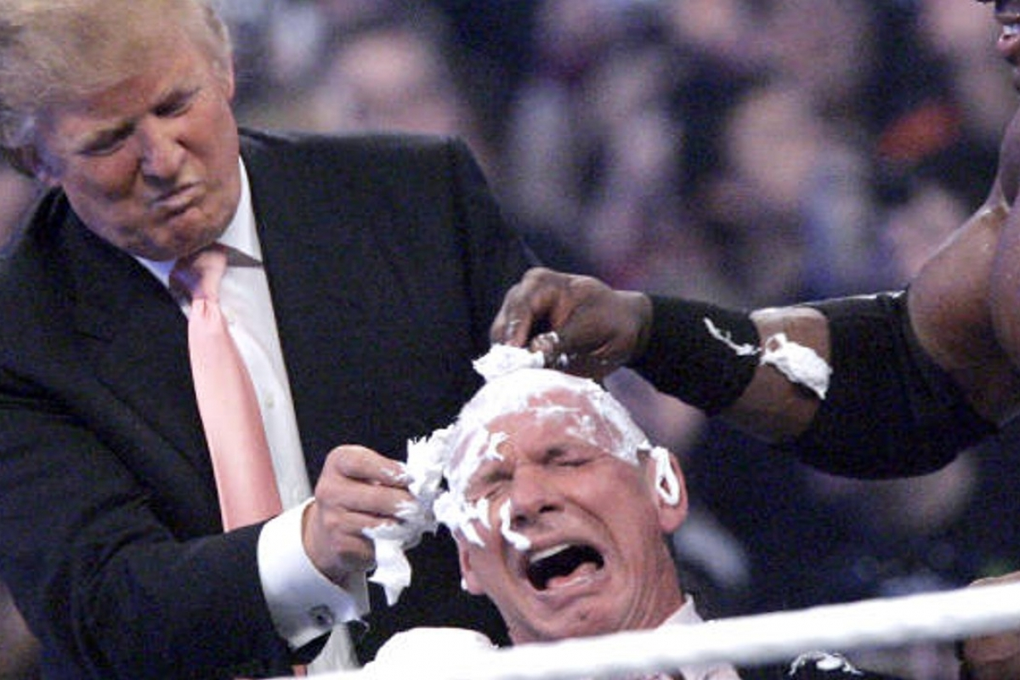
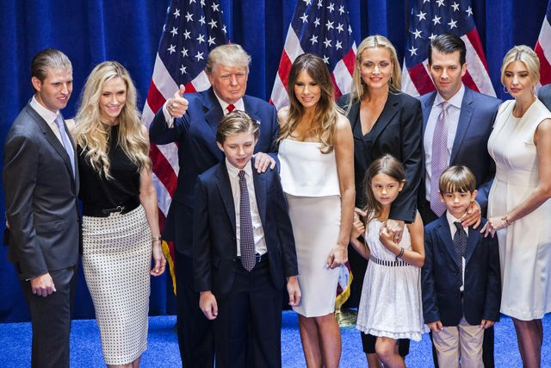
Interesting facts about Donald Trump
Trump doesn’t smoke or drink because his brothers death urged him towards these decisions
Trump has had three political affiliations. He was Democratic from pre 1987 to 2009, Independent from 2011-2012 and Republican at present
Donald is a WWE fan
Donald Trump has eight grandchildren.
Trump influents 85 million people on twitter

Slide 6
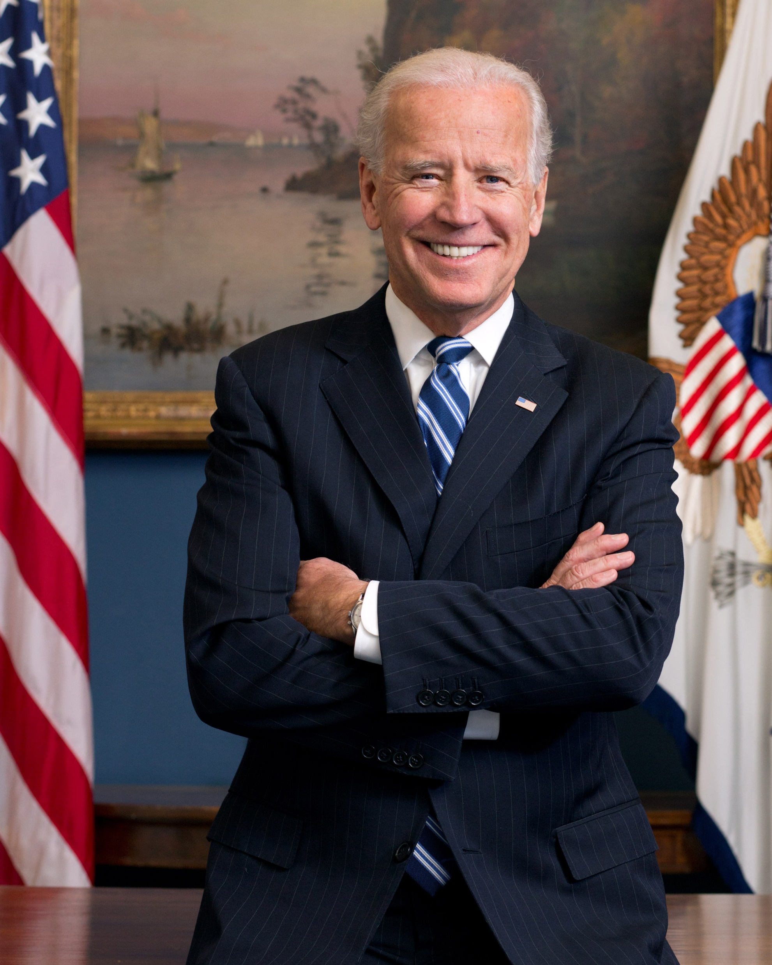
Basic facts about Joe Biden
His full name is Joseph Robinette Biden Jr
Joe was born on 20th November 1942
He has 4 children
He had 2 wives
He is the current president of United States
Joe Biden has 3 siblings

Slide 7
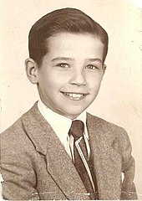
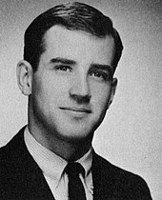
Early years of his life
Joe was born at St. Mary's Hospital in Scranton, Pennsylvania
At the Archmere Academy in Claymont, Biden was a standout halfback and wide receiver on the high school football team
A student with poor grades but natural leader, he was class president in his junior and senior years
On August 27, 1966, Biden married Neilia Hunter, a student at Syracuse University
In 1968, Biden earned a Juris Doctor from Syracuse University College of Law

Slide 8
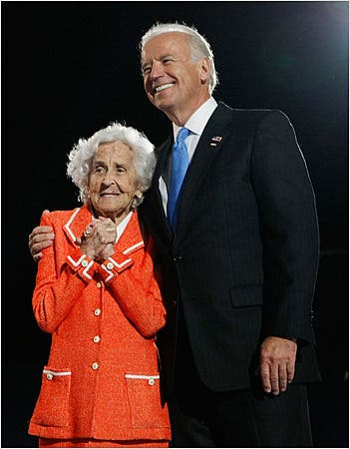
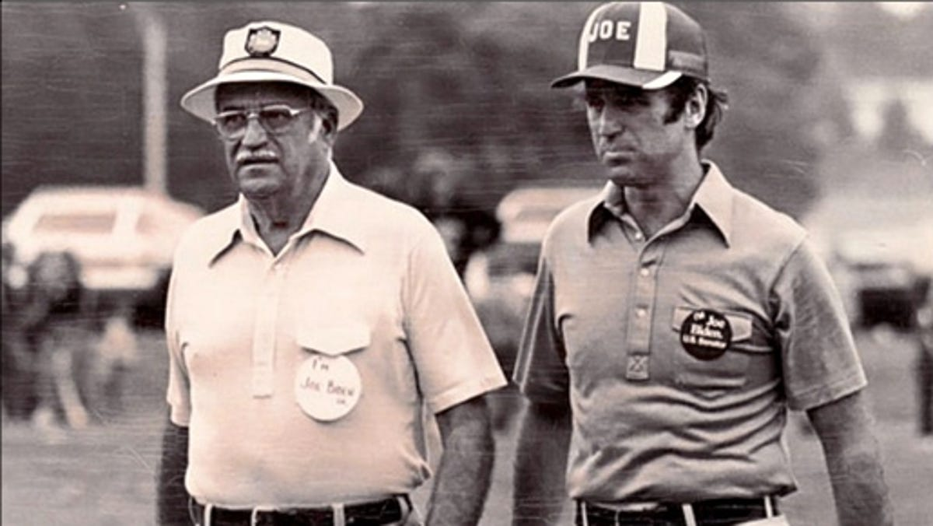
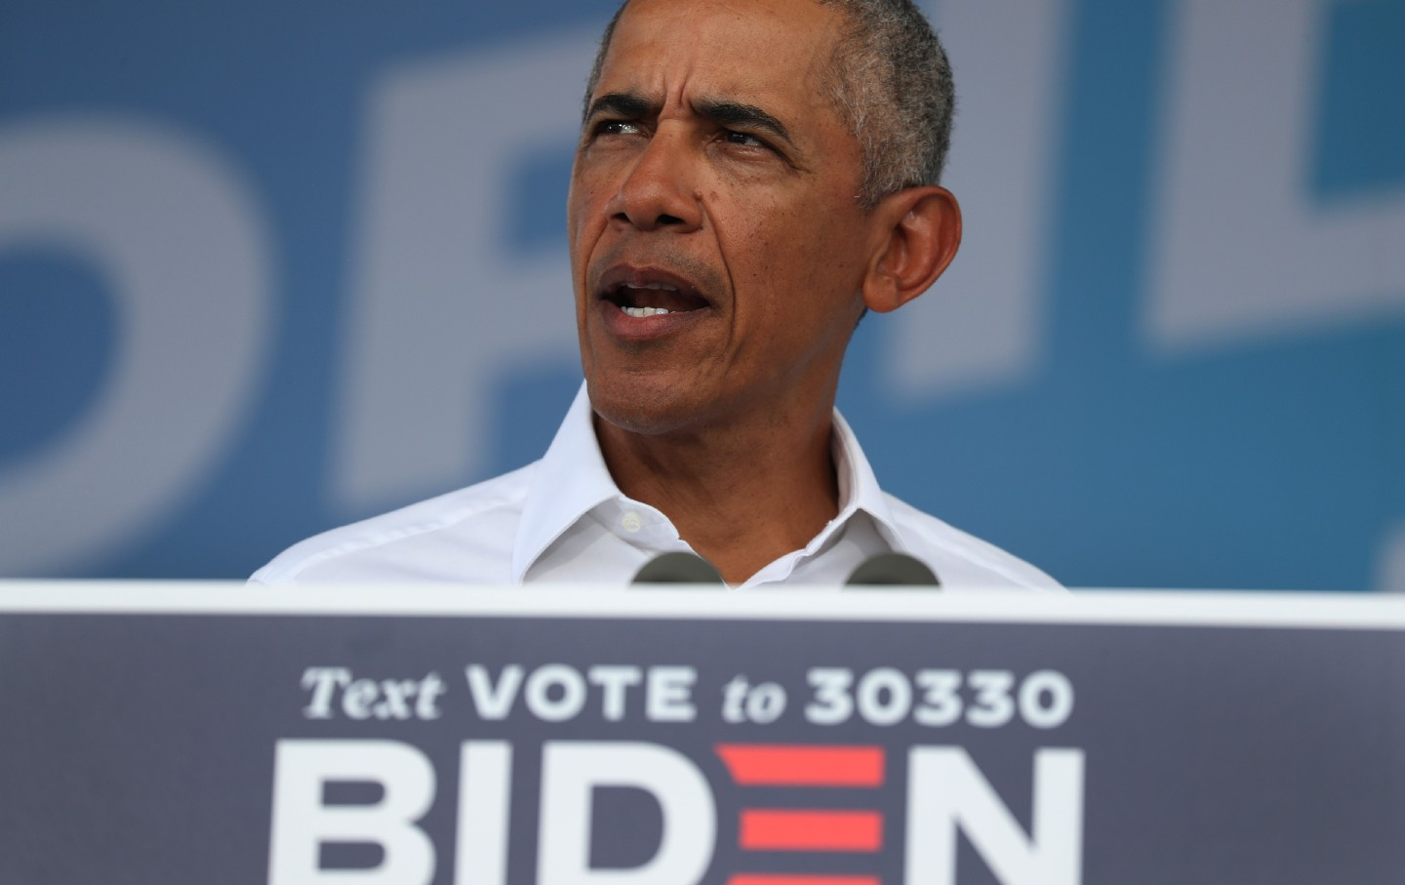
Joe Bidens parents and siblings
Joseph R. Biden Sr. and Catherine Eugenia Finnegan were parents of another 3 children Francis W. Biden, Valerie Biden and James Brian Biden
Catherine died on January 8 2010 and even Barack Obama came on her funeral
Joseph R. Biden Sr. passed away September 2 2002 when he was 87 years old

Slide 9
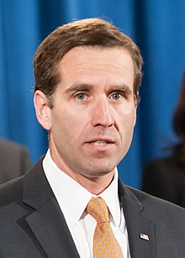
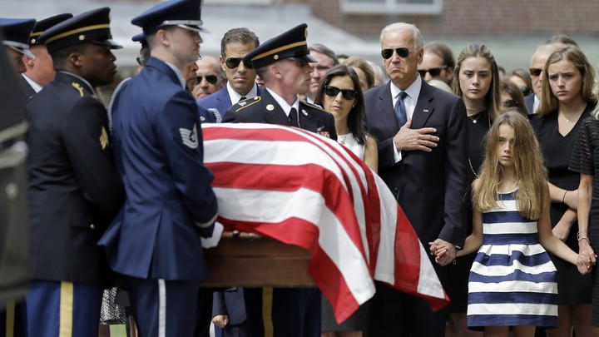
Interesting facts about Joe Biden
When he was a child he had a stutter and other kids called him bye-bye when he attempted to say his last name
Joe Biden lost his wife and daughter in car accident in 1972
His son Beau Biden died of brain cancer in 2015 that’s why he didn’t participate in the elections in 2016
Biden is the 46th president of United States and at the same time the oldest president
He was drafted for the Vietnam war but failed the medical test because of his asthma
On twitter he has his fanbase too. He has over 18 million followers.
Back in 2016 in interview he said: “My name is Joe Biden and I love ice cream.” He added: “I don’t drink. I don’t smoke. But I eat lot of ice cream.”

Slide 10
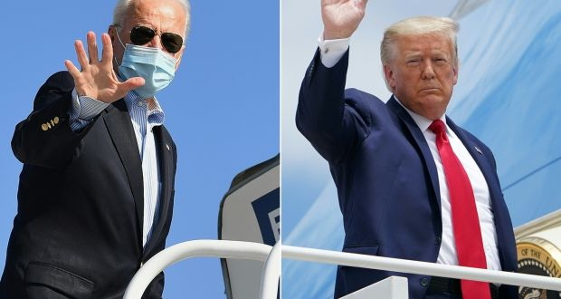
Thank you for your attention ♡
Mark Petromán
II.B

