Slide 1
PANDEMIC EPIDEMIC ENDEMIC
Nina Balážiková
3.C

Slide 2
Pandemic
Is worldwide epidemic (all continents)- but there can be rare regions unaffected by disease (islands, rain forrests,...)
It is mostly spred by air traffic
It must be infectious
Pandemics can also occur in important agricultural organisms

Slide 3
Spreading
the virus mostly infecting animals, with a few cases where animals infect people, then moves through the stage where the virus begins to spread directly between people and ends with a pandemic when infections from the new virus have spread worldwide

Slide 4
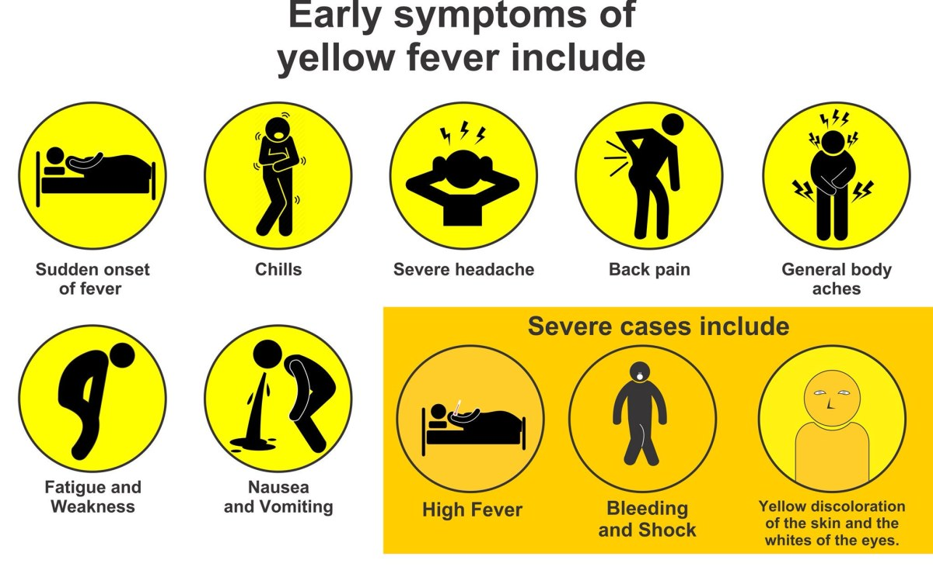
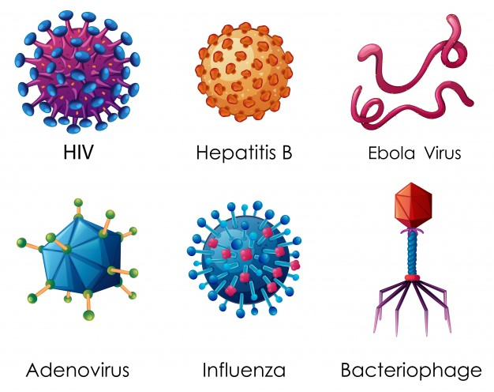
Current pandemics
Notable outbreaks
HIV/AIDS
Coronavirus disease 2019 (COVID-19)
Cholera
tuberculosis
leprosy
Influenza
yellow fever
malaria
Typhus
Smallpox
Measles

Slide 5
Epidemic
is the rapid spread of disease to a large number of people in a given population within a short period of time (in excess of 15 cases per 100,000 people for two consecutive weeks is considered an epidemic)
An epidemic may be restricted to one location; however, if it spreads to other countries or continents and affects a substantial number of people, it may be termed a pandemic
A few cases of a very rare disease may be classified as an epidemic, while many cases of a common disease (such as the common cold) would not

Slide 6
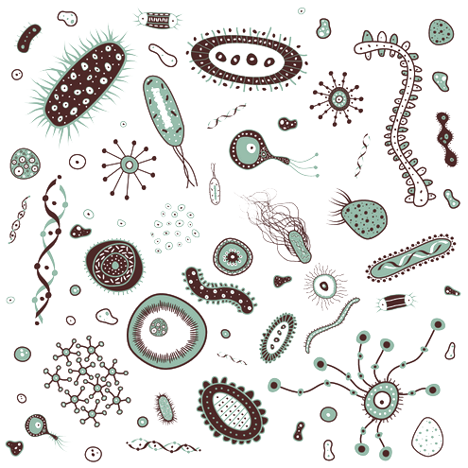
Causes
Increased virulence
Changes in host susceptibility to the infectious agent
genetic change in the pathogen
change in the ecology

Slide 7
The conditions which govern the outbreak of epidemics include infected food supplies such as contaminated drinking water and the migration of populations of certain animals, such as rats or mosquitoes, which can act as disease vectors
An epidemic disease is not required to be contagious
Certain epidemics occur at certain seasons

Slide 8
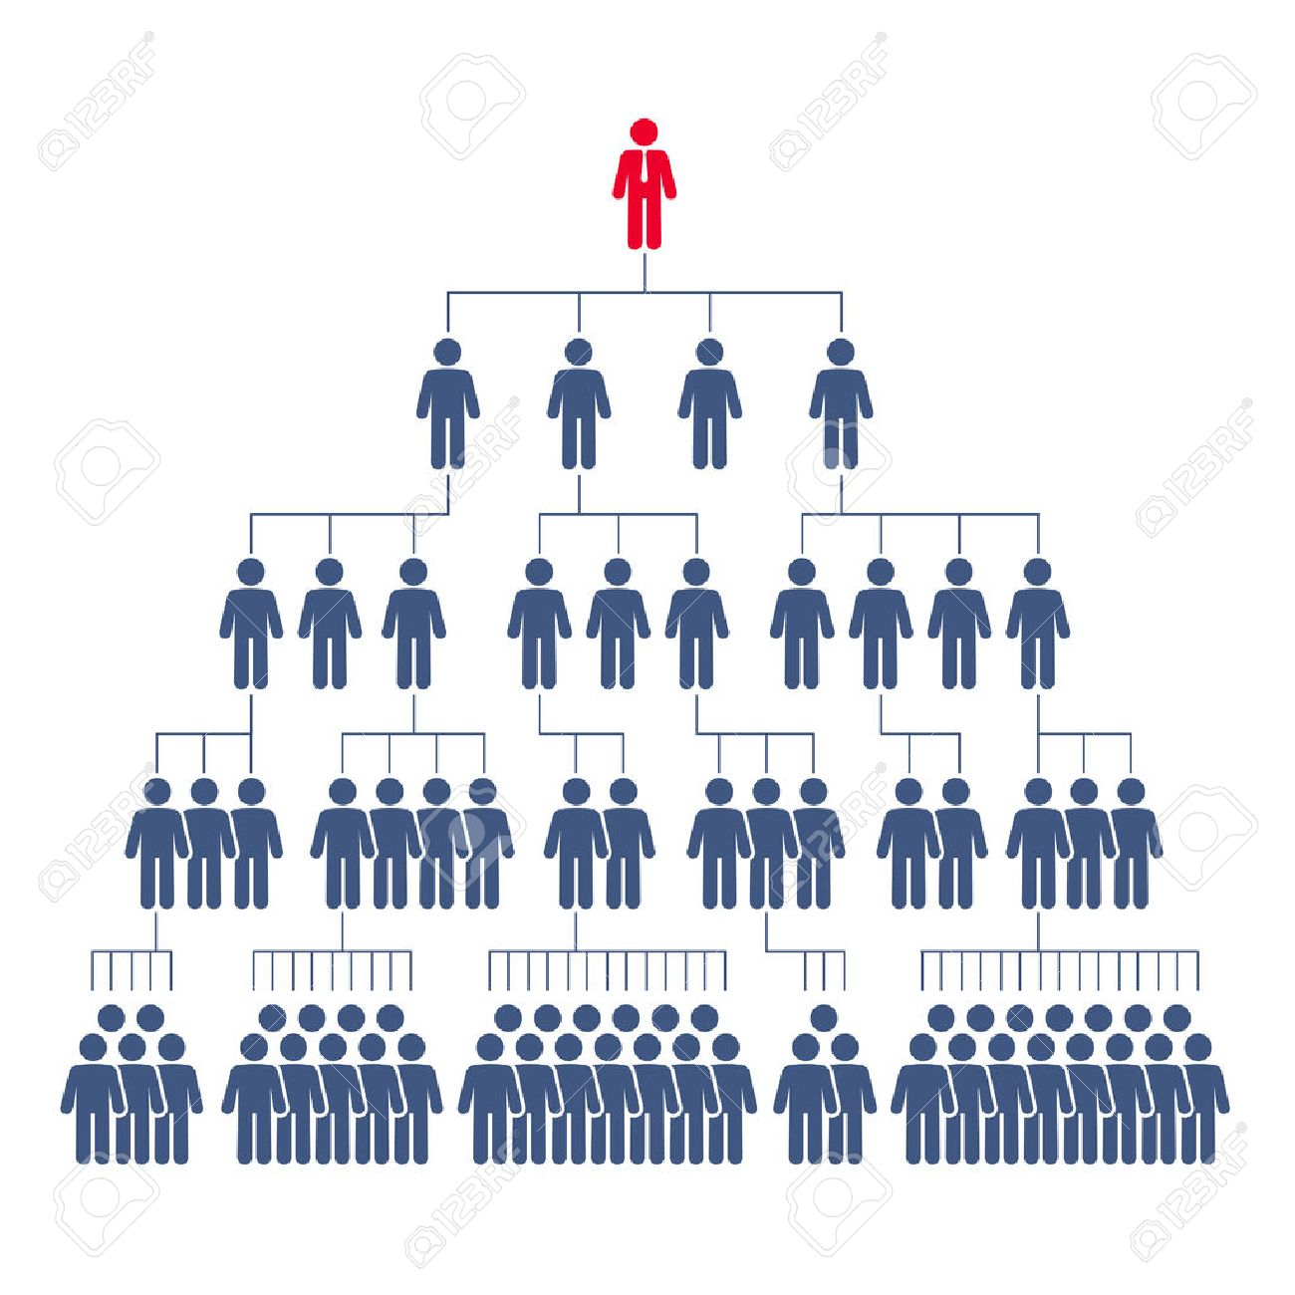
Endemic
In epidemiology, an infection is said to be endemic, in a population when that infection is constantly maintained at a baseline level in a geographic area without external inputs (chickenpox is endemic in the UK, but malaria is not)
For an infection that relies on person-to-person transmission to be endemic, each person who becomes infected with the disease must pass it on to one other person on average
In this way, the infection neither dies out nor does the number of infected people increase exponentially but the infection is said to be in an endemic steady state

Slide 9
STAY SAFE

Slide 10
THANK YOU FOR YOUR ATTENTION
Nina Balážiková
3.C

