Slide 1
Argentina
Ročiak Roman

Slide 2
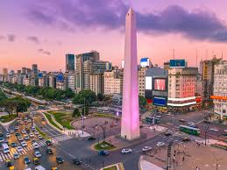
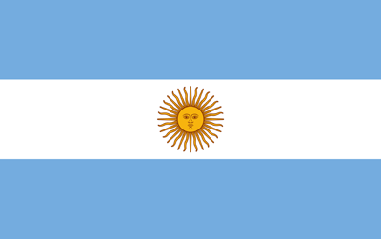
Basic facts
Argentina is located in South America.
It has around 44.5 milion inhabitants.
It is washed by the Atlantic and Pacific oceans.
The capital city of Argentina is Buenos Aires.

Slide 3
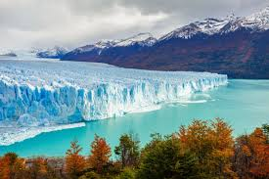
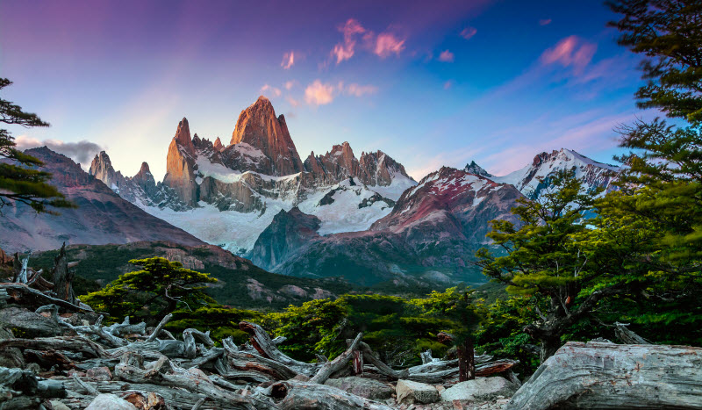
The things I like about Argentina
Beautiful country and Football are definitly the thinks why I chose to research Argentina.
I really like mountains and forests. Argentina is home of some of the most astonishing watterfalls, mountains, hills and forests.
Argentina is also the mother of football and one of the best player in the world Lionel Messi is also from Argentina.

Slide 4
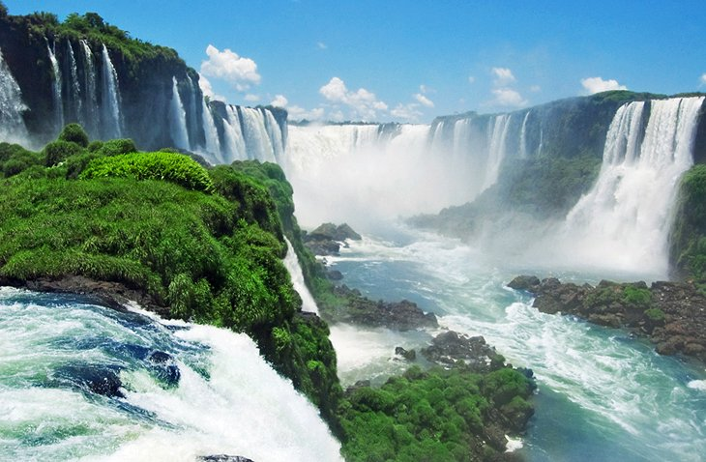
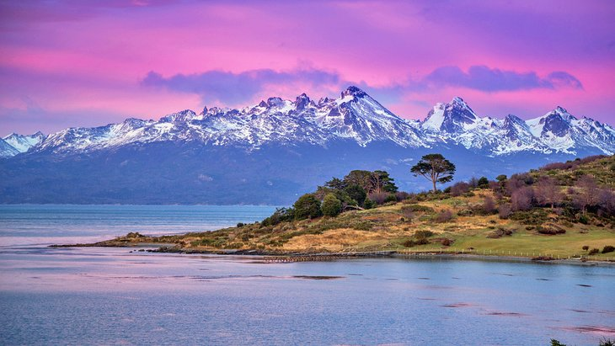
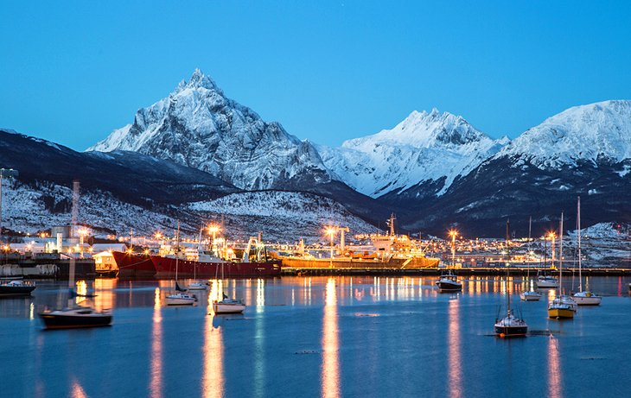
Nature
In Argentina, I would really like to visit Iguazu waterfalls. It is a really amazing combination of beautiful country and deafening waterfalls. In fact there are around 200 separated waterfalls each around 60-86 meters tall.
The second thing I would like to visit is National park Tierra de Fuego. I can clearly imagine the beautiful mountains, lakes and forests as a perfect place for hiking.
I would also like to visit ,,the end of the world,, the most southern place on earth.

Slide 5
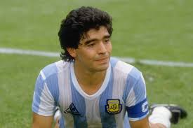
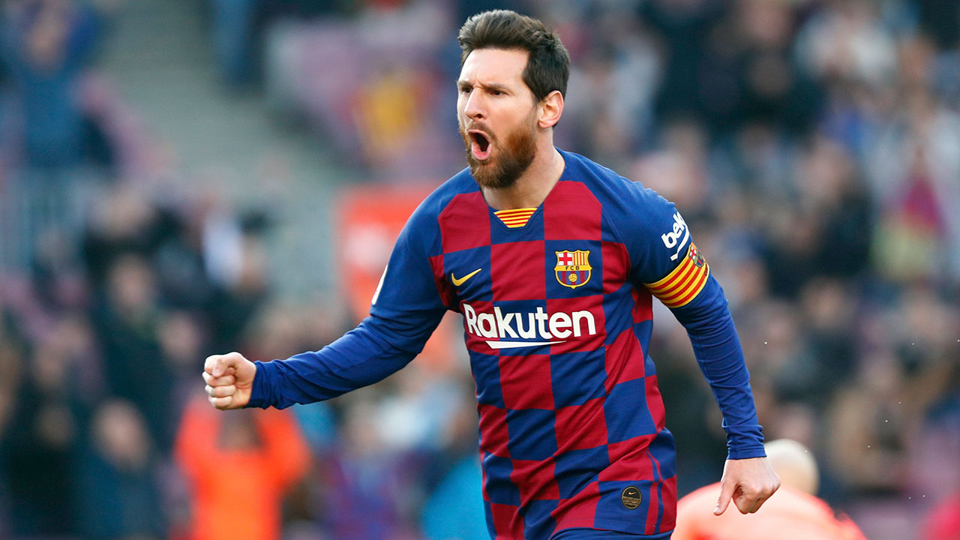
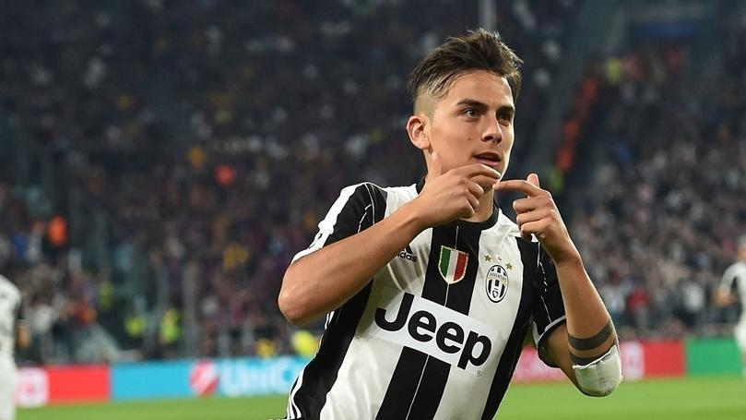
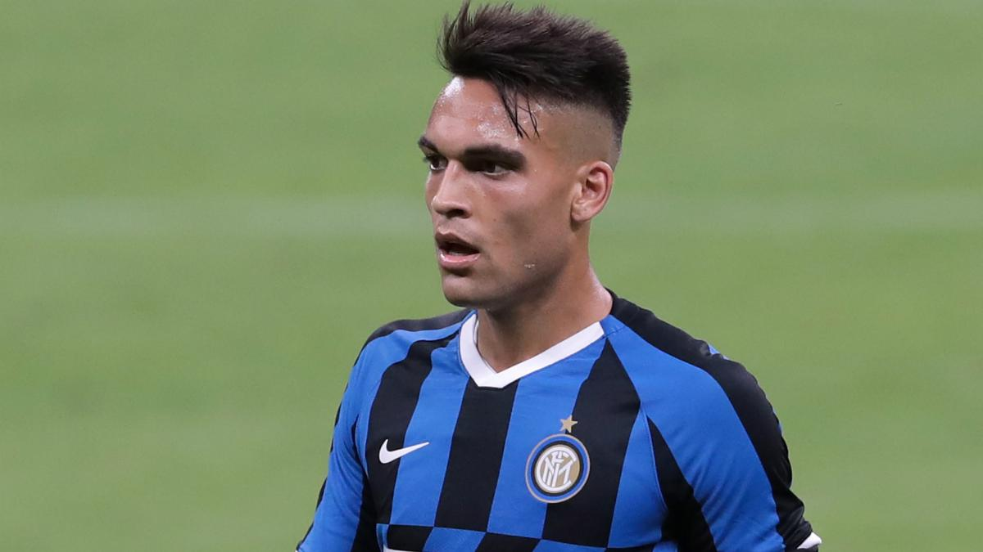
Football
Argentina is often called the mother of football, because of some really good players such as Diego Maradona or Lionel Messi.
I am a football player so Argentna is very interesting for me.
There are also many more great footballers such as Sergio Aguero, Lautro Martínez or Paulo Dybala

Slide 6
Gracias por prestar atencion

