Slide 1
FrancE
Sofia Dzíbelová

Slide 2
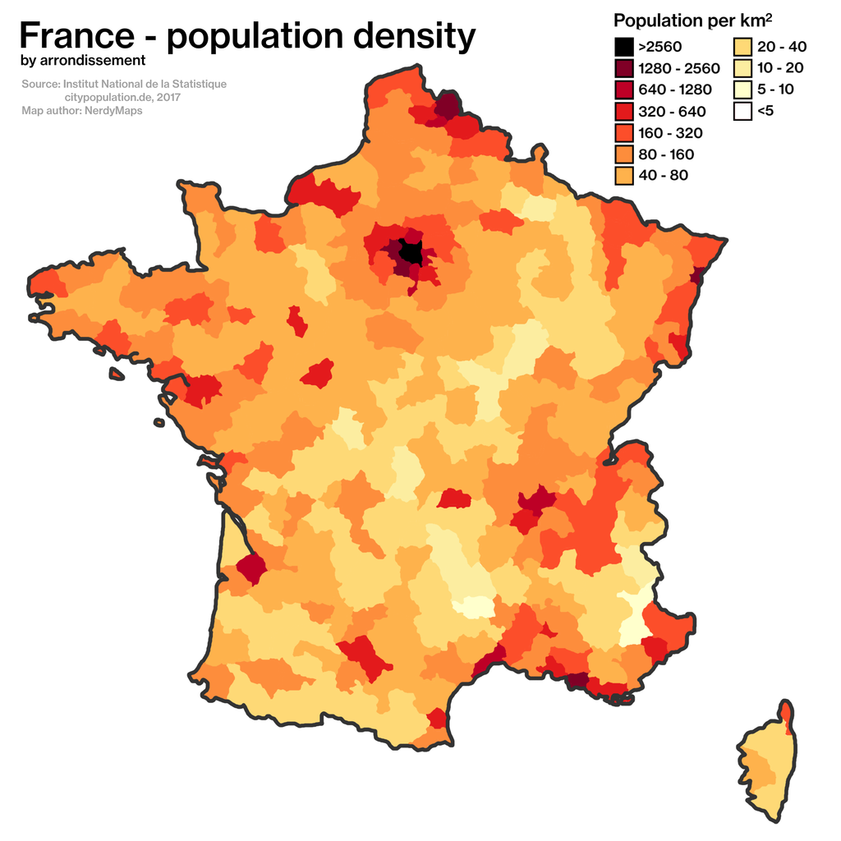
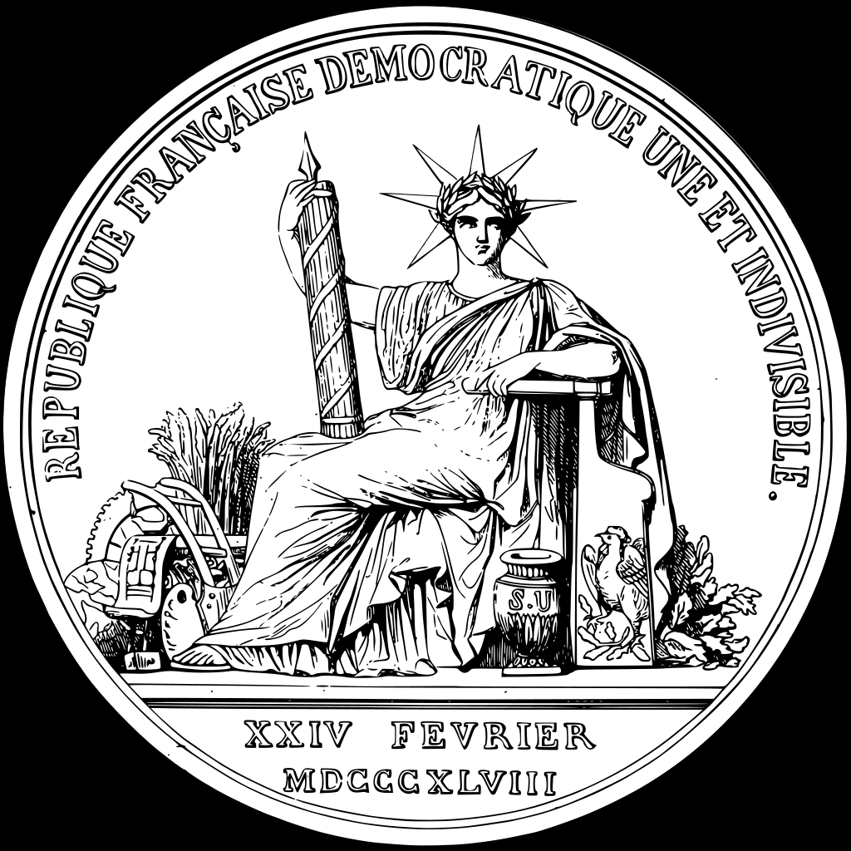
State France
population density
Nationality:
total population is 67.07 million ( of June 2020)
93.0% French citizens
7.0% foreign nationals
During the Iron Age France was inhabited by the Gauls —> collection of Celtic tribes.
The Great Seal of France
National emblem
Location of France

Slide 3
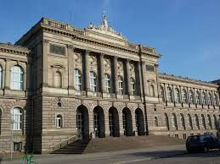
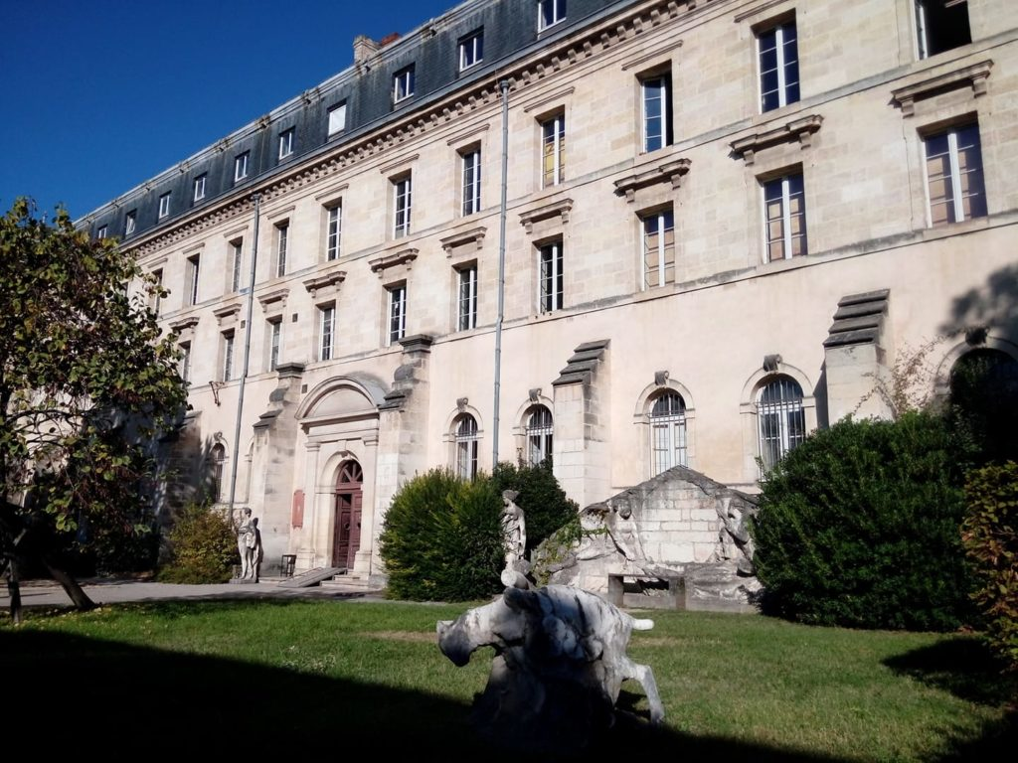
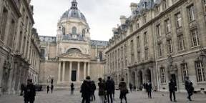
Education
Sorbonne University is a public research university in Paris, established in 2018 by the merger of Paris-Sorbonne university, Pierre and Marie Curie University. The field of study in which I am interested in is medicine.
My dad is a doctor and he wants me to follow in his footsteps.
The University of Strasbourg is a university in France with over 52,000 students and almost over 30 000 researchers.
I like this school becase you´ve got so many options here. It´s so hard to descide!
An École des Beaux-Arts is one of a number of influential art schools in France. It is the cradle of Beaux-Arts style in architecture and city planning that thrived in France during the end of the 19. and the first quarter of the 20. century. This is my dream school. A school of art.

Slide 4
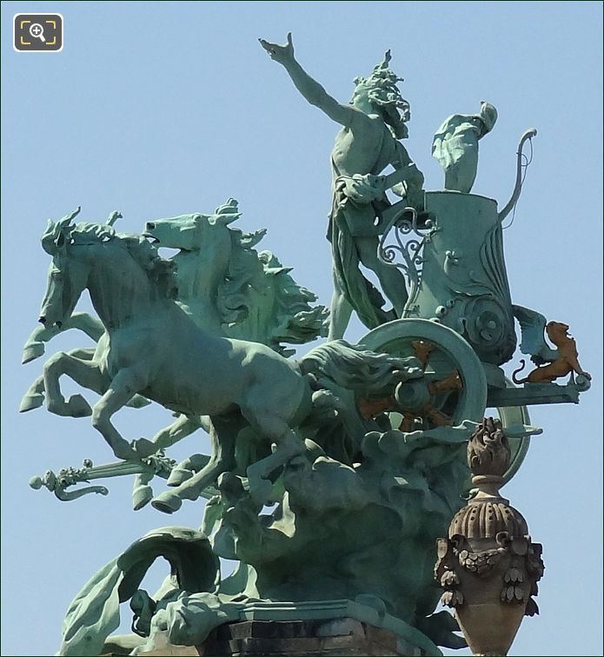
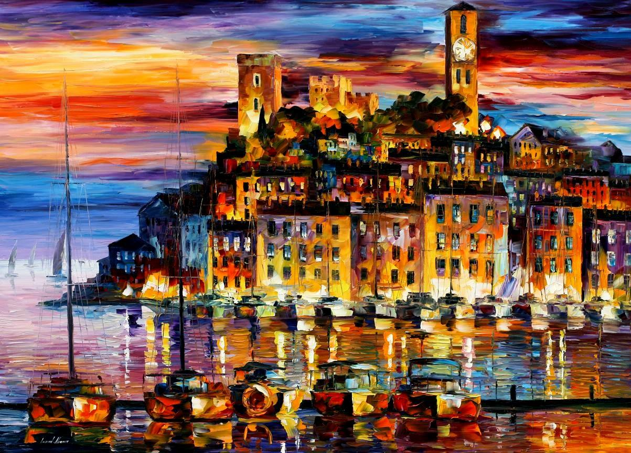
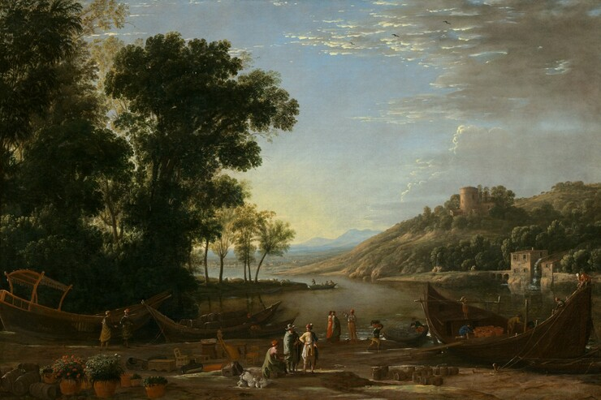
ART
Horses and chariot Quadrigas statue on the Grand Palais
Leonid Afremov
This beautiful paintig shows city Cannes(I have visitied this one too) in its evening beauty
Claude Lorrain 1604/1605
Leading French painters of the period traveled to Rome.

Slide 5
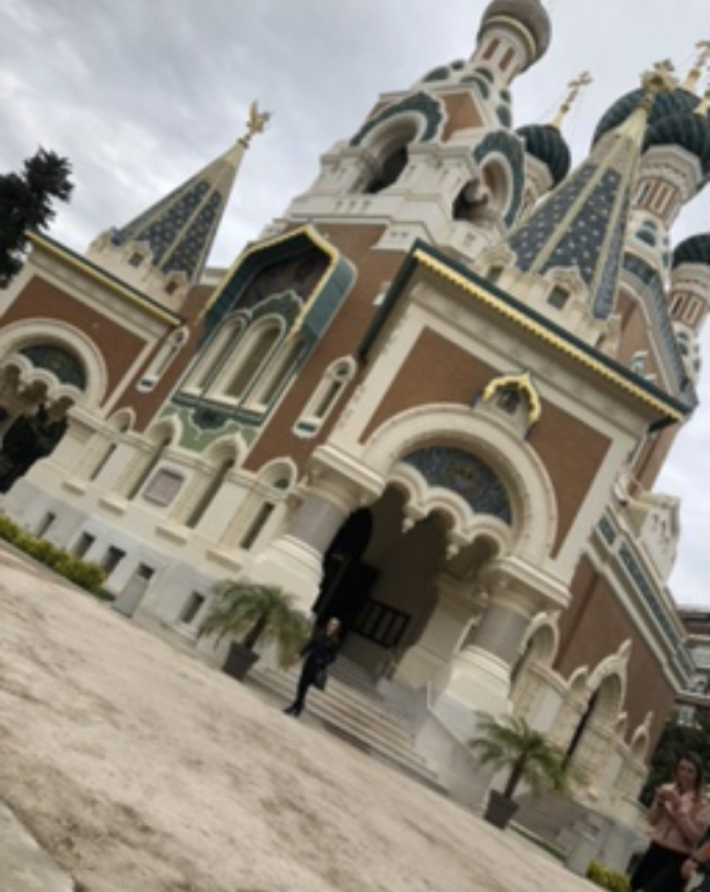
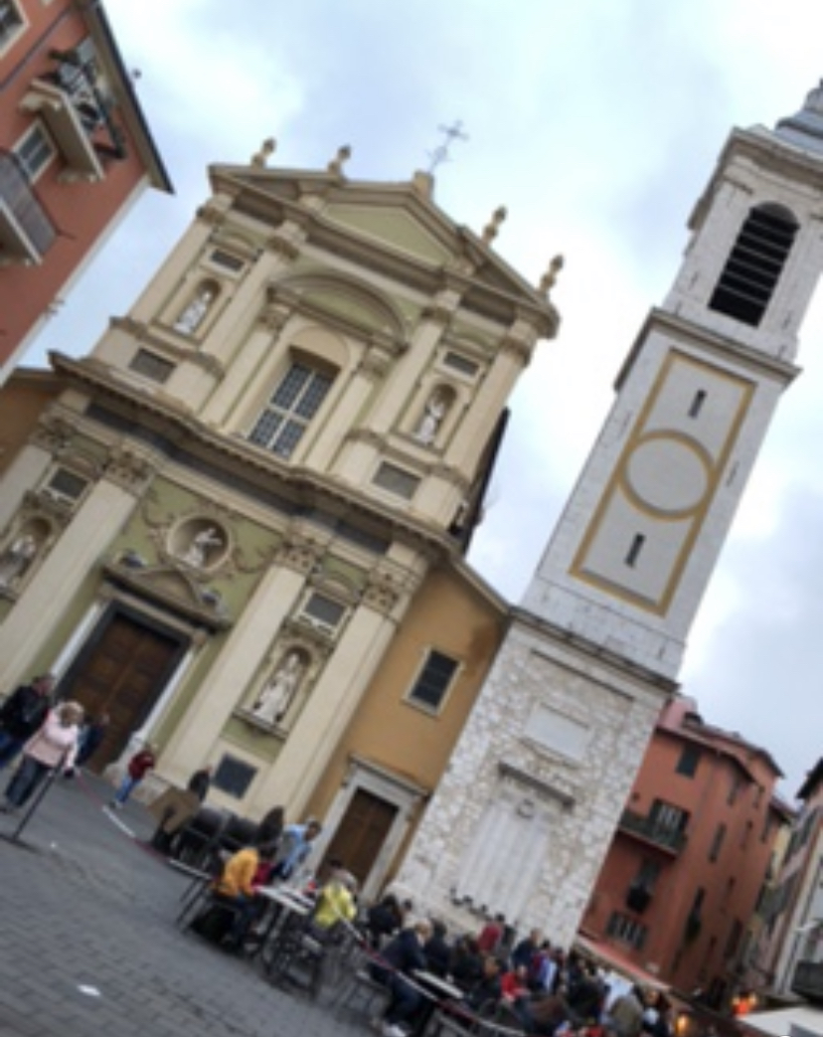
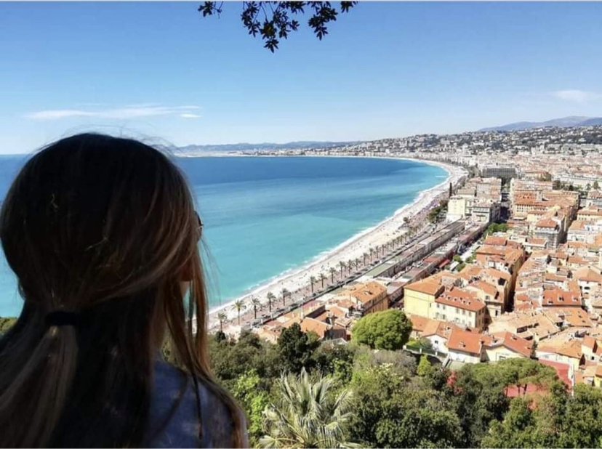
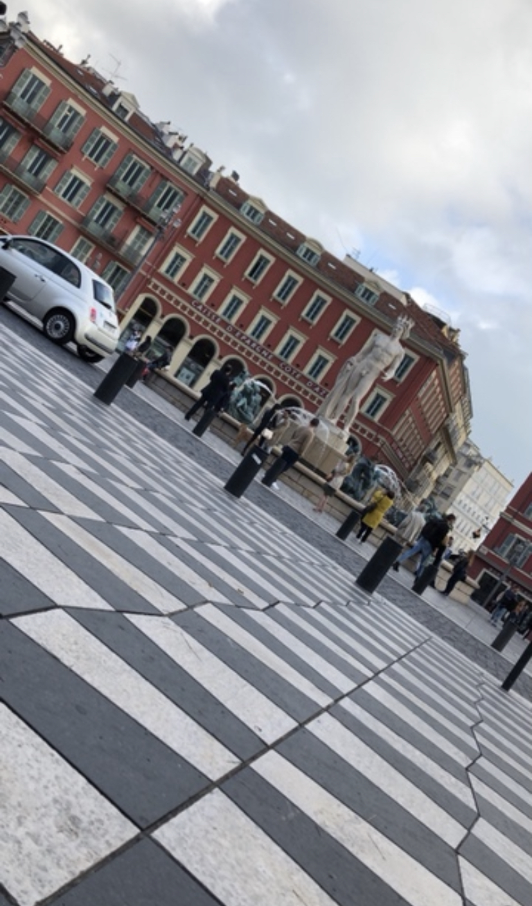
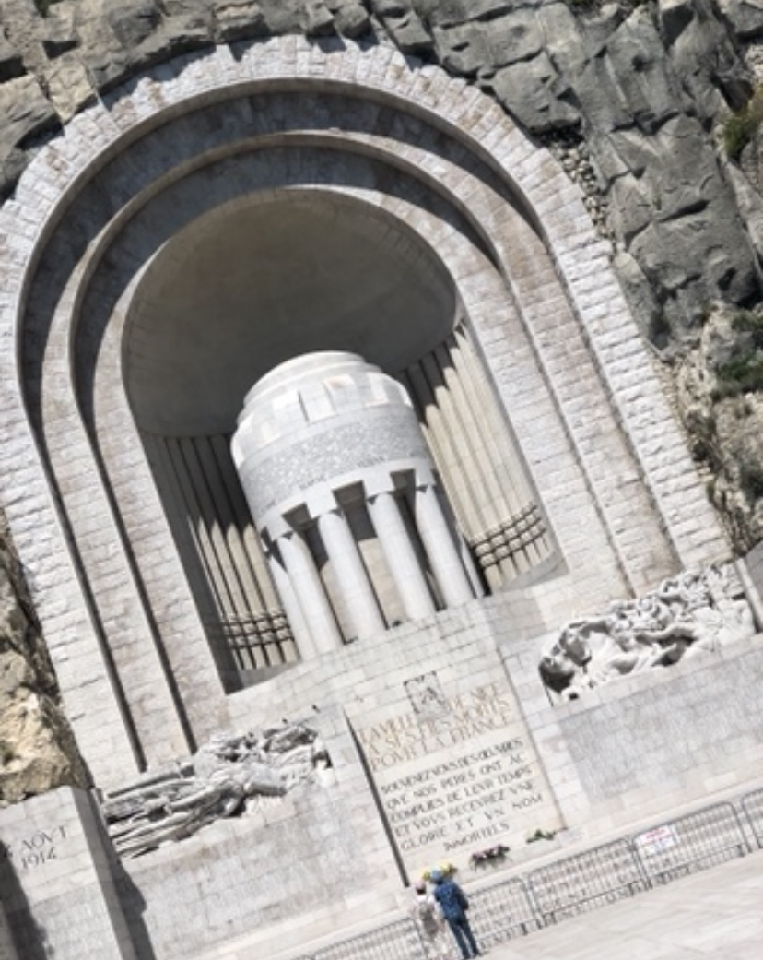
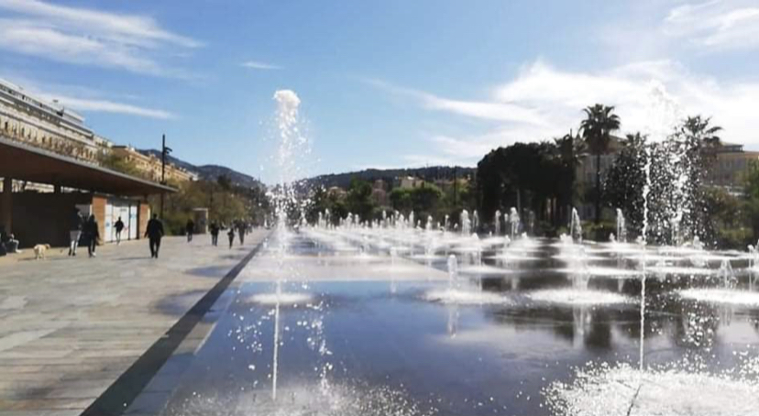
My favourite city NICE
Nice is such a beautiful town which really touched my heart. Here are some of my favorite places:

Slide 6
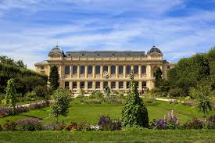
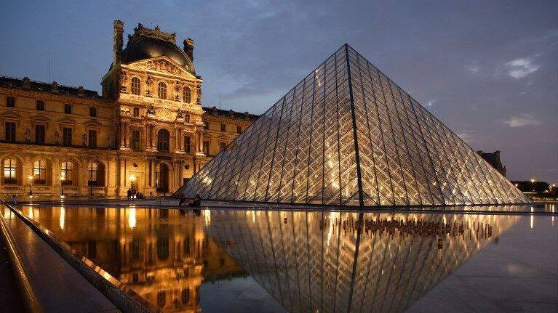
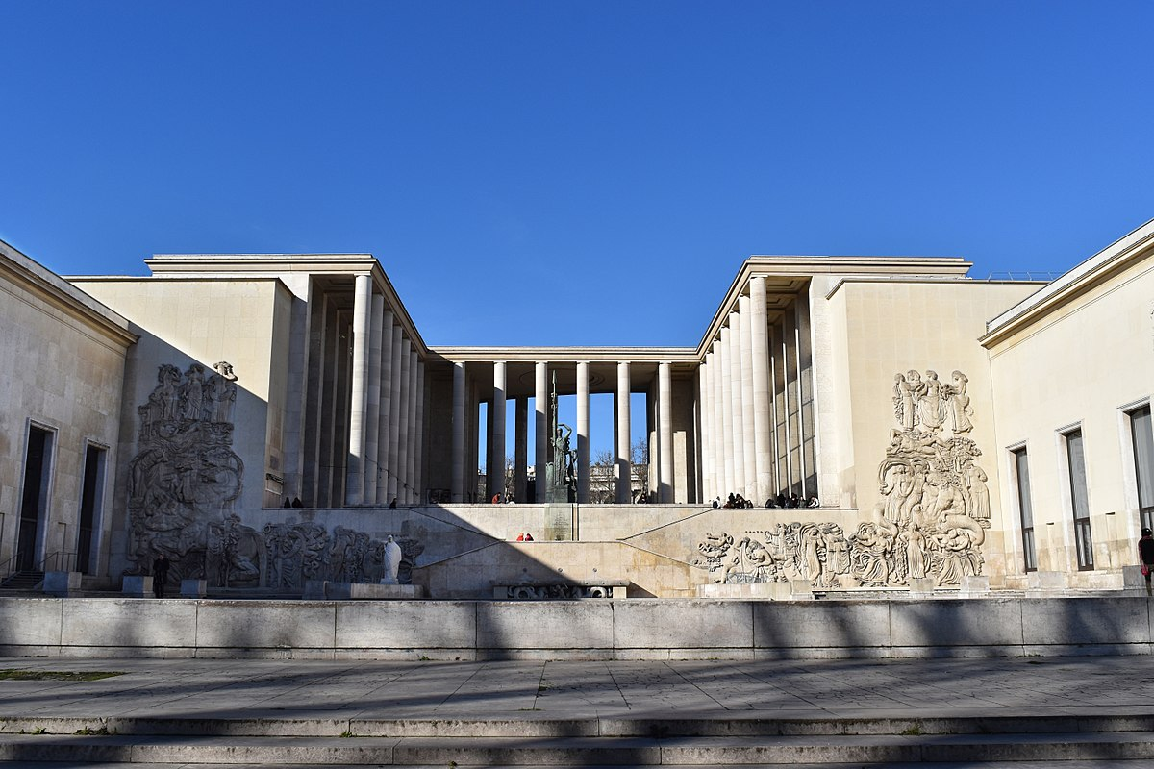
Museums
With about 15 000 works, The City of Paris Museum of modern art museum collections represent the wealth of the artistic creation in XXth and XXIth centuries. And as I love art, this would be my first stop.
It was established in 1635 by King Louis XIII as the royal garden of medicinal plants, and in 1793, after the Revolution, it was reorganized in its present form and under its present title. History is just so interesting!
Musée du Louvre owns a huge number of collectibles and more than 5,000 works of painting from the 13th - 19th century, stylish furniture from the 17th - 19th century. My friend visited this museum and she said I have to go there!

Slide 7
Resources
https://en.m.wikipedia.org/wiki/France
https://www.google.com/search?q=leonid+afremov+paintings+of+cannes&client=safari&hl=sk-sk&prmd=isvn&sxsrf=ALeKk03gB4noxaoH4LaGuH0GM6UjN9M1TQ:1604481744212&source=lnms&tbm=isch&sa=X&ved=2ahUKEwif56WjyOjsAhUJCxoKHWuIAEwQ_AUoAXoECAIQAQ&biw=487&bih=840
https://www.google.com/search?q=claude+lorrain+landscape+with+Merchants&tbm=isch&hl=sk-sk&client=safari&sa=X&ved=2ahUKEwj8tofVyOjsAhWBwAIHHdsYDWUQBXoECAEQFg&biw=487&bih=840
https://www.google.com/search?client=safari&hl=sk-sk&sxsrf=ALeKk00vf6d-23SyoEpXTlAGNZzazKO5Sg%3A1604482147148&ei=Y3SiX4m5CMGUa5_om4AP&q=the+best+universities+in+france&oq=the+best+universities+in+france&gs_lcp=ChNtb2JpbGUtZ3dzLXdpei1zZXJwEAMyBQgAEMsBMgYIABAWEB4yBggAEBYQHjIGCAAQFhAeMgYIABAWEB4yBggAEBYQHjIGCAAQFhAeMgYIABAWEB46BwgAEEcQsANQmhRYqyxg-SxoAXAAeACAAb4HiAGZIpIBBzQtMi4zLjKYAQCgAQHIAQi4AQLAAQE&sclient=mobile-gws-wiz-serp
https://www.google.com/search?q=museums+in+france&ie=UTF-8&oe=UTF-8&hl=sk-sk&client=safari

Slide 8
Merci d'avoir prêté attention

