Slide 1
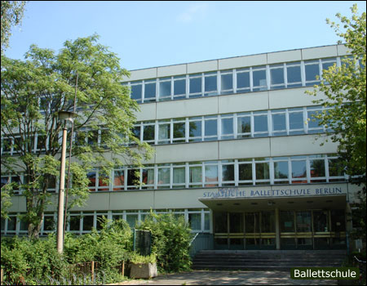
Coubertin-Gymnasium Berlin
Germany
Richard Haberern
Filip Kaleta
Gymnázium Pierra de Coubertina, Slovakia

Slide 2
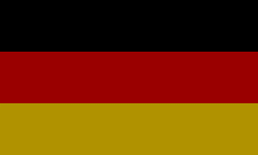
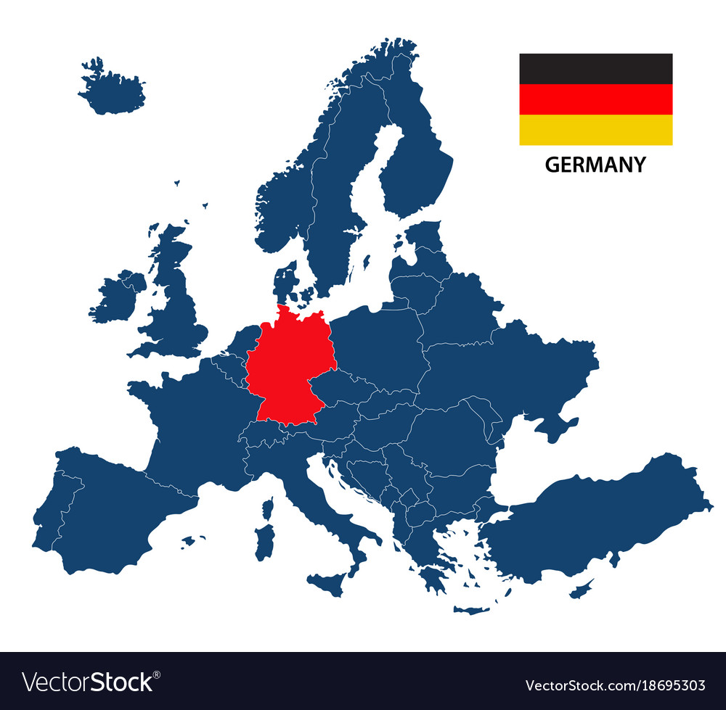
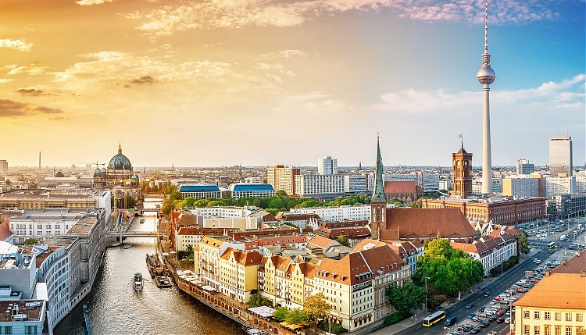
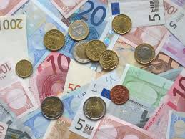
Factographic informations
Germany is located in central Europe
Capital city is Berlin
Area of Germany is 357 385,71 km²
Germany has 83 000 000 inhabitants (2018)
Germany is part of the EU and their currancy is euro
Language – German language is very popular in whole Europe even in whole world
Flag is in national colours that are black, red and yellow

Slide 3
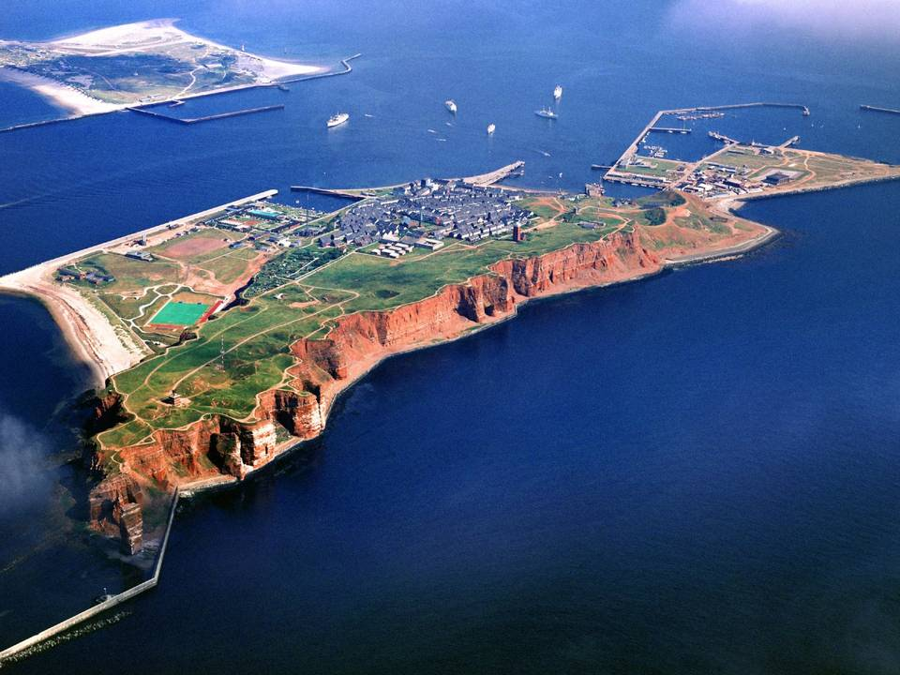
Geographical interests
The tallest mountain in Germany is Zugspitze, with the height of 2962 meters above the sea
It is a part of Bavorian Alps, which were formed by huge glaciers during the ice age
Germany has also some islands, for example Helgoland, which looks like golf court, in the middle of the North ocean

Slide 4
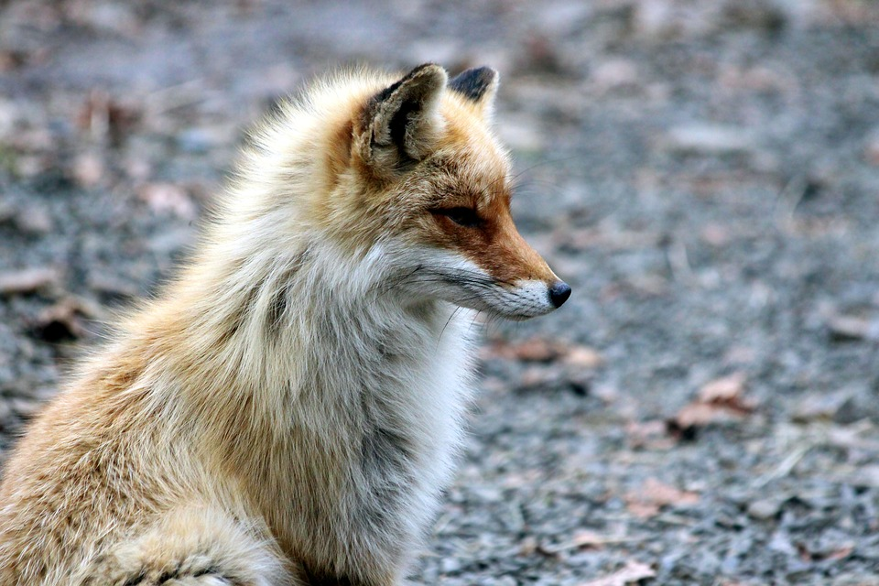
Nature of Germany
The nature of Germany is very varied
In the south of Germany are many more mountains for instance the Alps
There is mild climatic zone but it is affacted by Gulf Stream
that means there are some extreme weather conditions - drought, tornadoes, extreme frosts...
In Germany live many animals like European wild cat, Red fox, Wild boar, European Badger, Great horeshoe bat
There are many plants – Cornflower, German chamomile, Common bugloss

Slide 5
Sports - football
In Germany are many popular sports but the most popular is football
The national football association is DFB – Deutscher Fussball Bund
it has roughly 7 milion members – its the largest sports federation worldwide
The football league in Germany is called Bundesliga
German football is popular beacuse they are really good at it – Germany has already won Worldcup 4 times
Most famous Germany football star is Franz Beckenbauer – he is the only one German footballer who won Worldcup both as a player and as a manager

Slide 6
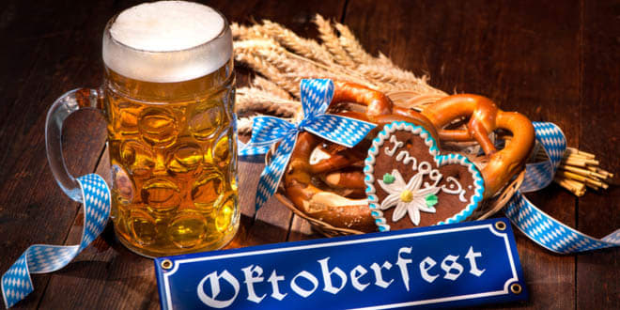
Customs and traditions
Germany is popular for their customs of beer and pretzles
Every year they hold a traditional festival where people from all over the world go – it is named Octoberfest

Slide 7
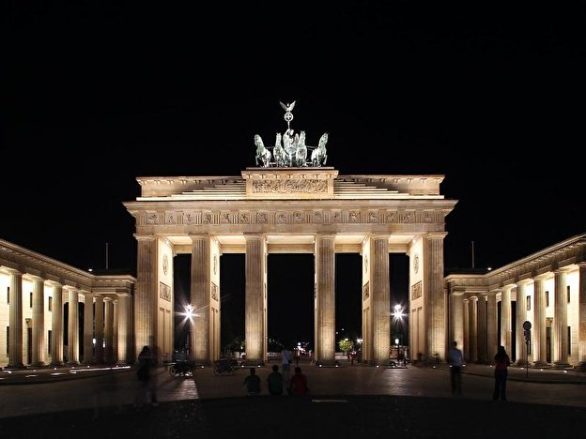
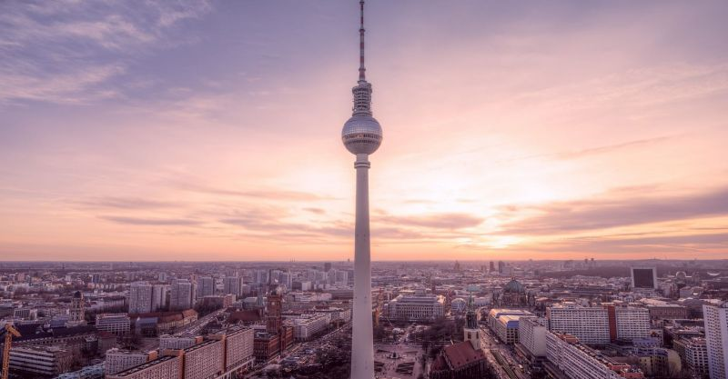
Germany’s beautiful architecture
They have many old buildings like the Brandenburg gate and But some modern buildings like Berlin Fernsehtrum

Slide 8
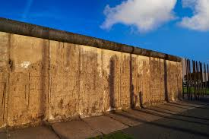
Berlin wall
This 165 km wall fascinated me for its history and of course for its length
It is the most famous symbol of the cold war
It divided the city of Berlin from 13th August 1961 to 9th November 1989 to west and east part of Berlin
It was built as a measure, to prevent the escape of citizens to the west side of Berlin

Slide 9
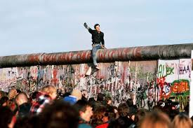
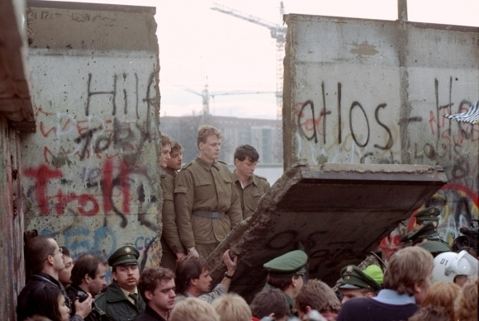
Finally on 9th November 1989 it was destroyed and people can move to the west side

Slide 10
Why I would like to visit Germany?
I would like to visit Germany because of its beautiful nature - nature in Germany is various in a lot of different ways
For example the plants and animlas are amazing, you can find there a lot of different animals from wildlife animals that live mainly in Germany to some more common animals
But the real reason I like the nature is because of the mountains
I love hiking, skiing, cycling and in the Germany there are beautiful mountains, you can do there all things I am interested in
The sport is interesting too – the most famous is football

Slide 11
Thank you for your attention

