Slide 1
Greece
Tomáš Marek
Kvarta

Slide 2
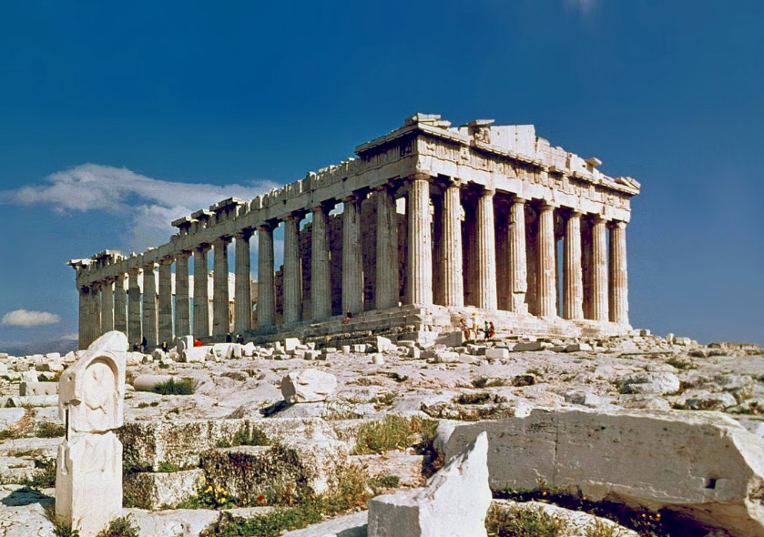
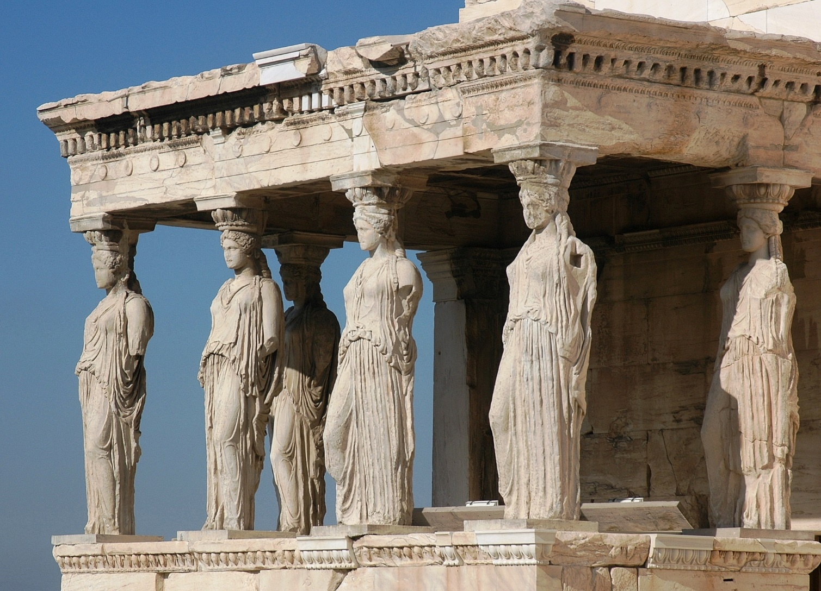
Ancient architecture
Athens
Parthenon
Caryatid
Notes:
Architecture in Greece is against the others single chapter. Is very different visually, but also atmosphere is different. We could say, that most prominent centure of this building are Athens.

Slide 3
Ancient architecture
Ancient architecture in Greece comes from period of antiquity. Is very different visually, but also atmosphere is different, and we could say, that the most famous and beautiful buildings are concentrated in Athens.
For me Athens are most interesting and most typical city of Greece, because it boasts many rare architectural and historical buildings.
Parthenon is located in the heart of Athens. For me, it is one of the most interesting buildings ever, just when I imagine,what it probably looked like in the past. It is unbelievable, how long this building has survived. It is one of the biggest icons of past times.
And one detail interested me. It is caryatid. On one hand, we can consider it as separate art work, on the other hand it is architectural element. I like the idea of replacing ordinary columns with beautiful statues.
But even outside the magnificent buildings, I love small Greek villages. For me, the most beautiful are white houses with blue roofs.

Slide 4
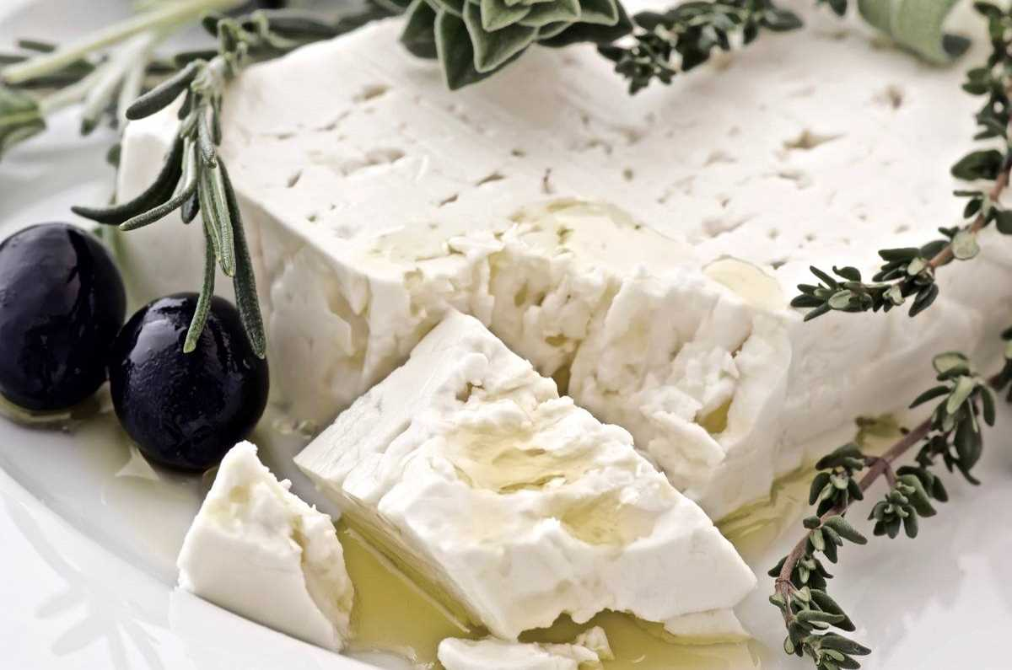
Food
Gyros
Feta cheese

Slide 5
Food
Nowadays you don’t have to go far to taste some of Greek specialties (even though I think, that real, original taste we can find just in Greece). Greek cuisine is one of the most favourite in the world and that’s why we can find Greek restaurants almost everywhere. If not the most known meal, sure one of them is gyros. Most people (and I am one of them) love gyros, maybe because it is very cheap, but incredibly delicious. I love Greek cuisine. I didn’t taste by far everything, but all I did, was absolutely great.

Slide 6
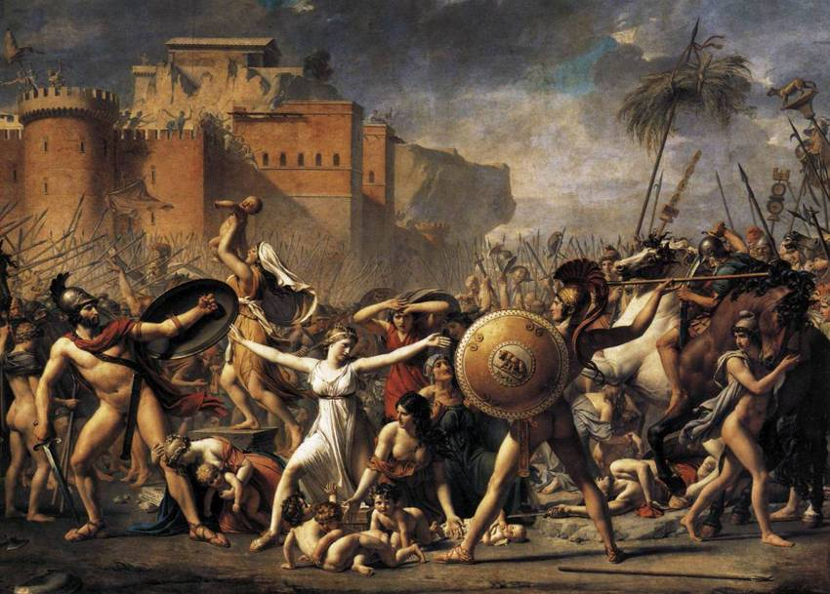
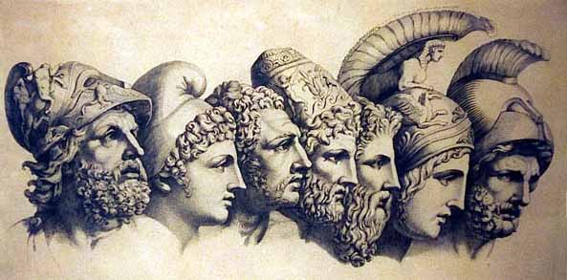
Greek mythology
Trojan war
Trojan horse
Greek gods

Slide 7
Greek mythology
I’ll say it bluntly, I don’t believe in Greek gods, but Greek mythology is really interesting. It is, for me, something like one great story. I know just some of these stories and I saw couple of films, but every story was very trilling and absorbing. I think The Trojan War is the most known story from the Greek mythology. It’s about love, hate, fighting, and politics too, everyone just find their there.
I think that the mythology has different meaning for different people. For somebody it is article for marketing, for somebody religion, and for somebody just something interesting to watch, read or listen to.

Slide 8
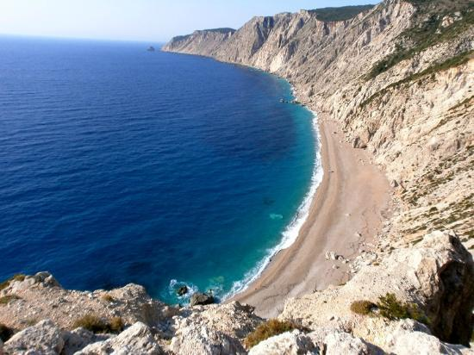
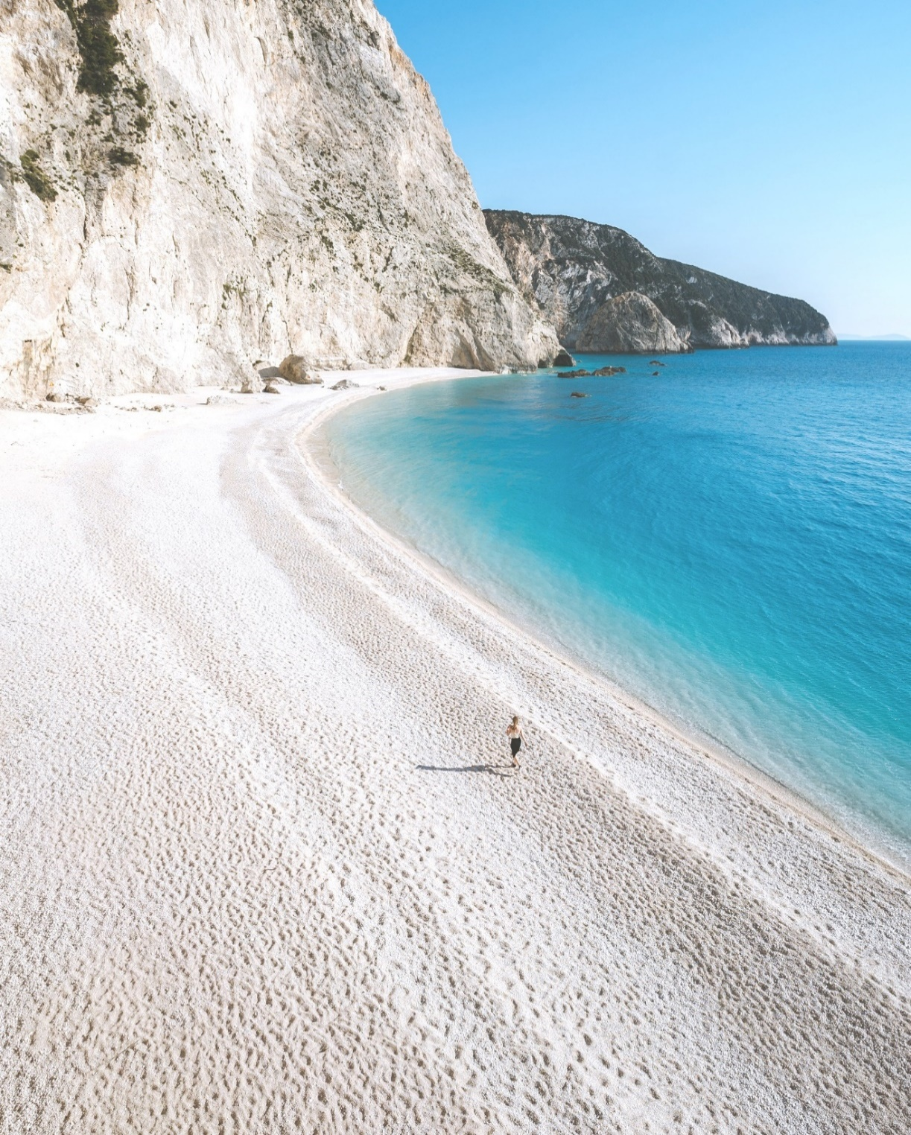
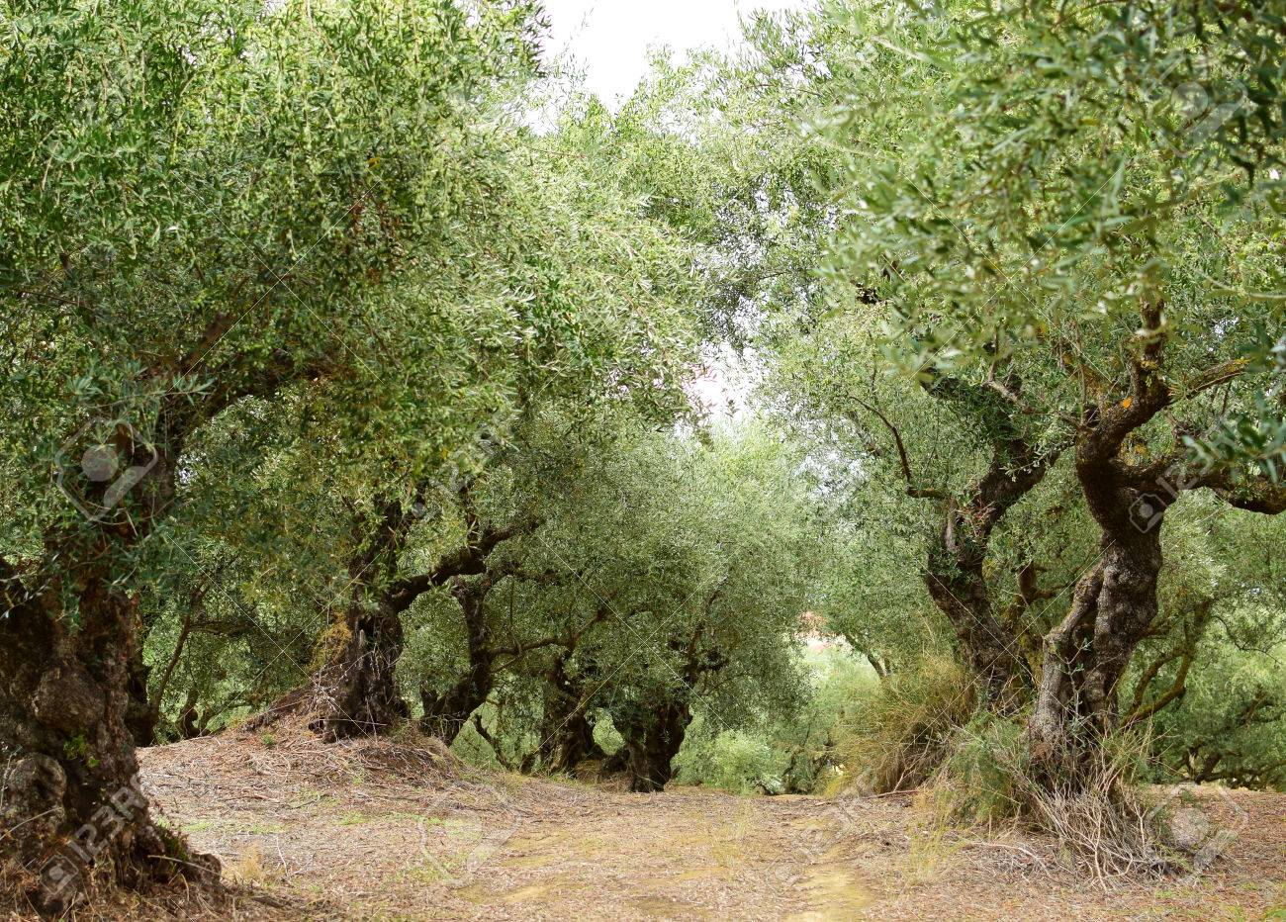
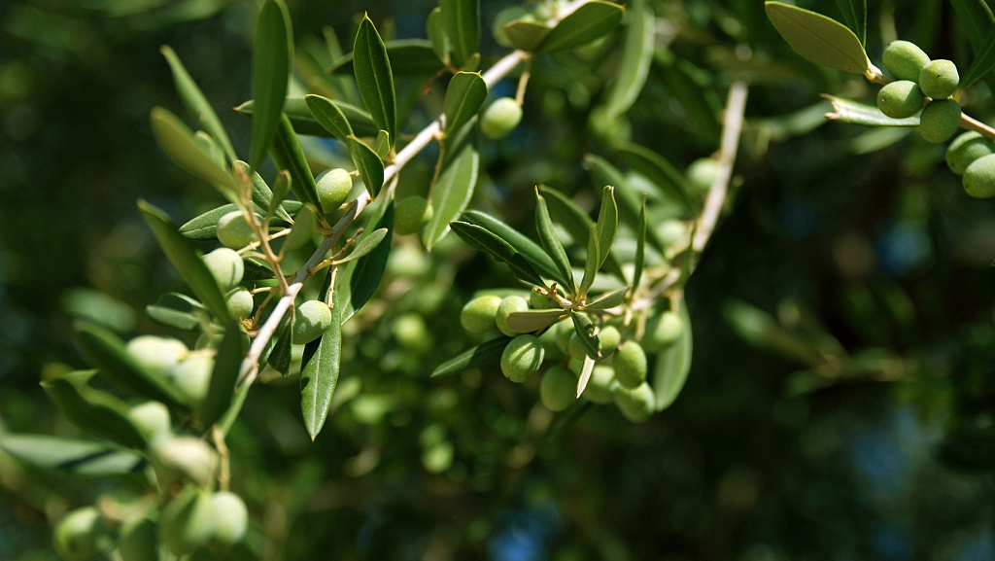
Nature
White rocks
Waves
White sand
Olive trees
Olives
Notes:
Kefalonia – plathiamos – big waves
I like the Greece beaches, because on every beach I was, there was difference. On one there was white sand, on the other white rocks and others were surround by mountains. I was on the beach, where were waves two or more meters high (biggest in my life).

Slide 9
Nature
Greece has very lovely nature. There are one of the most beautiful beaches. I like the Greek beaches, because on every beach I have been to, there was a difference. On one there was white sand, on the other white rocks and others were surround by mountains. I was on a beach, where the waves were three or more meters high (biggest in my life). Nature here might seems that it is dry and rocky, but it has its beauty. For me, for example are olives trees one of most beautiful trees of all. It has unbelievable shapes. And the most interesting is, when there are buildings or statues between trees and mountains. On one side it looks sad, that all that old culture is disappearing, but such beautiful wild gardens are created and we can just imagine, what it maybe looked like in the past.

Slide 10
Thanks to these...
Architecture: en.wikipedia.org
Food: www.streetfoodhunters.com
Pictures: google images

Slide 11
Thanks for paying attention ☺

