Slide 1
India
Barbora Matyšáková

Slide 2
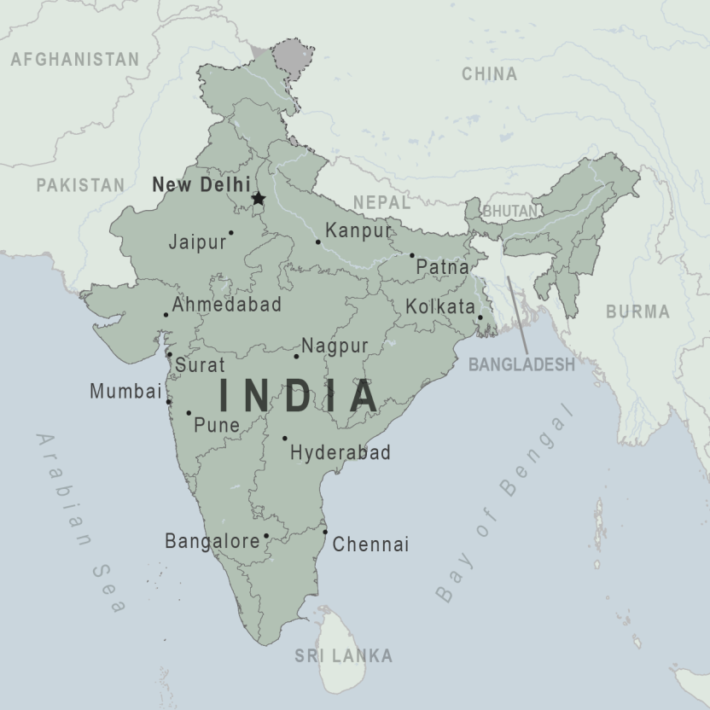
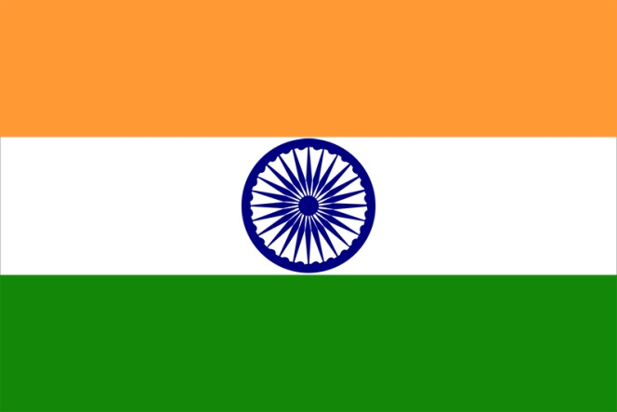
Basic information
Population: 1,353 billion
Government: Federal Republic
Location: South Asia
Capital: New Delhi
Religion: 80%Hinduism,
13% Muslim
Language: Hindi

Slide 3
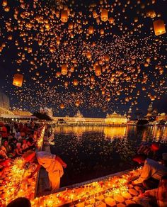
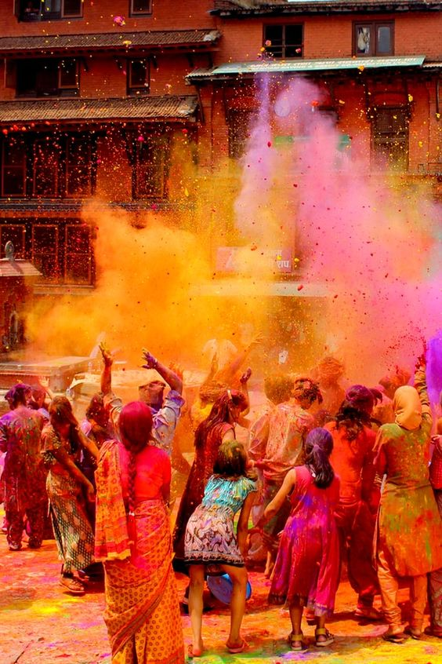
Culture
Holi- this festival is on my bucket list for such a long time, from the pictures and videos I assume that this special day must have great atmosphere, the way that all people celebrate and throw colour powder all around themselves is just beyond believe. In my country there is also a holiday of spring but it is very different from the Indian one. We set a witch doll on fire and throw her to the water-it isn´t as wonderful as yours
Diwali-the festival of light or victory of good over the evil, what I really like about this festival is the way that people are generous and how they are giving gifts to their neighbours, friends, etc.
But of course the decorated houses, diyas on fire and giant fireworks are just incredible.

Slide 4
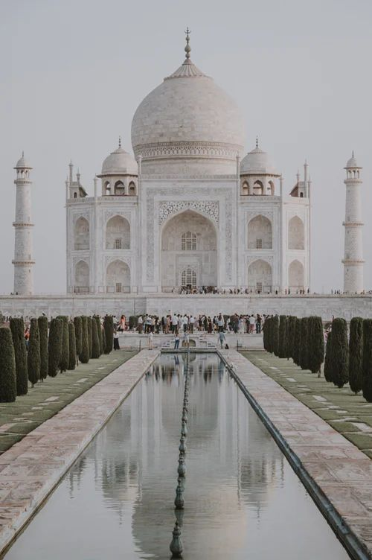
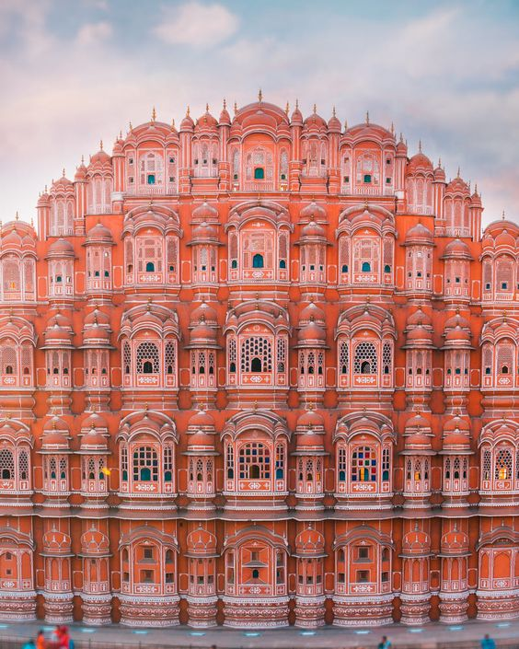
Monuments
-Taj Mahal- the building of a great love story, the man who had this building built, had to love his wife very much. I want to visit this building because of the gorgeous architecture and large gardens that surround it. This building is called the most beautiful building in India and I think that it deserves it
-Hawa Mahal- this incredible monument built for royal ladies to observe everyday life and festivals celebrated in the street below without being seen is one of the most beautiful buildings in India, what I really like about this building is the beautiful colour, truly charming architecture and indoor design of it

Slide 5
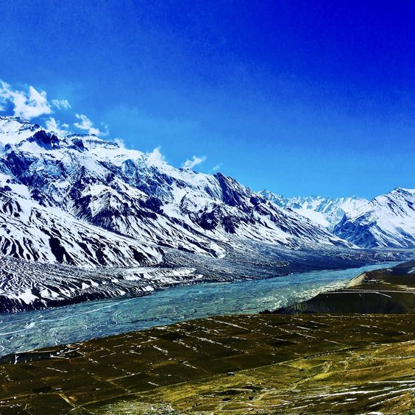
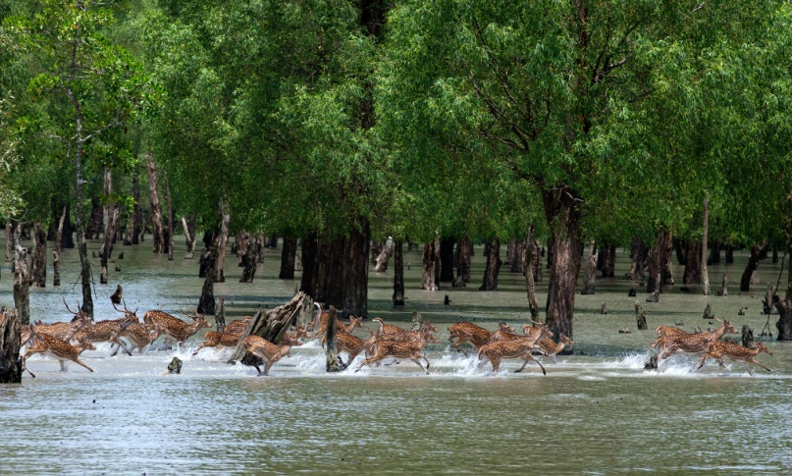
Nature
India´s nature is varied-from desert, mountains to mangrove forest.
I think that my most favourite type of nature from this country is mangrove forest- this place is home for so many species of animals, for example: tigers, dolphins, sharks, sea turtles, salt water crocodiles...This is a unique place on our planet that people don´t talk enough about

Slide 6
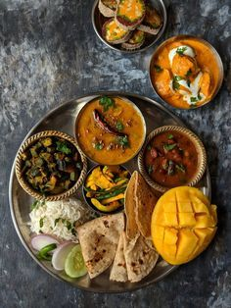
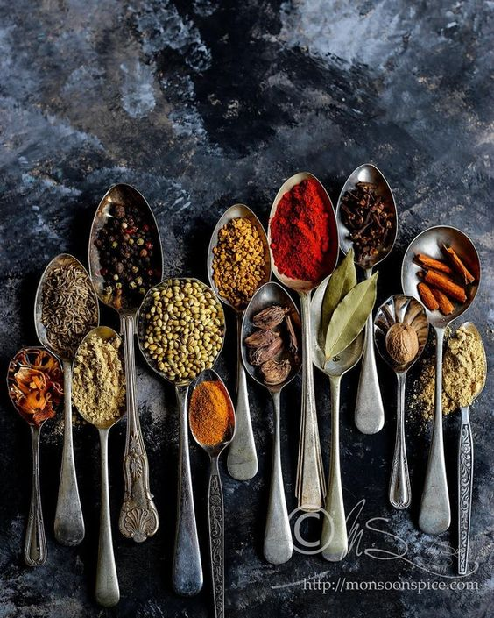
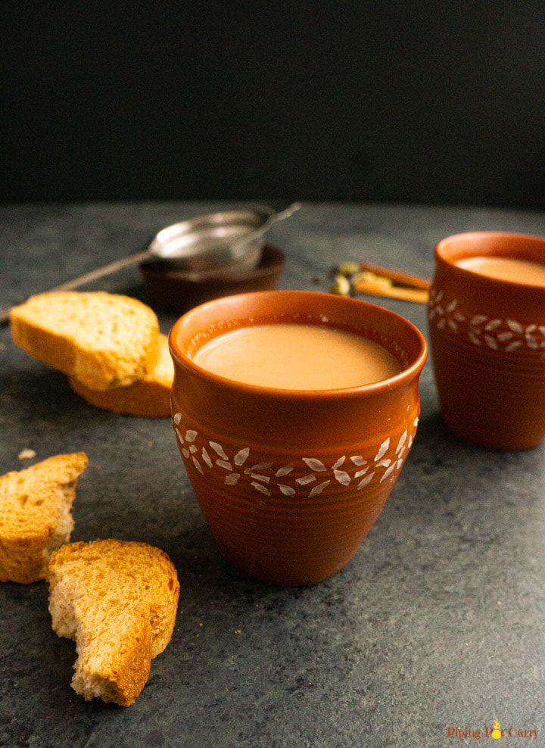
Food
Indian cuisine is one of my most favourite cuisines because I am a big fan of spicy food and veggie based diet, the fact that 40% of India´s inhabitants are vegetarian and there is a bigger option of vegetarian food to choose from is stomach pleasing.
I would really like to try is Masala chai, the combination of tea, milk and few different spices sounds really interesting to me.

Slide 7
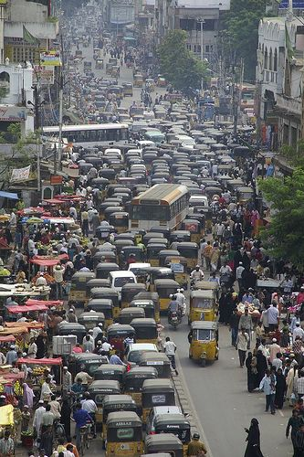
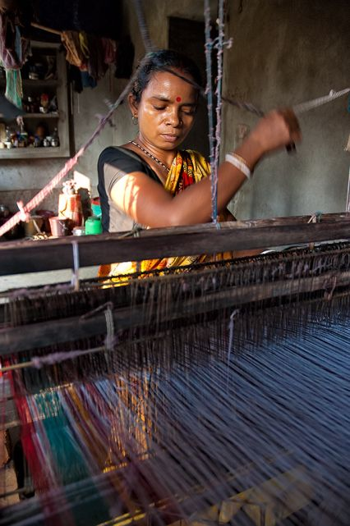
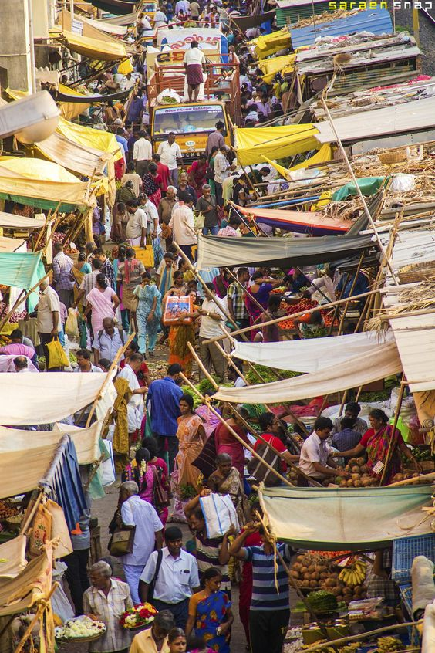
Way of living
India may not be the richest country in the world, but still I think that the people who live there may be happy, there is very big difference between my country and India, different values and people find their happiness in different things.
India is beautiful country with gorgeous architecture, nature, interesting culture and kind people and when the pandemic situation in the world will be better I will visit it and observe the all the beauty that it offers.

Slide 8
Sources
https://pinterest.com/
https://www.desktopimages.org/
https://wallpapermemory.com/
https://www.wikipedia.org/
https://www.kids-world-travel-guide.com/

Slide 9
Thanks for
attention

