Slide 1
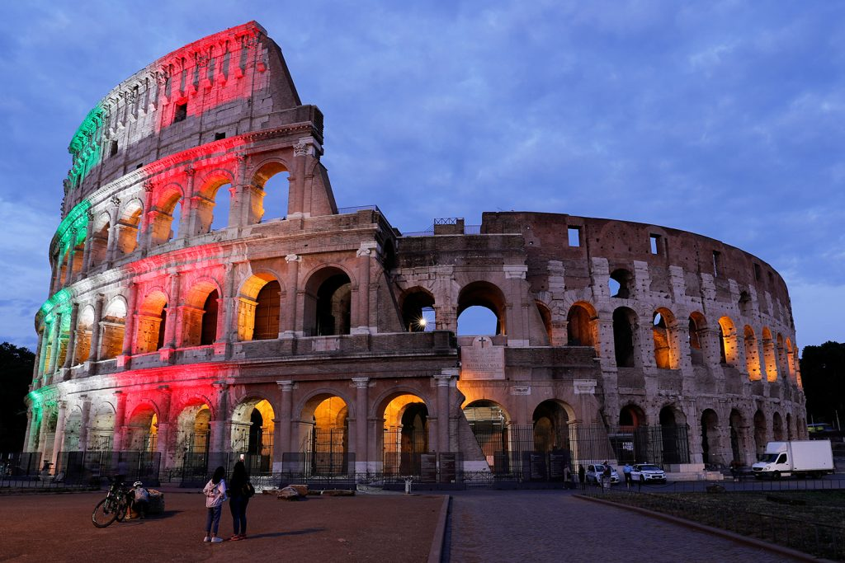
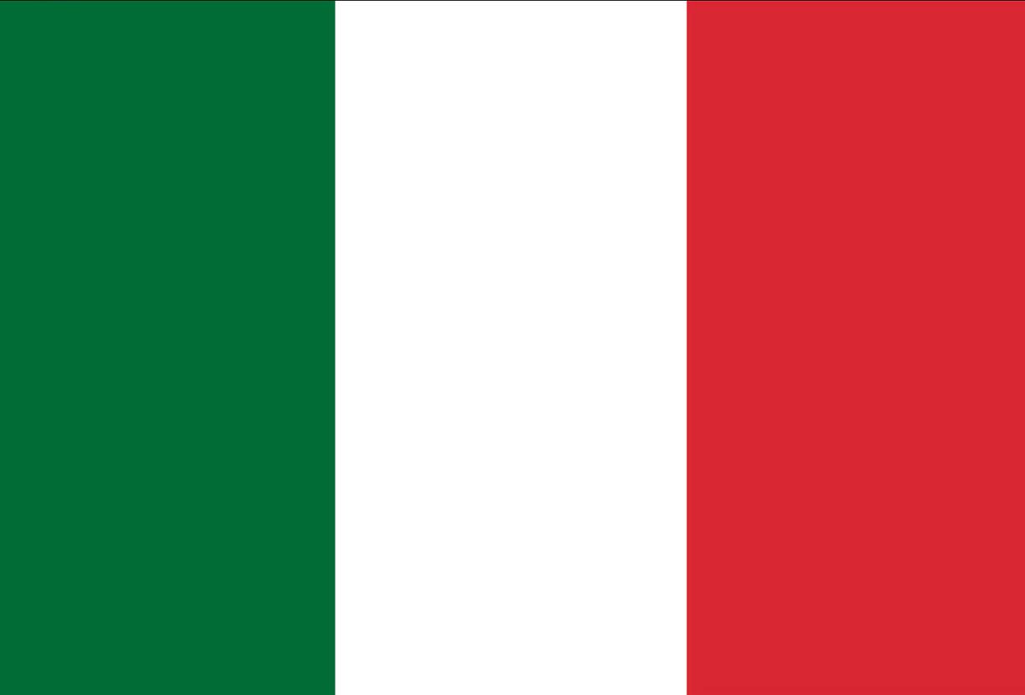
Italy
PETER ŠTUBŇA
SLOVAKIA
2020/2021

Slide 2
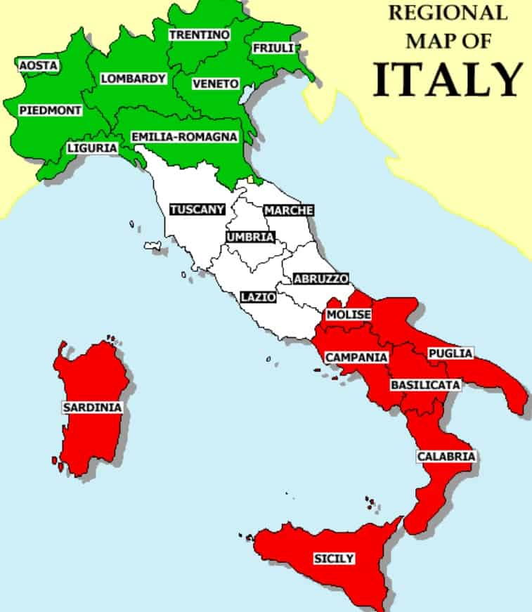
ITALY
The country lies on Apennine peninsula
Italy is washed by the Ligurian, Tyrrhenian, Ionian and Jadran sea
In the north there are Alps and huge lakes
The capital city is Rome
Italy has about 60 millions inhabitants

Slide 3
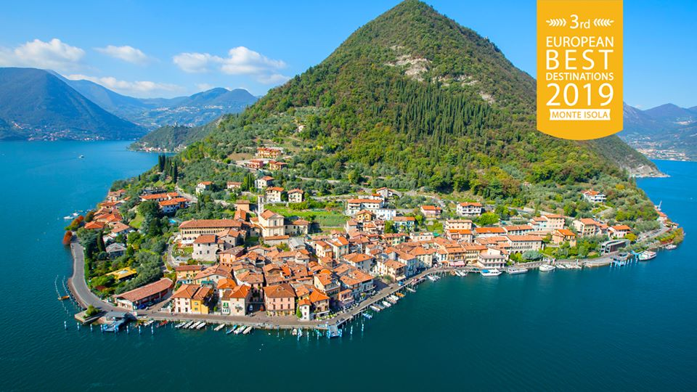
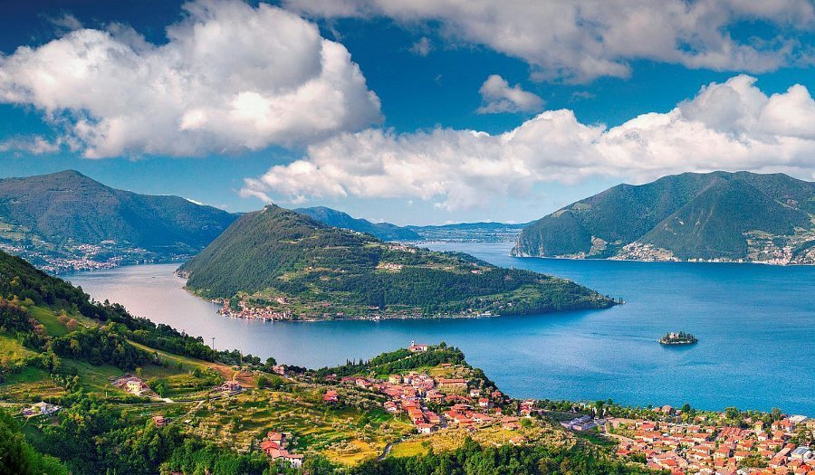
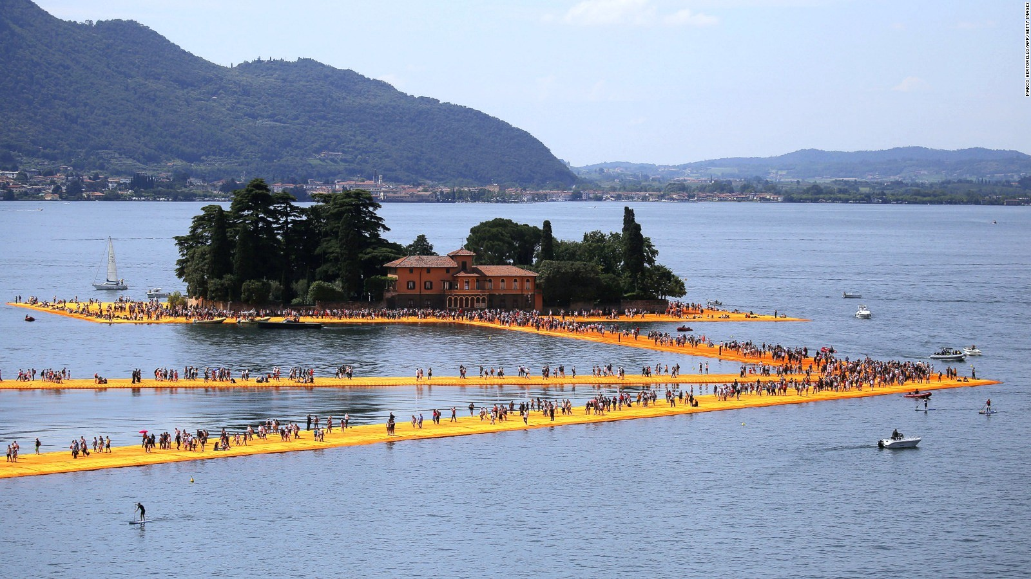
Monte Isola
Monte Isola is the most amazing island in a lake I have ever been to
It´s the biggest island in sweet water in Europe
There live about 1770 people in 10 different villages. I find them very friendly, lively and helpful. Every time we come there, they start chatting with us, have a lot of questions, talk about their family...
The hight expendancy is very hight there because of healthy eating habitats. We can see a lot of old people enjoying their active life
We can only get there by ship or helicopter
A temporary, site-specific work of art by Christo and Jeanne-Claude was installed here in 2016
I always enjoy a wonderful view from Santuario della Madonna della Ceriola on the top of the hill

Slide 4
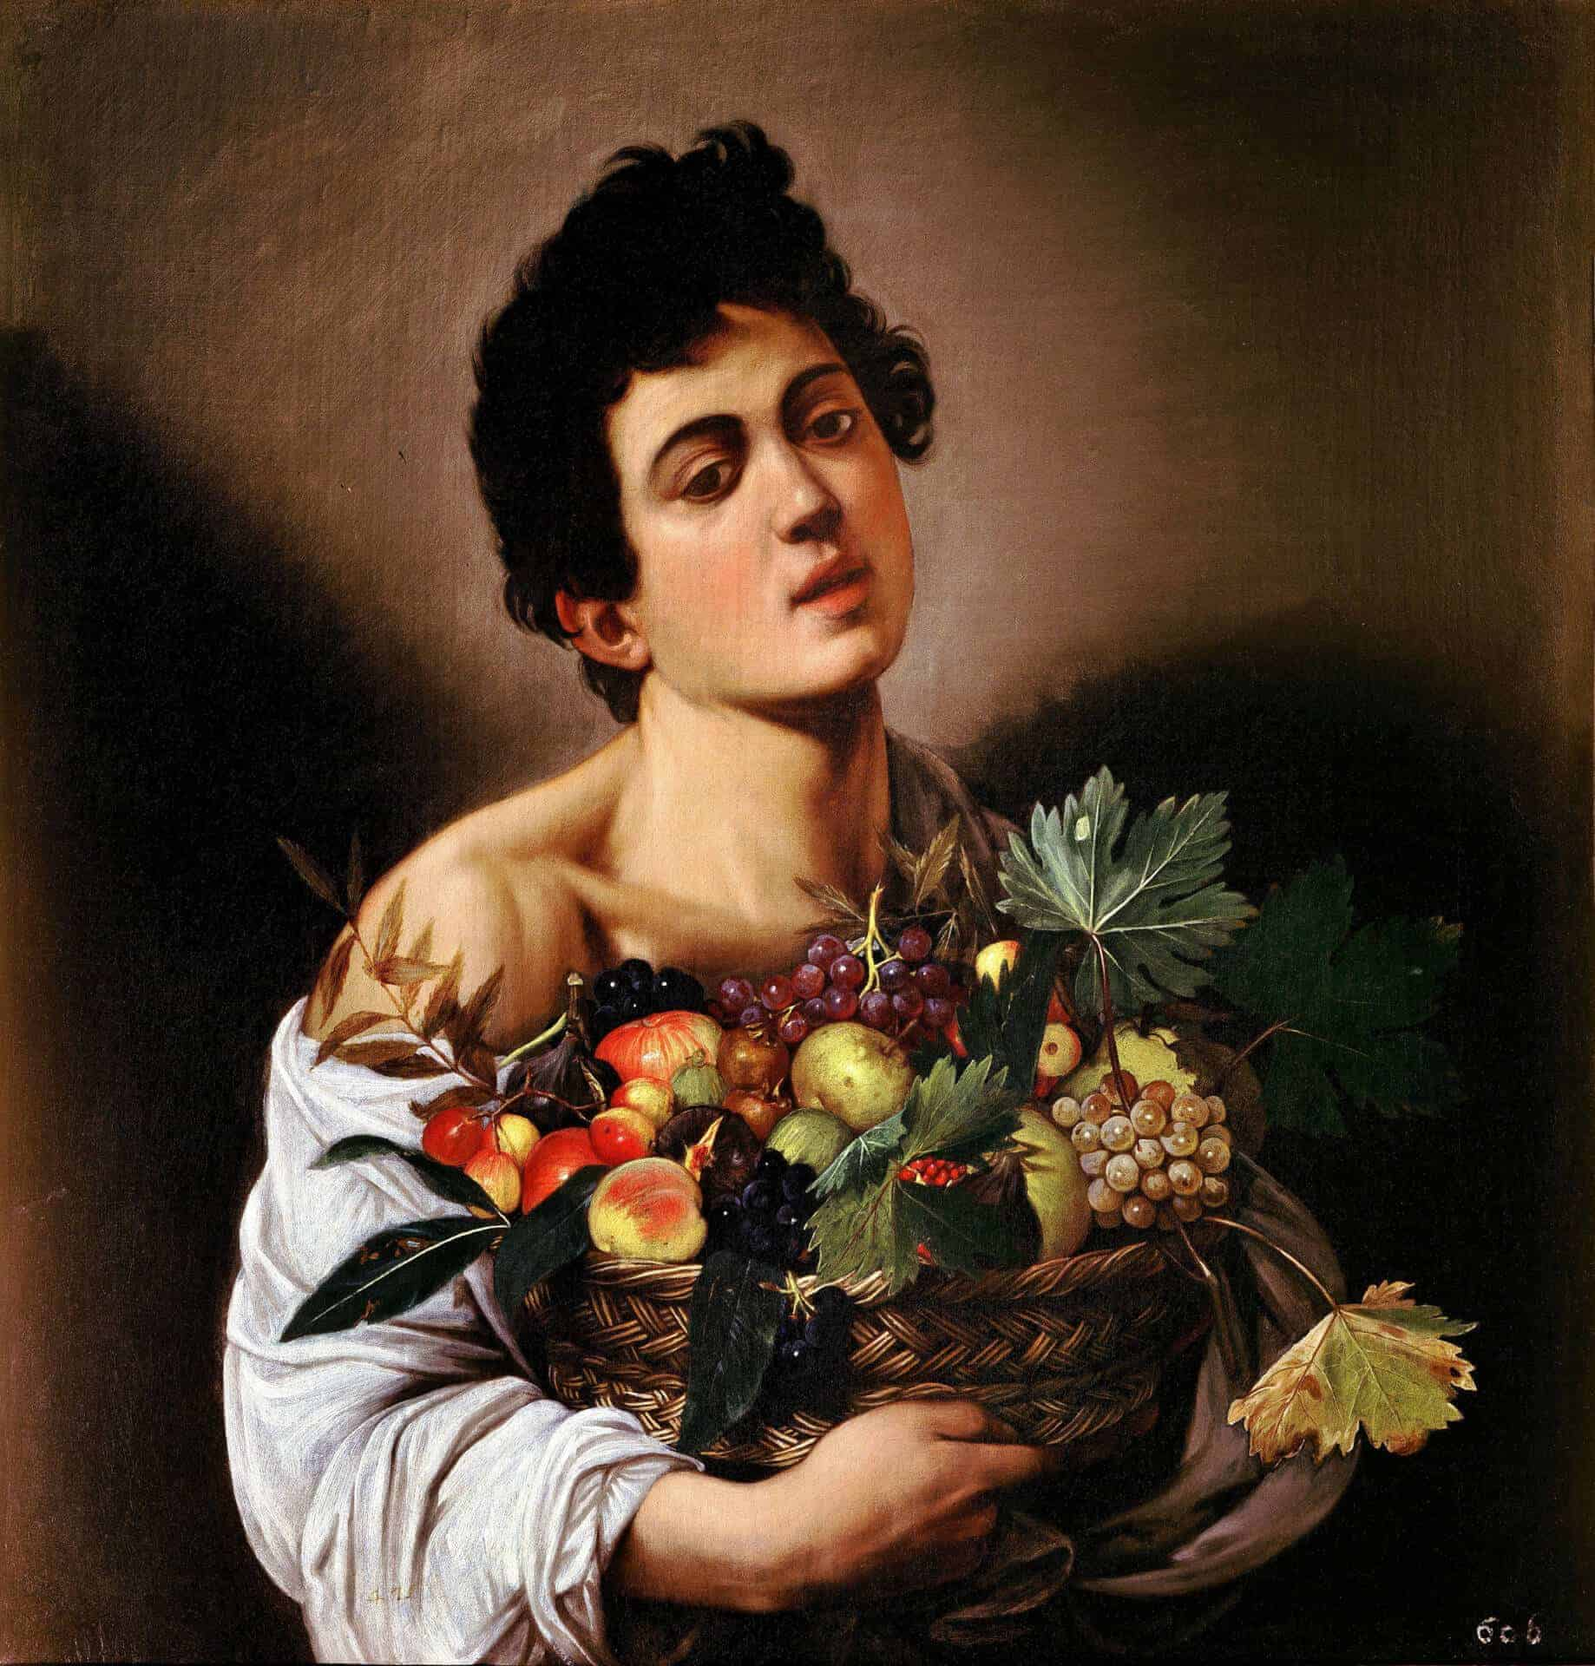
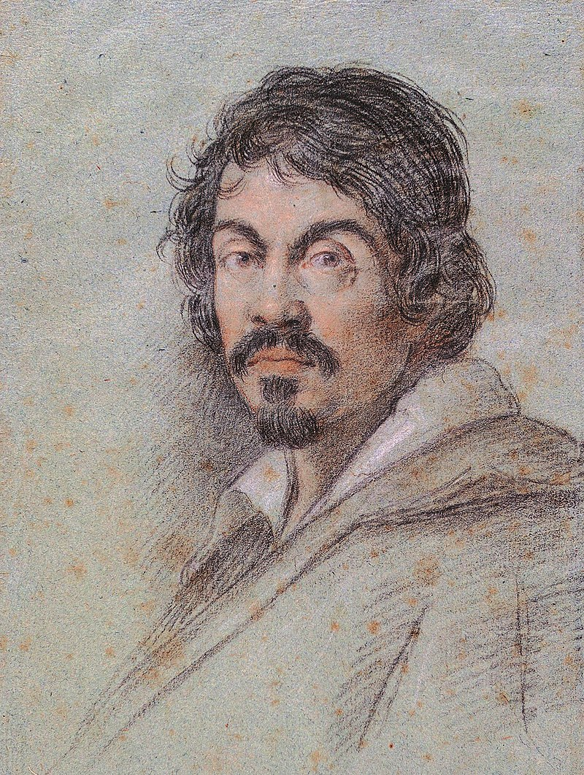
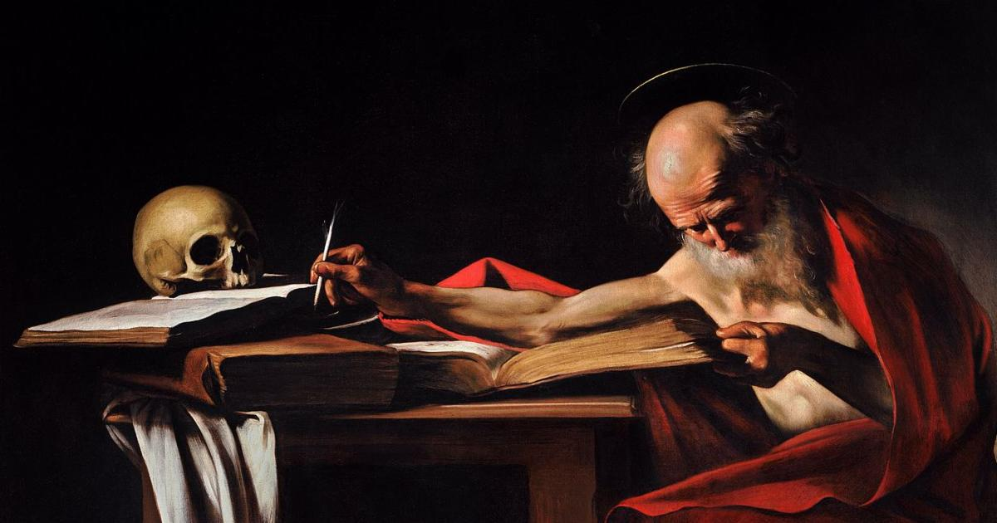
Michelangelo Merisi da Caravaggio
Every year I and my family spend a lot of beautiful moments in our appartment near Milan where was born
Michelngelo´s name comes from Italian countryside Caravaggio, near Milano
He was one of the most important barok painters in Italy
My favourite paiting is Sain Jerome Writing
He made 80 artworks and I have seen most of them in museums in Bergamo and Milan
His paintings are sold for record price -$170 milions

Slide 5
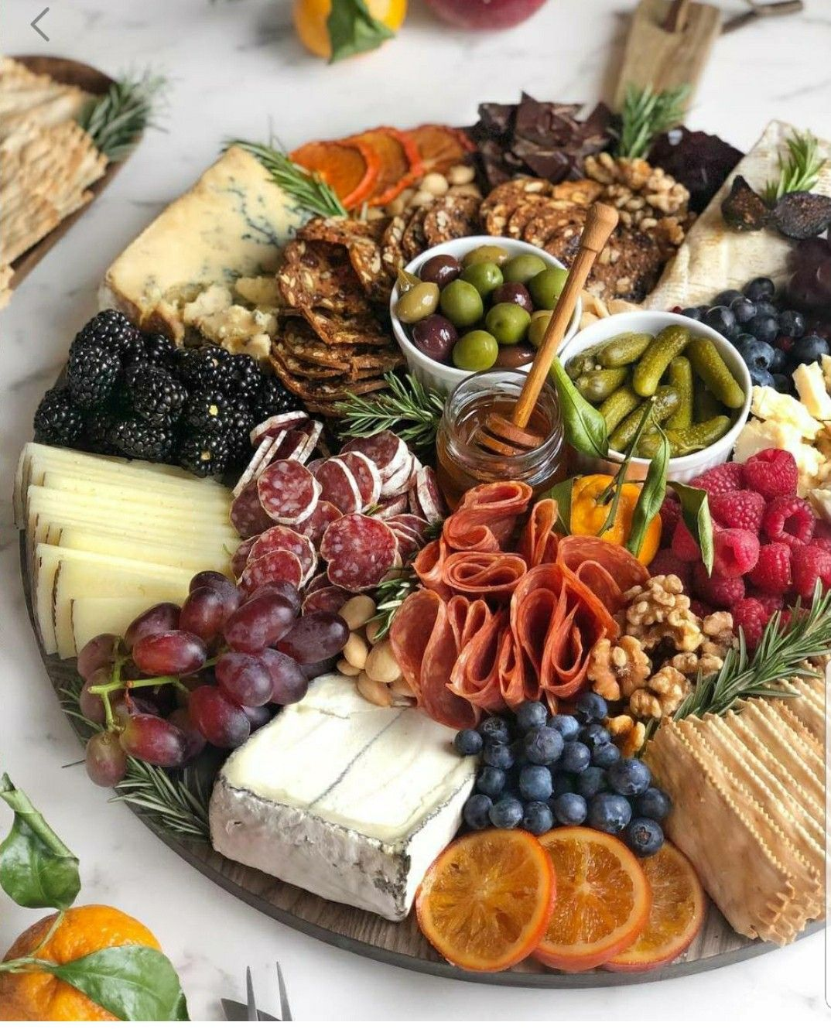
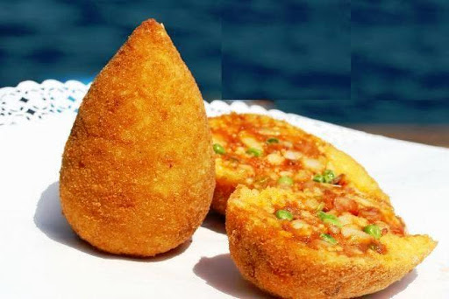
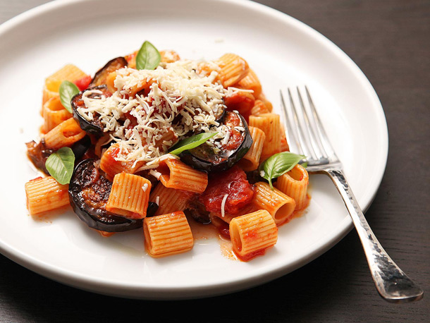
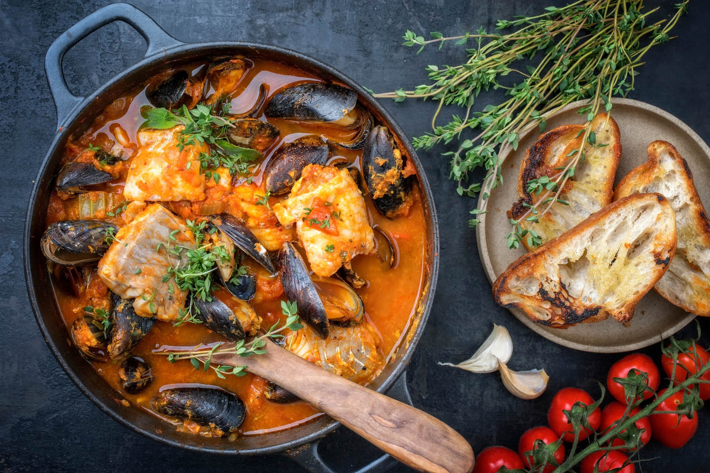
Sicilian FOOD
Is the style of cooking on the island of Sicilia
SALT
Italian cuisine is world famous, but I love Sicilian food the best
For me it is really tasty, traditional, very unique
It shows traces of all cultures that have existed on the island of Sicily over the last two millennia
Its cuisine has a lot in common with Italian, Greek, Spanish, Franch and Arab cuisine
I really love this food because it is healthy with its variety of vegetables, seafood and herbs
If you visit Sicily, you must try their delicious Arancini
There exist a lot of kinds of them (ragú, burro, chipolla)
My favourite one is Ragú - rice, pasta all ragú, peas and beef
Pasta alla Norma - Aubergines, tomatoes, garlic, and ollio di ollive
Zuppa di pesce – fish soup is a food made by combining fish or seafood with vegetables and stock

Slide 6
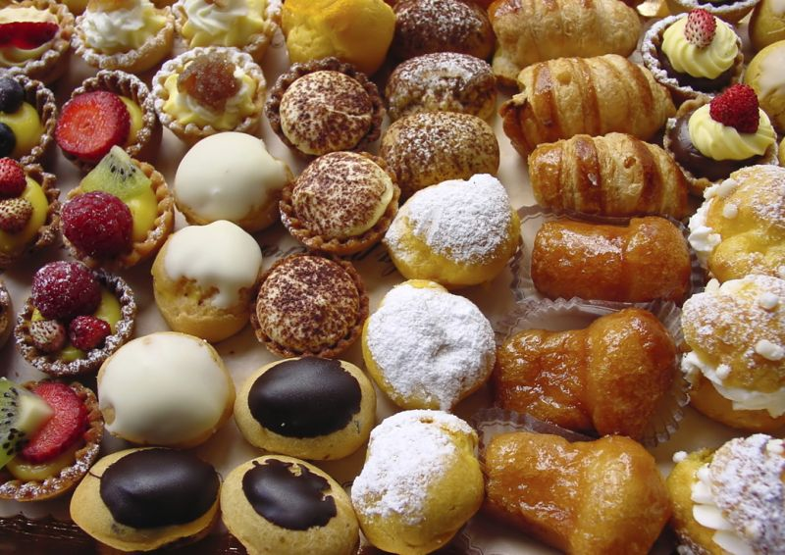
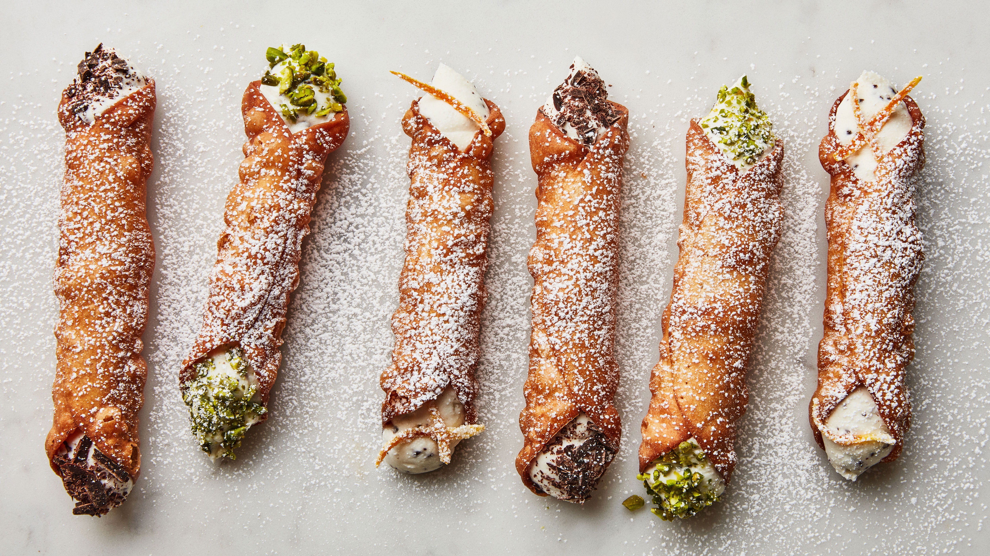
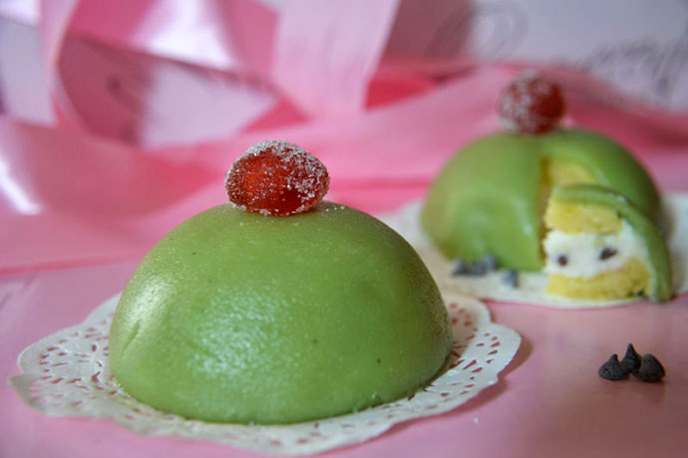
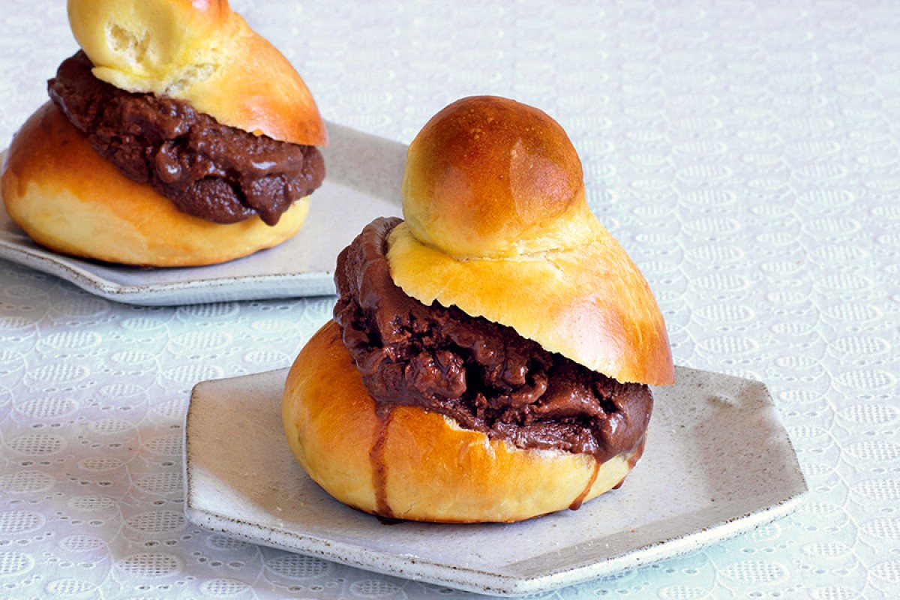
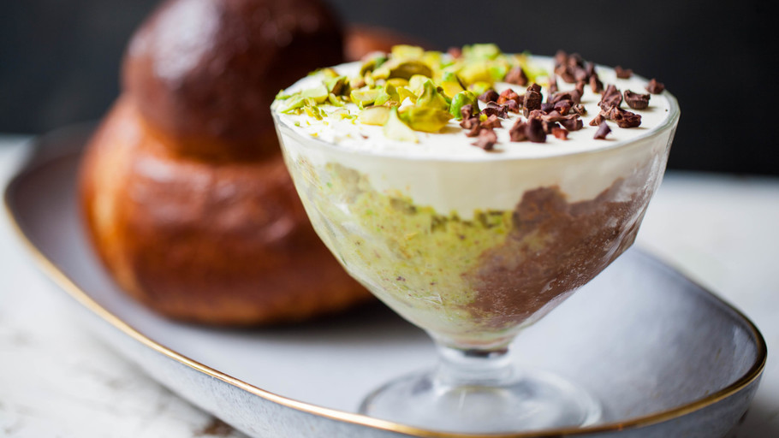
SWEETS
Once I tried their desserts, I have to confess they are masterpieces - I recommend you to taste them all
Cannoli – are pastries consisting from tube-shaped shells of fried pastry dough, filled with a sweet, creamy filling usually containing ricotta - a staple of Sicilian cuisine
Cassata - consists of round sponge cake moistened with fruit juices or liqueur and layered with ricotta cheese and candied fruit, a filling also used with cannoli
Granita con Brioche - Granita is a semi-frozen dessert made from sugar, water and various flavorings

Slide 7
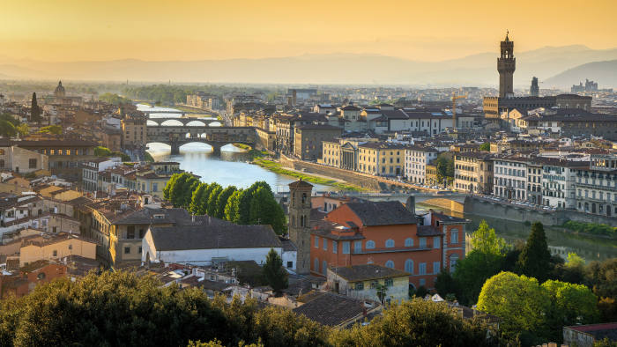
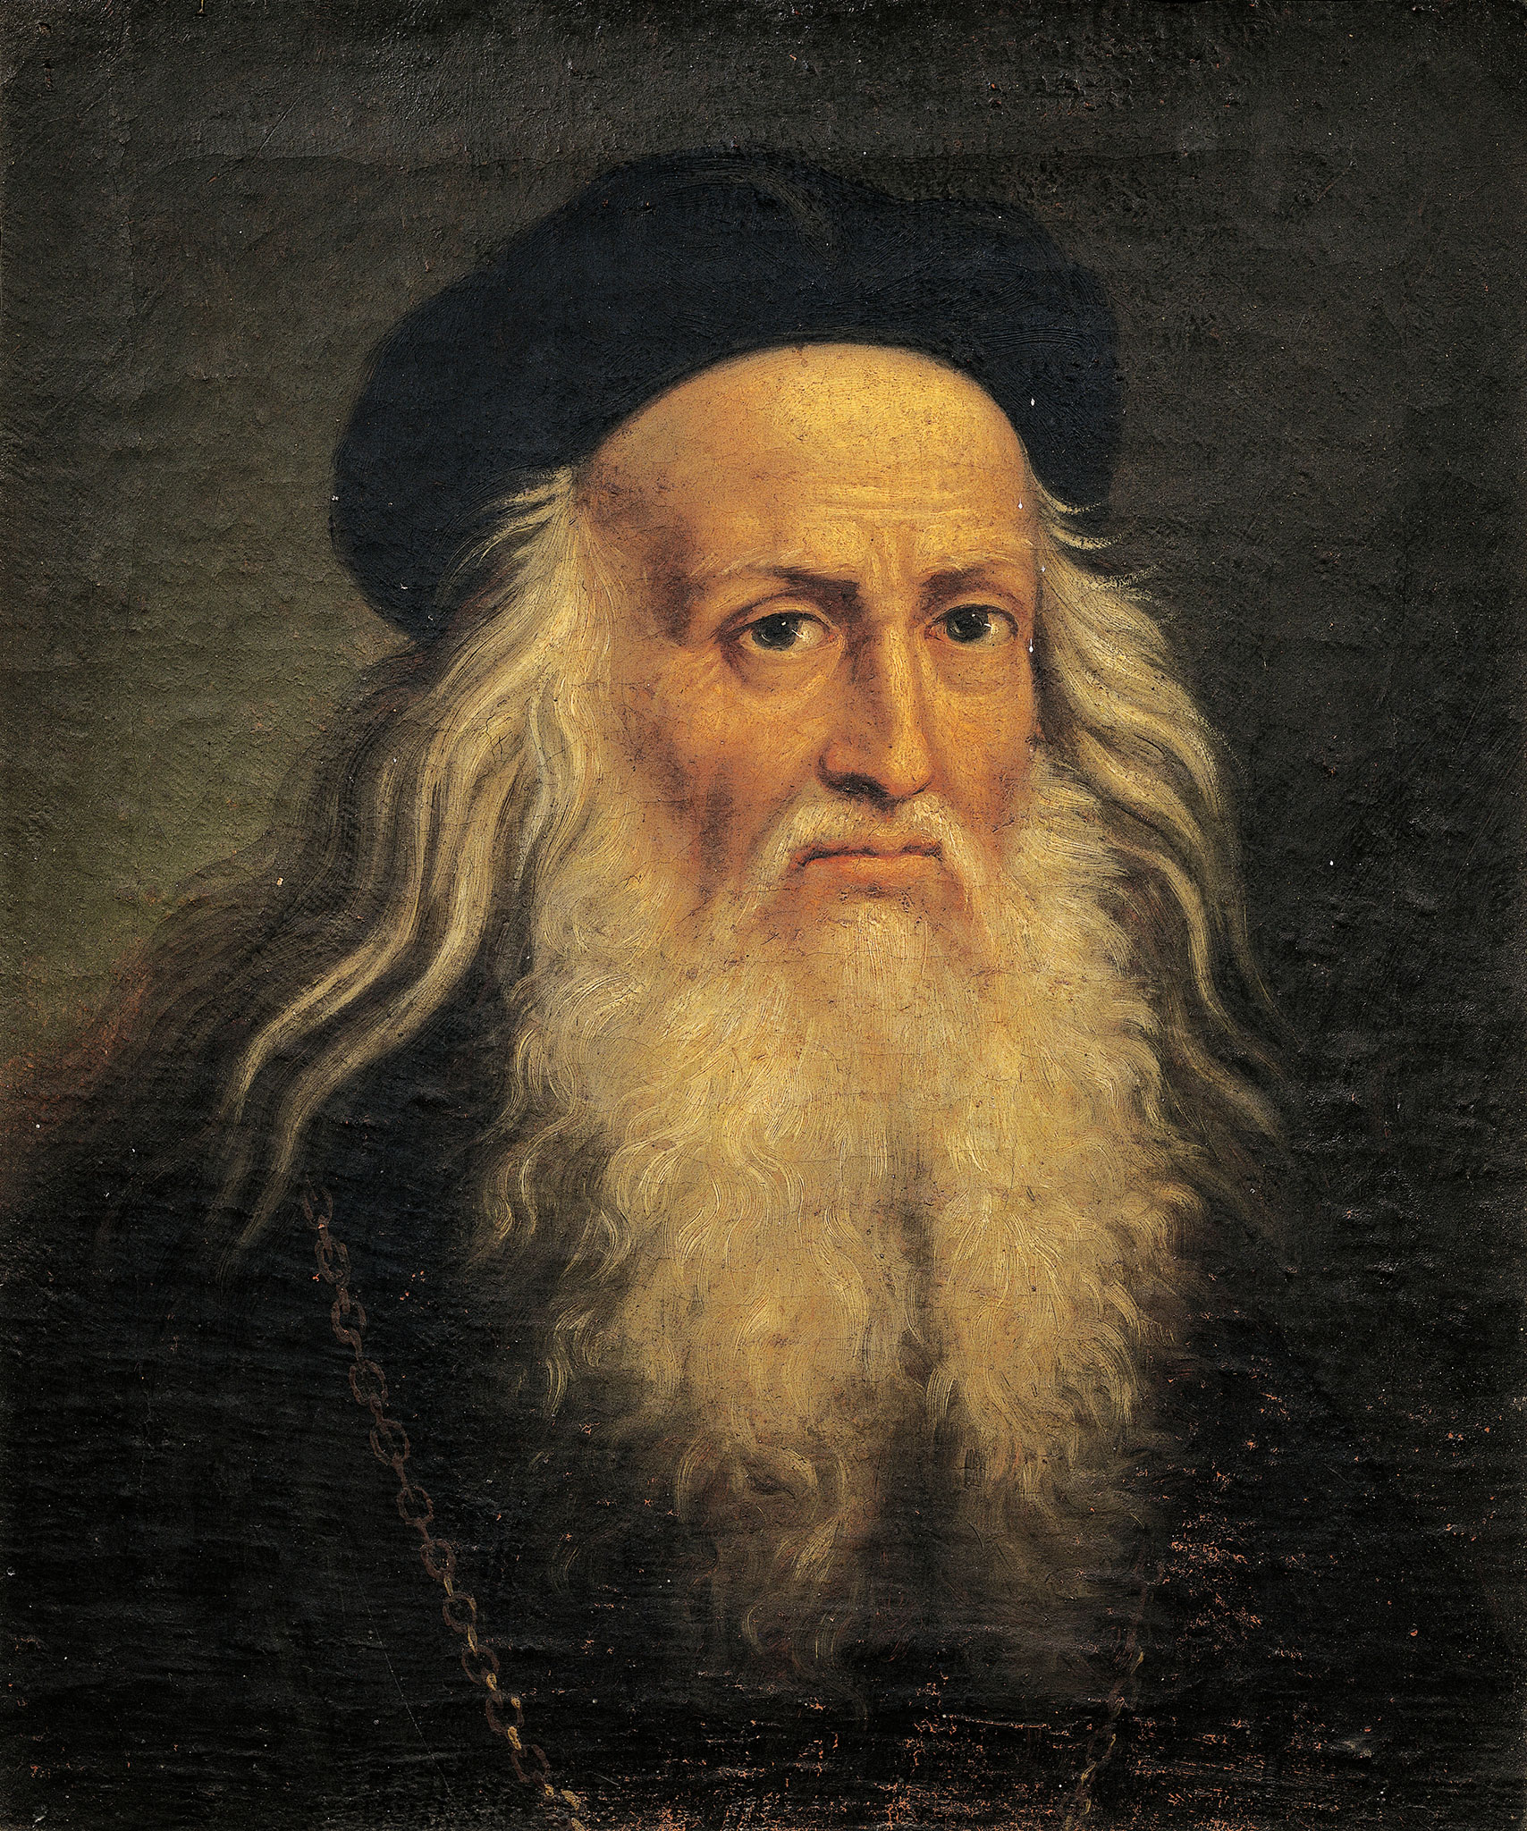
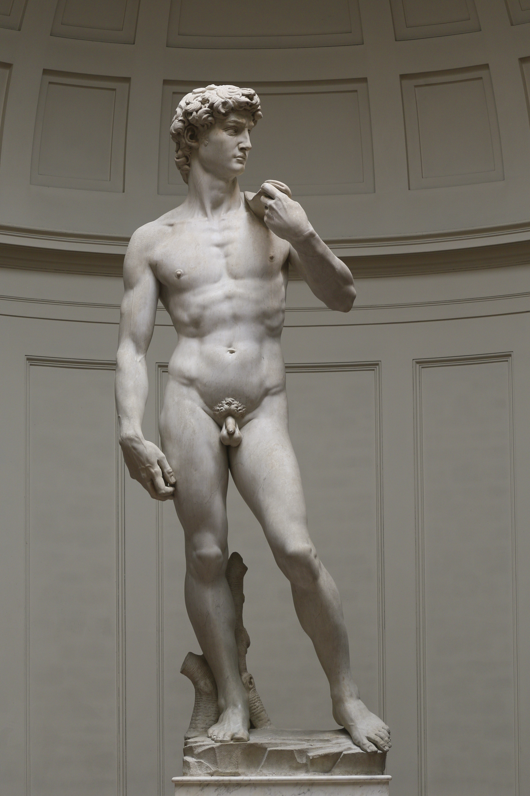
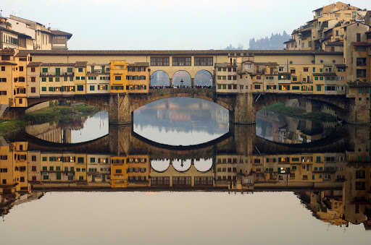
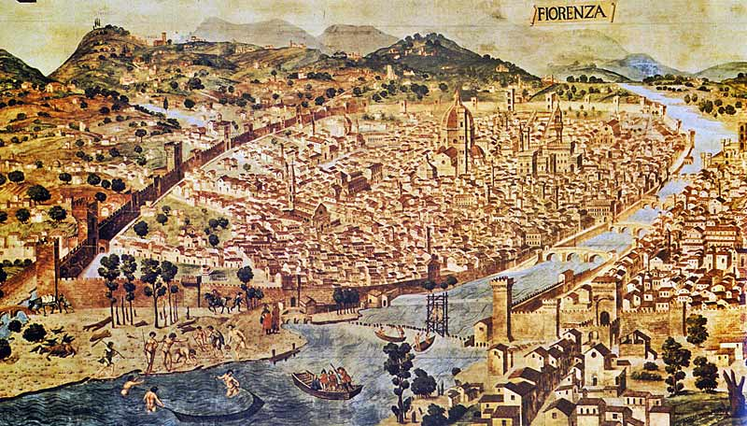
Florence
As I see it, Florence is breath-taking
Florence was a centre of medieval European trade and finance and one of the wealthiest cities
Leonardo da Vinci was born near Florence and he operated there
Here one can admire the famous statue of David by Michelangelo
I have spent hours and hours visiting its beautiful museums and walking in its historical streets
In Florence there are 3 museums dedicated to Leonardo Da Vinchi but my favourite one is Leonardo International Museum because we can touch and try all his excellent inventions. We can see how they work, how they are used nowadays
Without any doubts, it is worth of your time

Slide 8
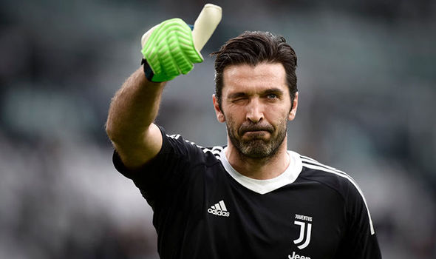
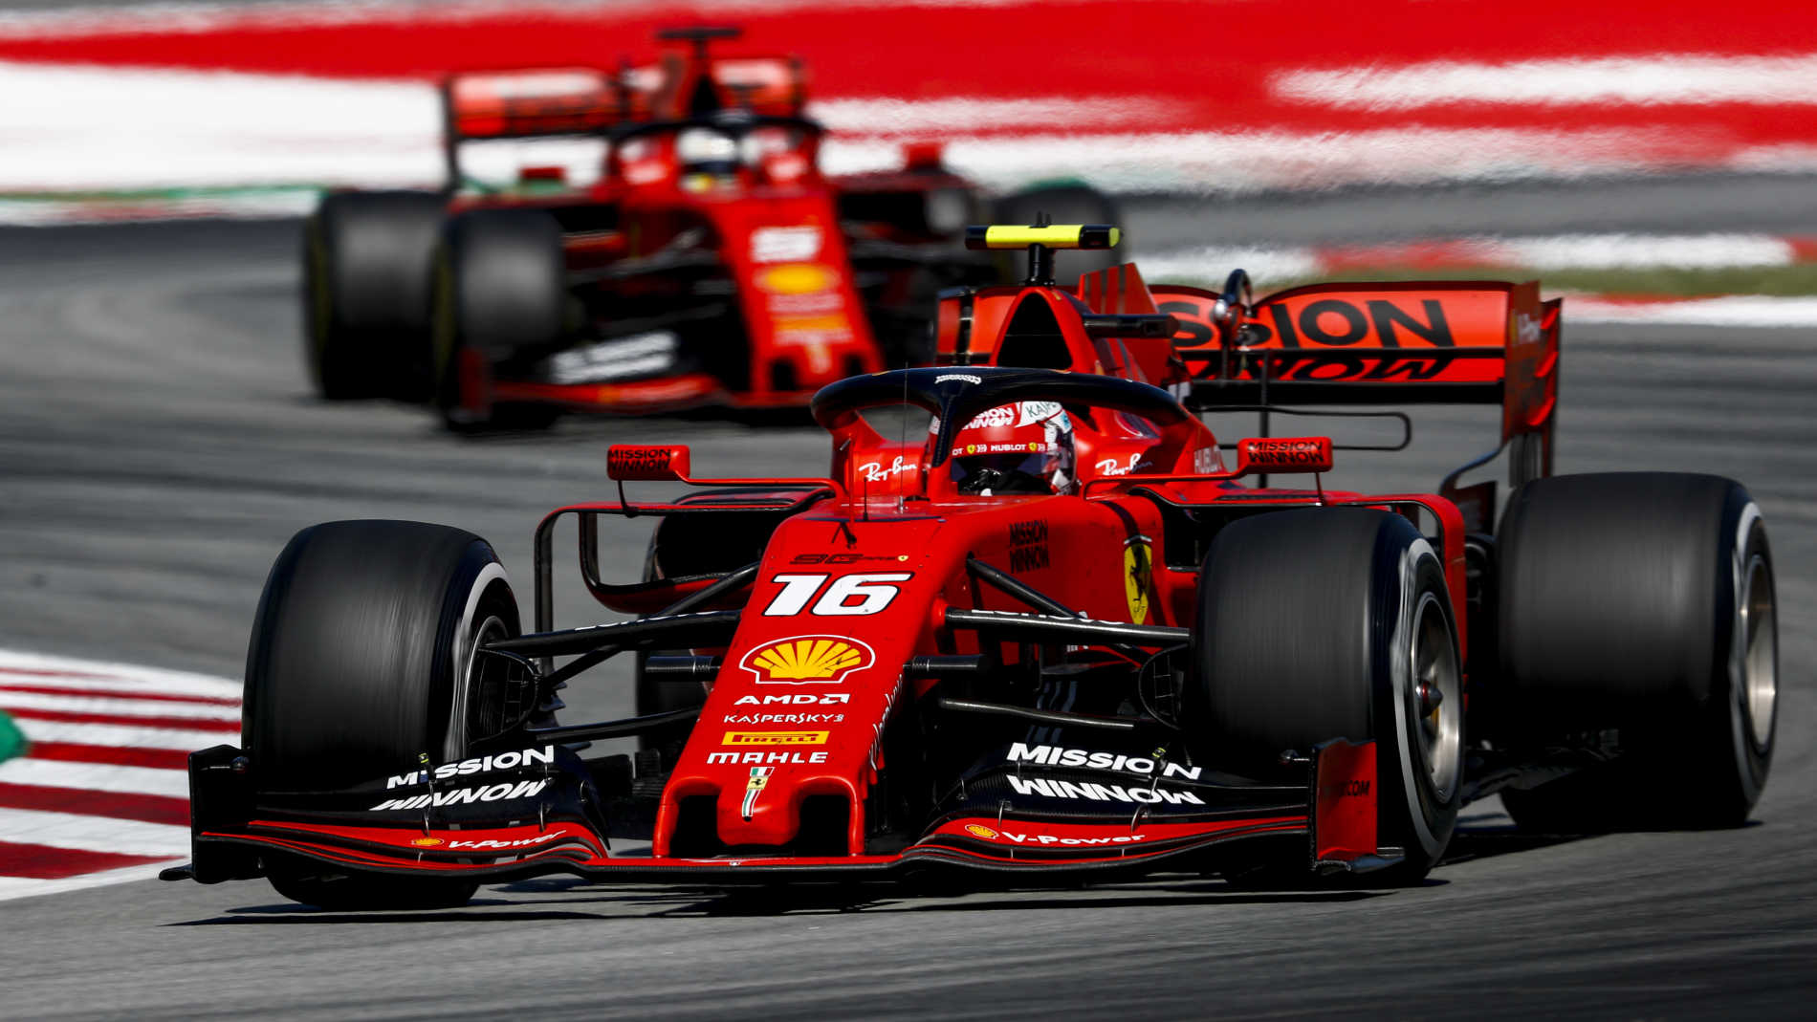
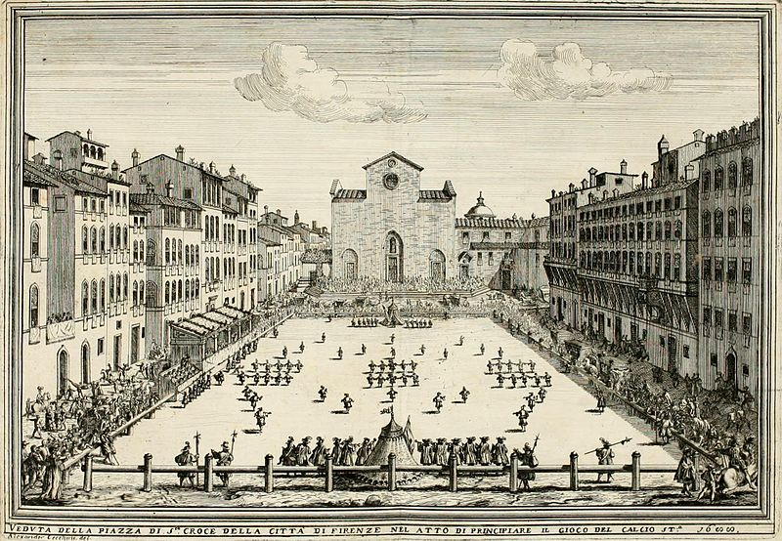
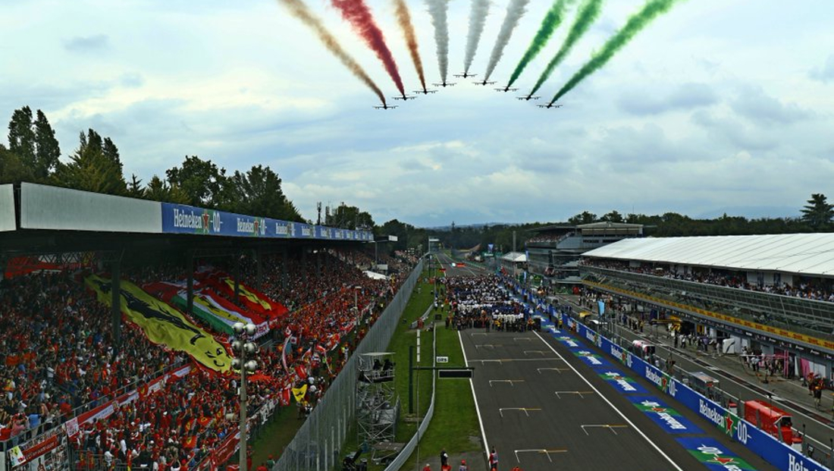
Sports
F1
Football
All Italians love football and the best football players are the national heroes
The official first team was Fiorentina in 16 century
In this time the best team is Juventus
F1 is the second most popular sport in Italy and I am its big fan
We can date the start of F1 in 1920s-1930s
Italians have one of the best companies Ferrari
Typical circle in Italy is Monza and for me to join the even was one of the best experience in my life

Slide 9
Resources
https://en.wikipedia.org/wiki/Wiki
https://www.formula1.com/
https://www.tripadvisor.com/Tourism-g187895-Florence_Tuscany-Vacations.html
https://www.greatitalianchefs.com/features/10-best-sicilian-dishes
https://www.nationalgallery.org.uk/artists/michelangelo-merisi-da-caravaggio
http://www.legaseriea.it/en/serie-a/league-table
https://www.visitmonteisola.it/en/
https://www.tripadvisor.sk/Attraction_Review-g194783-d246676-Reviews-Lago_d_Iseo-Iseo_Province_of_Brescia_Lombardy.html
https://www.britannica.com/place/Italy

Slide 10
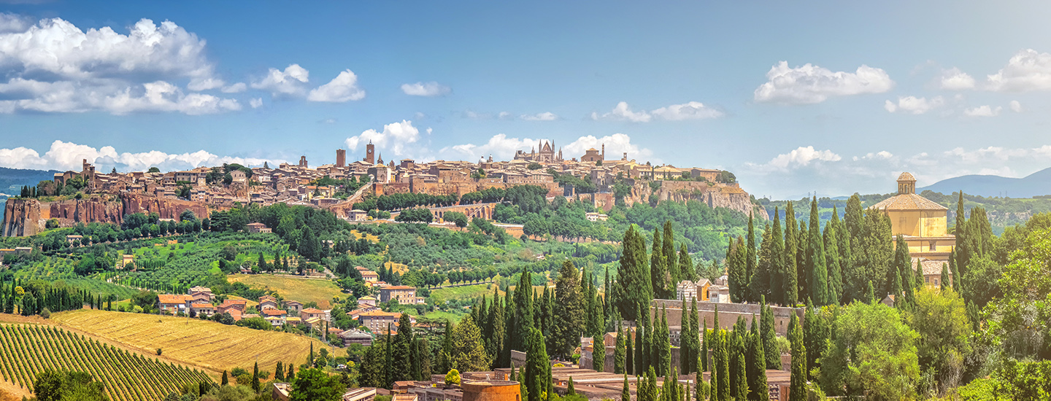
THANK YOU FOR YOUR ATTENTION

