Slide 1
JAPAN
にほん
Andrea Žlnayová

Slide 2
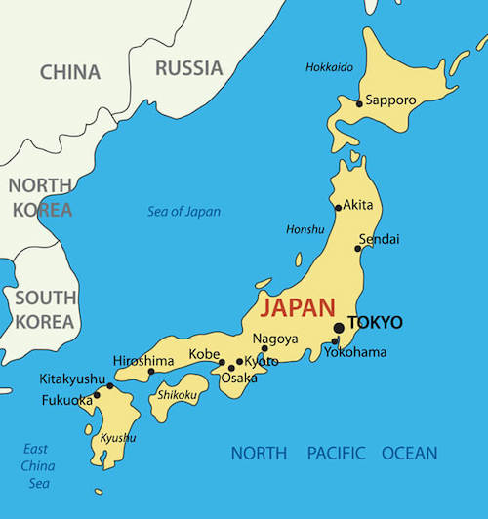
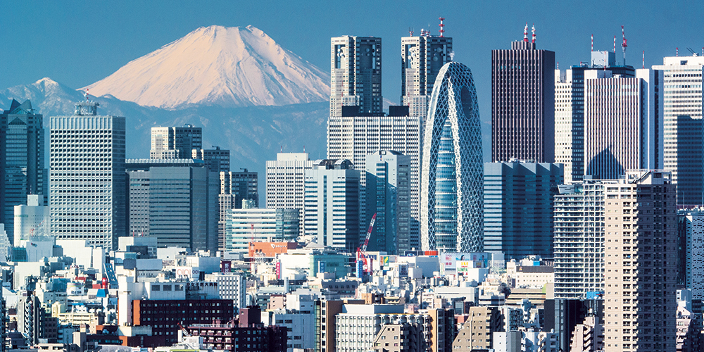
General information
Japan is an island country on the eastern coast of Asia consistent of 4 main islands and many smaller ones - there are over 6,800 in total
Capital – Tokyo (the biggest city in the world)
Population – 126.5 million people
Currency – yen (¥), JP¥ = 0,0081€
Language – Japanese
Flag:

Slide 3
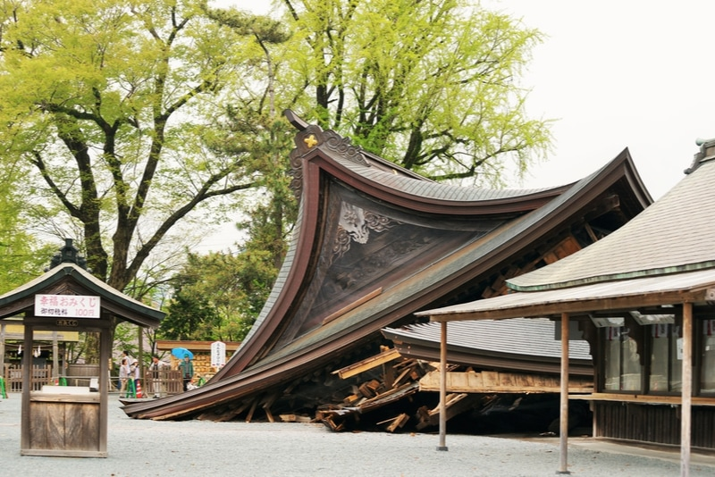
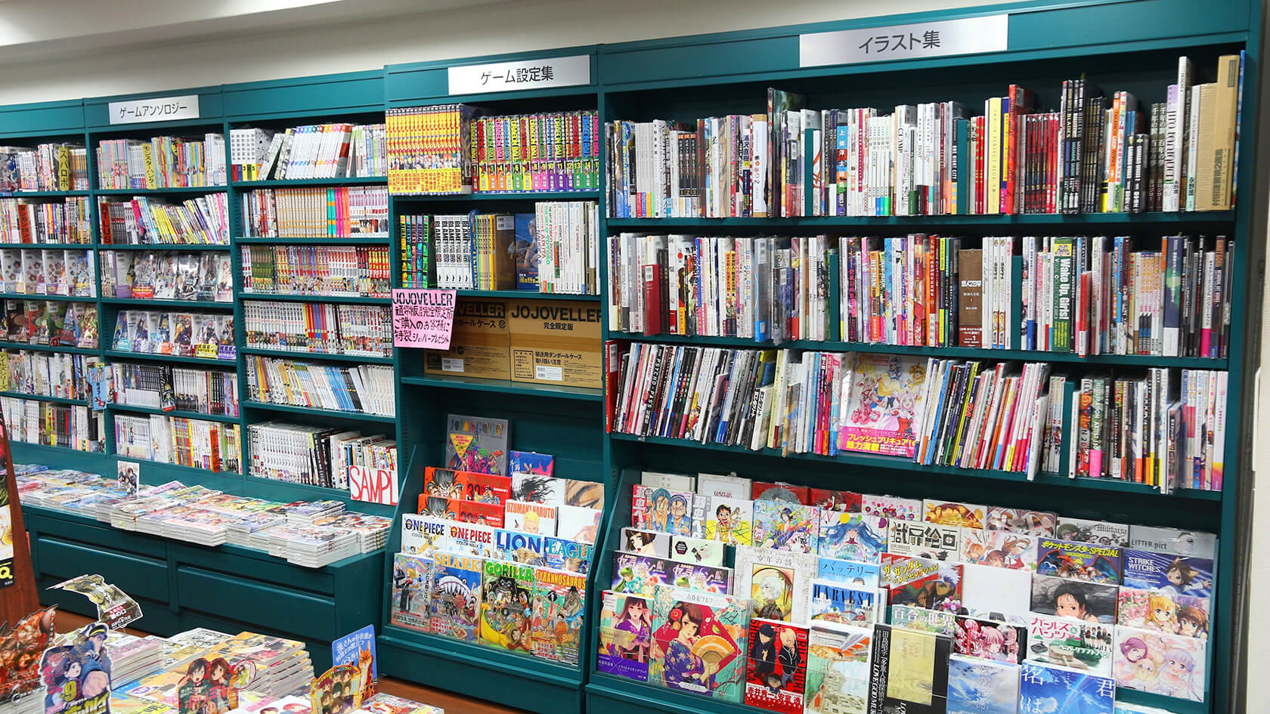
Fun facts about Japan
Japan is the oldest monarchy in the world
Japan has one of the world´s lowest crime rates
In general, there are more than 1500 earthquakes a year
In Japan, you bow instead of shaking hands
More than 2 billion manga magazines are being sold each year
Suicide is a big problem in Japanese society
Japan is one of the loneliest countries in the world

Slide 4
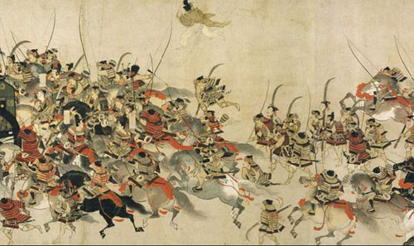
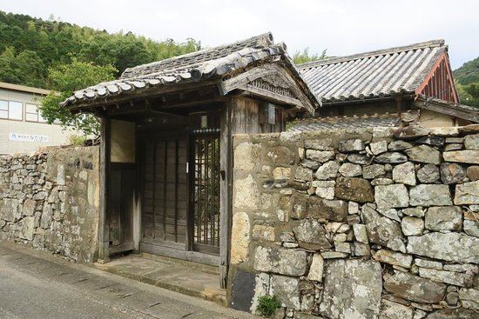
JAPANESE HISTORY
History is very important in shaping the country´s culture, and history of Japan is especially unique which makes it even more interesting.
When it comes to history alongside with Heian, Kamakura and Edo period, I´m mainly interested in samurai and their weapons especially katana and how they were made. The best katana were made by master craftsmen who would repeatly heat and fold the steel to produce blades of extraordinary strength to be used in defence and sharpness to slide through limbs. The samurai could also draw the sword and strike the enemy in one single motion which I find very fascinating! So while visiting Japan, I would like to visit alongside with historical locations some remains of samurai residences for example in Tsushima.

Slide 5
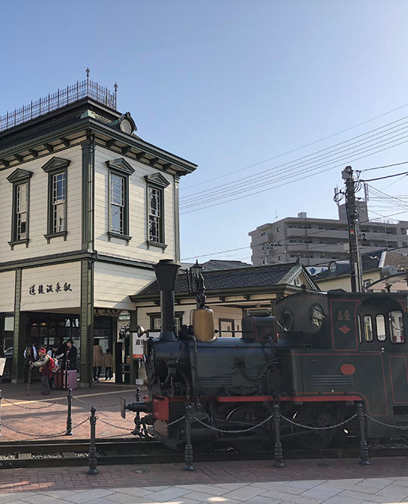
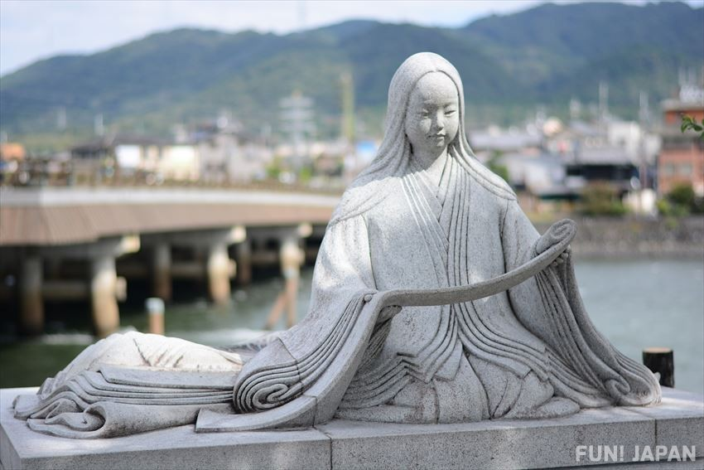
JAPANESE LITERATURE
There are mainly two places that I would like to visit in Japan:
Matsuyama
Matsuyama has a variety of museums and is especially rich in literary talent and history. Poet Masaoki Shiki was born and raised in Matsuyama and Natsume Sōseki´s most famous novel Botchan is featuring the locations around the city. I read couple of their works and I would like to visit Matsuyama to learn more about them and visit some of the locations mentioned in Botchan.
Uji
Uji is frequently mentioned in the 11th century novel (and also the world´s first novel) the Tale of Genji. Several locations in the town are marked by statues or plaques. There is also the Tale of Genji museum.

Slide 6
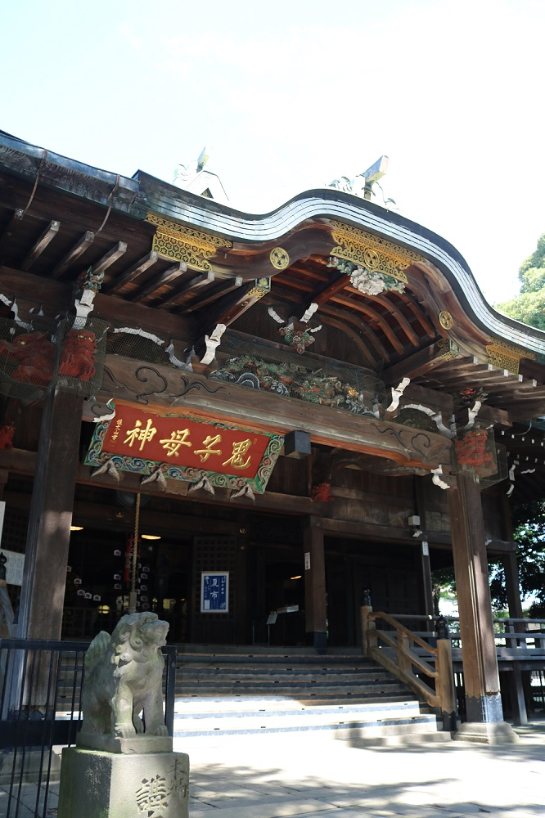
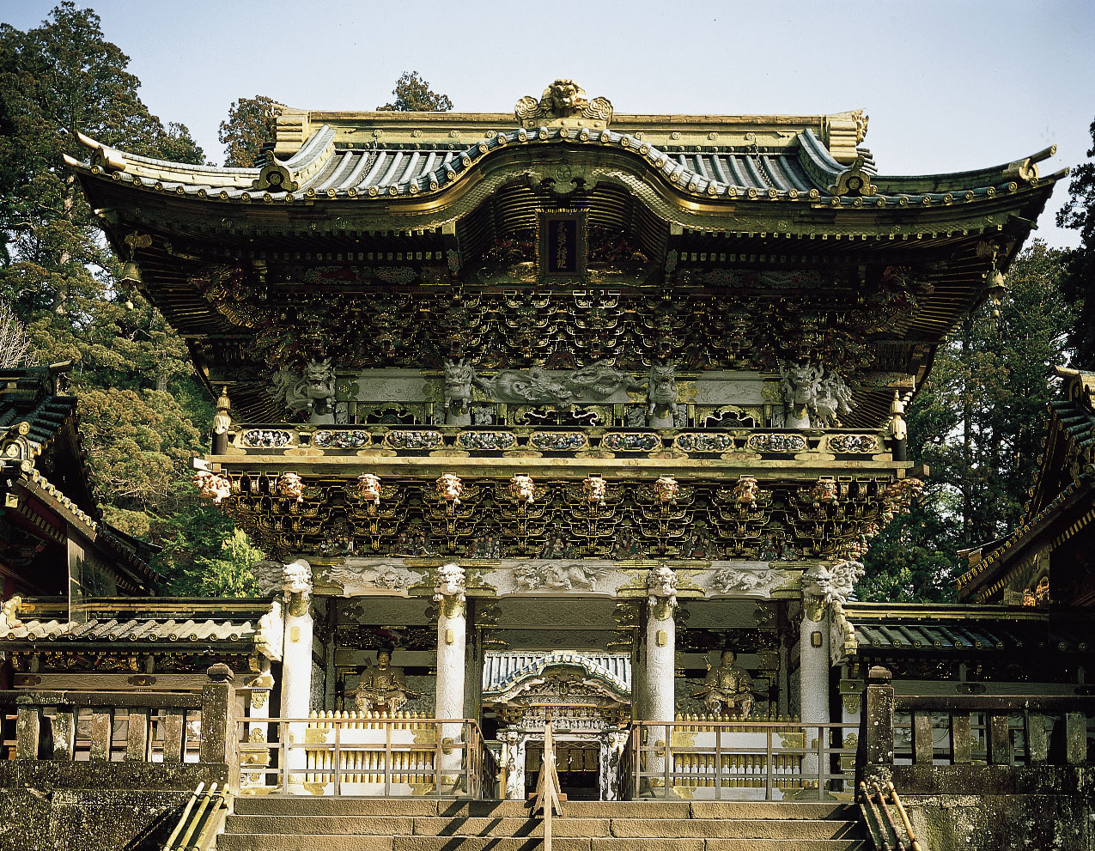
JAPANESE ARCHITECTURE
Japan has a great variety of buildings that exhibit different architectural forms from the oldest surviving wooden buildings, temples and grand imperial palaces to daring modern buildings that play an important role in global architectural trends.
What captures my interest in architecture the most are shrines built towards the Edo period. I really like how they´re ornated to the smallest details.

Slide 7
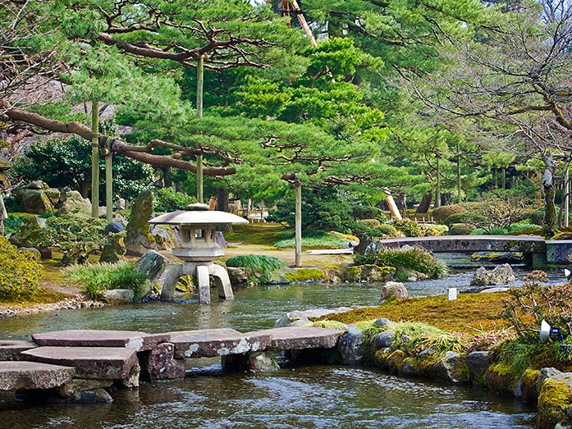
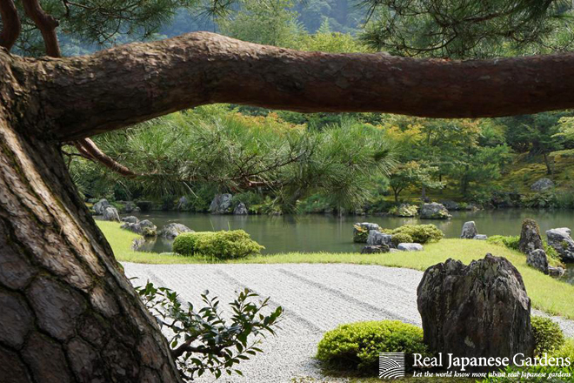
GARDENS
Japanese gardens are an important art form in Japan that has been refined for more than 1000 years. Through time gardens developed variety of styles and purposes.
From the gardens that I researched, my attention grasped the Kenroku-en garden that posesses the six attributes that bring out the perfect garden (tranquility, anquinity, water cources and magnificient view from the garden) in Kanazawa and Tenryū-ji in Kyoto.

Slide 8
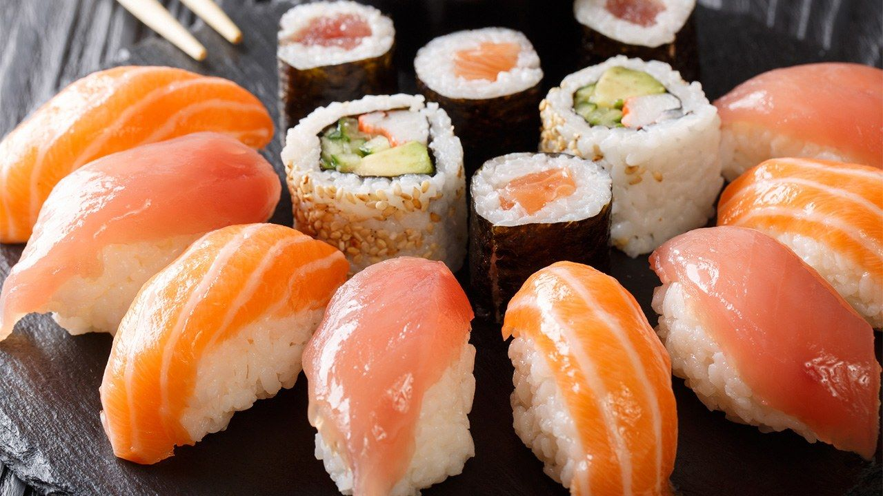
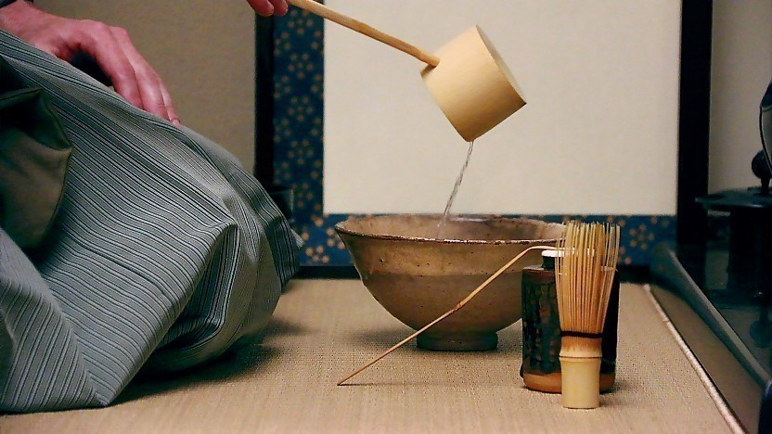
FOOD
Food is other thing that attract foreigners into country and I´m no different. Japanese food is also very different from Slovak mainly in its simplicity and representation. Personally, I would like to taste ramen, yakitori, soba and sushi. But what catches my attention the most is tea. As a big tea lover I´d love to try Matcha tea.
The most interesting thing I read about tea was the tea ceremony. It is a Japanese tradition steeped in history. It is a ceremonial way of preparing and drinking green tea typically in a traditional tearoom with tatami floor. Beyond just serving and receiving tea, one of the main purposes of the tea ceremony is for the guests to enjoy the kindness of the host in an atmosphere apart from the everyday life. Today, it´s mainly practiced as a hobby.

Slide 9
Sources:
https://unseenjapan.com/
https://www.japan-guide.com/
https://www.britannica.com/
https://www.historyhit.com/
https://pinterest.com/
https://motto-jp.com/media/
http://www.japanesegardens.jp/
https://www.wikipedia.org/
https://www.kids-world-travel-guide.com/geography-facts.html
https://kids.nationalgeographic.com/explore/countries/

Slide 10
THANK YOU FOR YOUR ATTENTION

