Slide 1
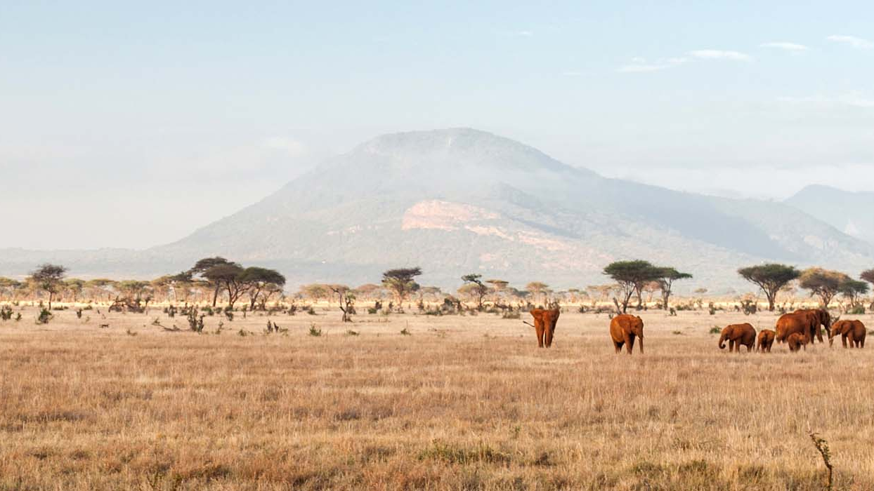
Kenya
Samuel Rybansky & Zoja Mlynarikova

Slide 2
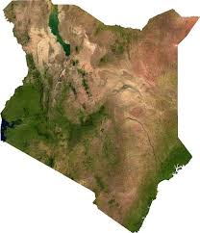
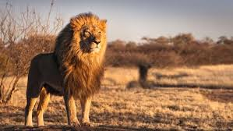
Basic information
Geographical location: Eastern Africa, Coast of Indian Ocean
Capital: Nairobi
Population: 47,5 milion
Currency: Kenyan shilling, but tourists are welcome to use US dollars
Language: Swahili and English
Flag:
National animal: Lion
Religion: mostly Christians

Slide 3
Interesting places in kenya
National reserve Maasai Mara
Named in honor of Maasai people, ancestral inhabitants of the area
One of the most important wildlife areas in Africa
Lamu island
Port, town
Kenya’s oldest town
Best-preserved Swahili settlement in East Africa
Mount Kenya
Highest mountain in Kenya, second highest in Africa
Nairobi
Capital of Kenya

Slide 4
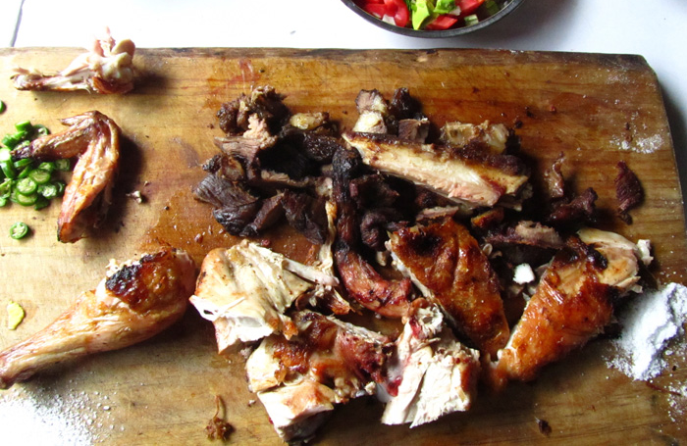
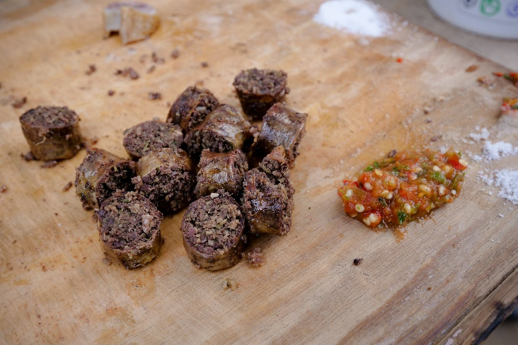
Kenyan food
Nyama Choma (Roasted Meat) – Pride of Kenyan Food
Goat and beef are two of the most common forms
of nyama choma, but this meal can be also made with
chicken and fish
This meal is consumed with a quick dip into a pile
of sand for extra flavor
Mutura – best street food snack
Mutura is the real Kenyan sausage, a protein rich meaty
snack that could be the envy of every beer drinker.
Goat intestine wrappers are stuffed full of the alluring combination
of ground meat parts and goat blood. The sausage is boiled until it
is almost cooked through and then thrown on the grill to dehydrate
the meat and give it that sensational smoky taste.

Slide 5
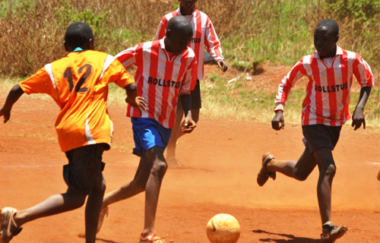
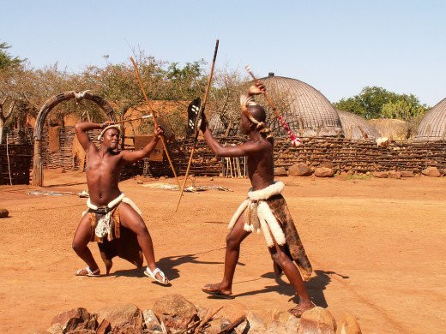
Sports
Soccer
This sport is not only beloved by children, but profesionals also
play it. Most popular teams are: Gor Mahia, Tusker F.C.,
AFC Leopards SC, Mathare United F.C., Banddari S.C
Athletics
Kenya is known for having one of the best athletes in long and middle distance running,
winning a lot of awards, for example:
holder of world record holder in marathon - Eliud Kipchoge
two-time Olympic gold medalist - Kipchoge Keino
two-time World Champion and world record holder in the 800m run - David Rudisha
Traditional sports
Lots of traditional sports disappeared, but some of them are practised
to this day, but with some restrictions
These sports include wrestling, stick fights, hunting and bull fights

Slide 6
nature of kenya
Considered the safari epicentre
Amazing varieties of wildlife
Steppes, deserts and semideserts
Dangerous animals, such as lion, rhinoceros, leopard and buffalo
National parks: Mount Kenya National Park, Meru National Park, Maasai Mara National Park, Kora National Park, Lake Nakuru National Park, Nairobi National Park and many more
Nairobi National Park

Slide 7
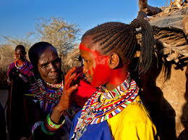
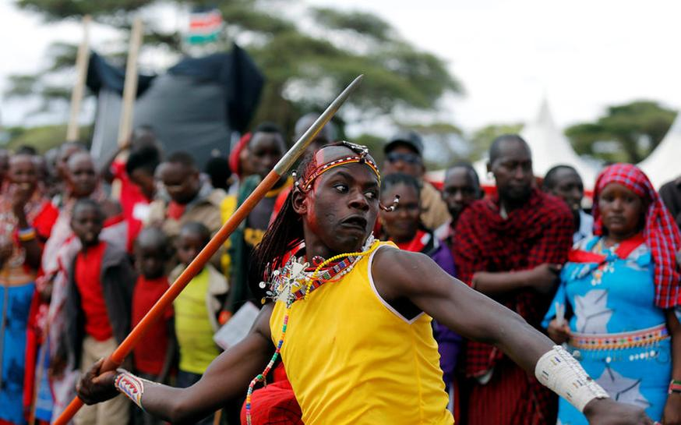
Traditions
Child birth
Across all tribes, child birth is seen as a blessing and newborns are welcomed with song, dance and appropriate rituals such as child naming. Traditionally among the Kikuyu, people would wait outside anxiously during a birth.
Coming of age rituals
Many tribes in Kenya give high value to coming of age
rituals which are mostly signified by circumcision
( in past for both boys and girls)
Circumcision for boys is an important step marking
transition from boyhood to adulthood. In the past,
circumcision was done by an experienced elder by the
river very early in the morning, with the cold water serving
as the anesthetic. But nowadays, many boys find themselves
in hospitals for this important step.
The newly circumcised are then kept in isolation for healing,
usually for two weeks after which they graduate into manhood.

Slide 8
music of kenya
Very diverse
Multiple types of folk music
Music genre taarab: influenced by the musical traditions of the African Great Lakes, North Africa, the Middle East, and the Indian subcontinent
Other popular genres: hip hop, reggae, soul, soukous, zouk, rock and roll, funk and Europop
Famous Kenyan musicians:
Eric Wainaina - RnB, Afro-pop
E-Sir - Rap, Hip-Hop
Mighty King Kong - Reggae

Slide 9
Reasons why we want to visit Kenya
A country with a rich culture and great sights to see
It´s very different from what we are used to in almost every aspect
Even though we have countries on our list we would much rather visit, from the countries we could choose from and from the ones that weren´t taken, this was the most interesting one

Slide 10
Links to sources
https://en.wikipedia.org/wiki/Kenya
https://explorepartsunknown.com/kenya/phrasebook-kenya/
https://ajkenyasafaris.com/unique-experience/kenya-cultures-and-traditions/
https://sk.wikipedia.org/wiki/Ke%C5%88a
https://www.travelpulse.com/news/tour-operators/lion-king-inspired-trips-to-kenya-and-tanzania.html
https://migrationology.com/kenyan-food/
https://www.michezoafrika.com/tournaments/brazil-kenya-soccer-championship-enters-quarter-finals/1139.aspx

Slide 11
Thanks for YOUR attention

