Slide 1
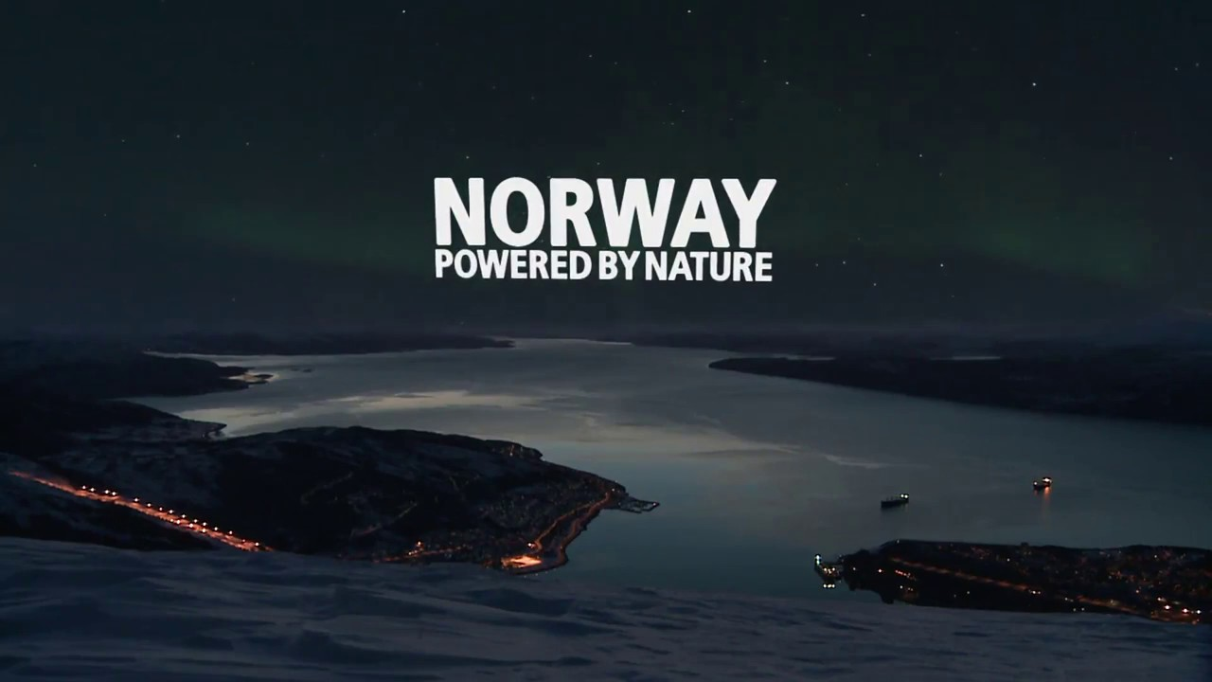
Filip Sova

Slide 2
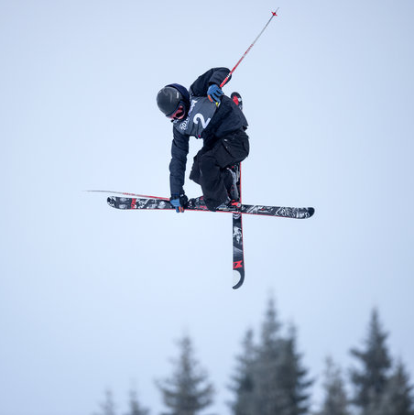
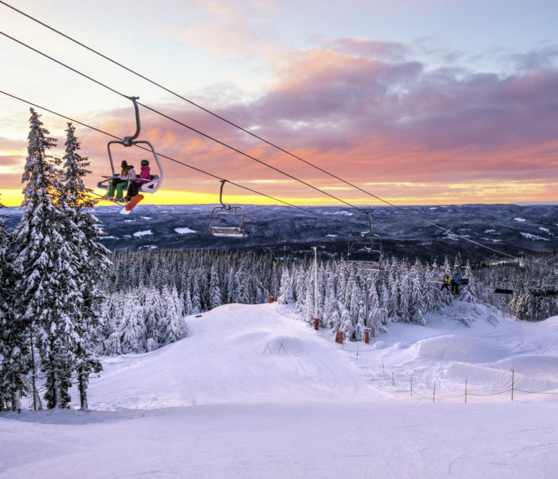
My interests about Norway
First of all, I love winter and skiing. Norway is one of the best places in the world to ski. There are incredible mountains and nature is also stunning. It is one of countries, where winter X Games took place. Birk Ruud comes from Norway too. He took part in this competition and placed several times in the first rungs. He is a big inspiration for me.

Slide 3
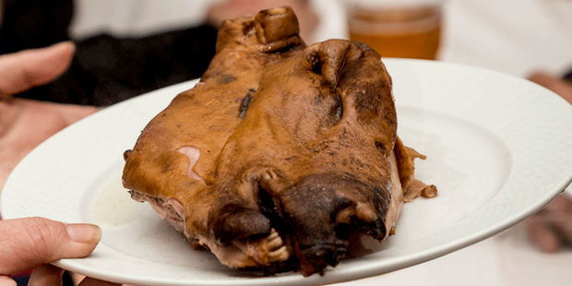
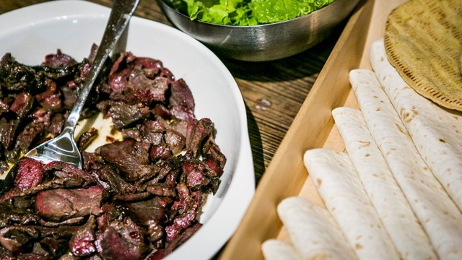
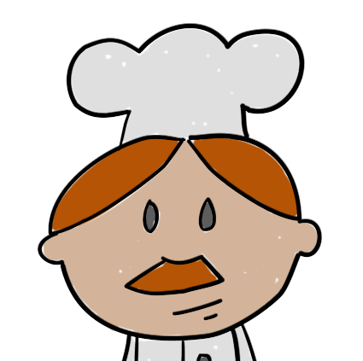
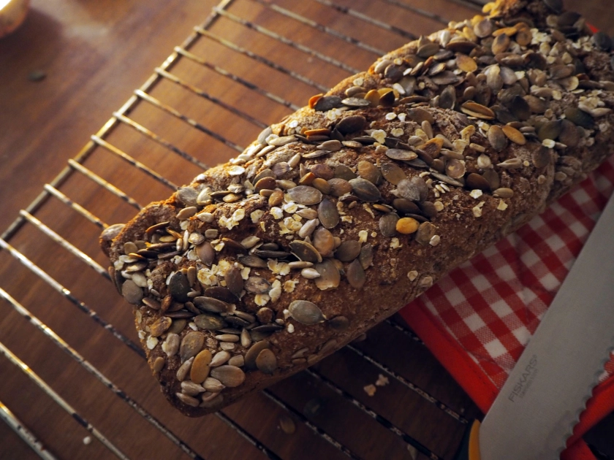
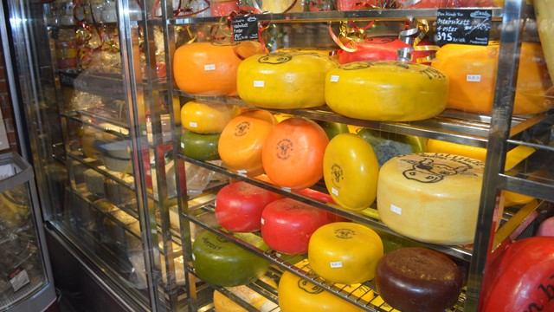
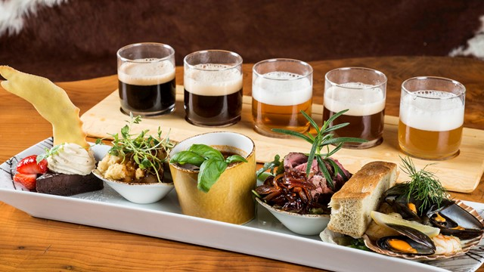
I´m not a picky eater, I love to try new foods. Norwegian foods seems pretty interesting to me. From what I read, your foods contain meats, fish, bread, cheese, grains and vegetables. That is great and tasty ! From meats, for me, the most interesting is lamb, because it is served in many different options. While many of the local people are quick to recommend “smalahove”, not every visitor wants to sample sheep’s head which is a delicacy in certain pockets of Norway. Knekkebrød, kveldsmat and Fjellbrød breads are similar to breads, which we have in Slovakia.
Foods

Slide 4
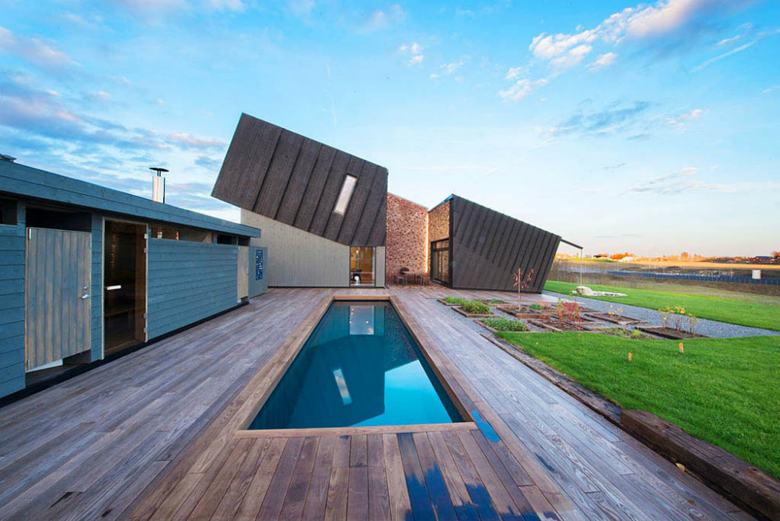
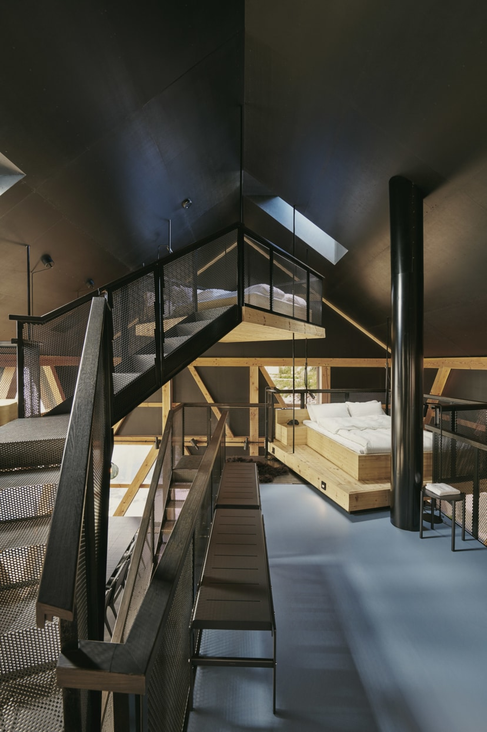
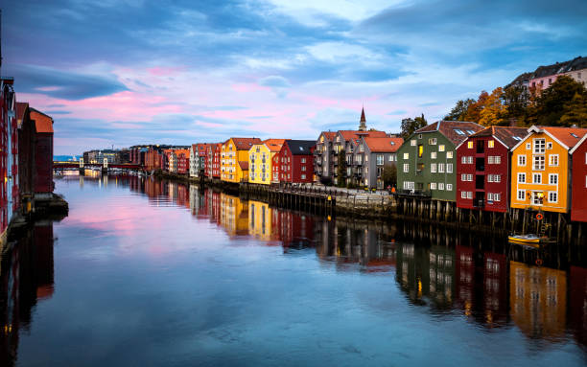
Architecture
In my opinion, the first thing you see, when you come to a country is the architecture. Architecture in Norway is one of my favorite. I really like modern houses, with wooden components and timeless equipment. I also saw images of small houses built in forests, which are kind of eco-friendly. Norwegian architecture goes well with environment and that is the main reason, why I find it interesting

Slide 5
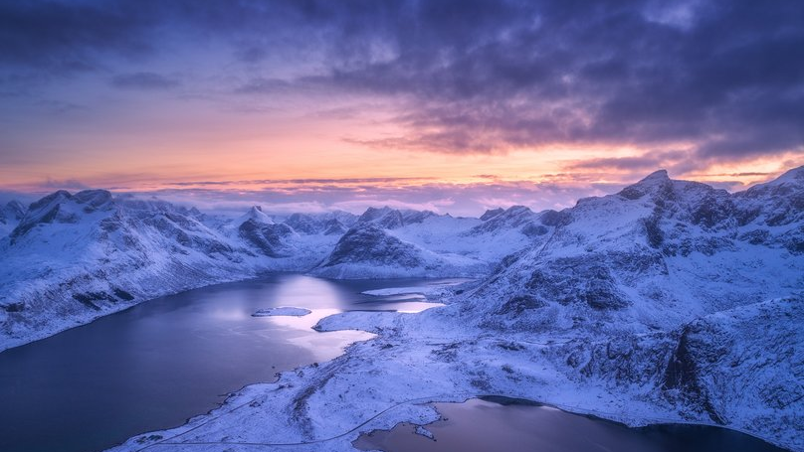
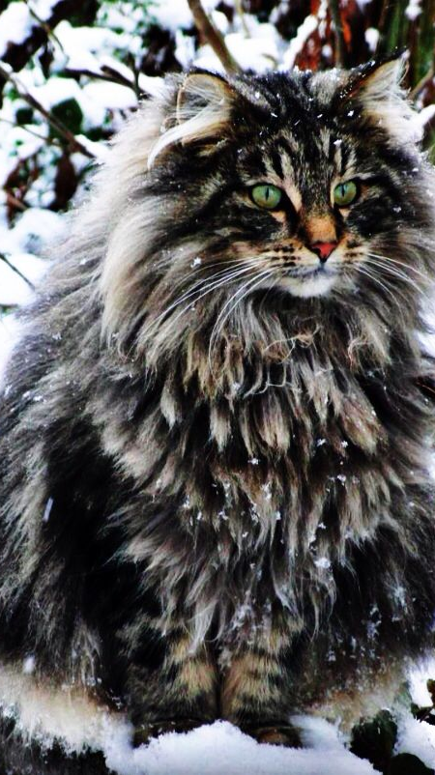
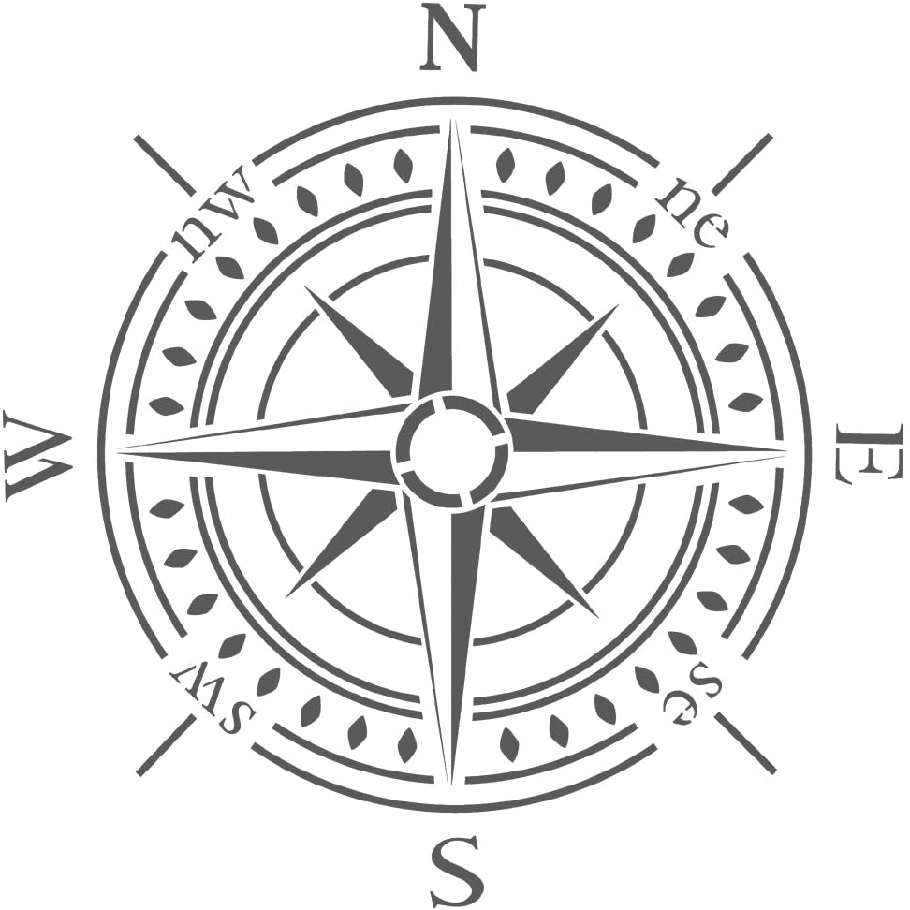
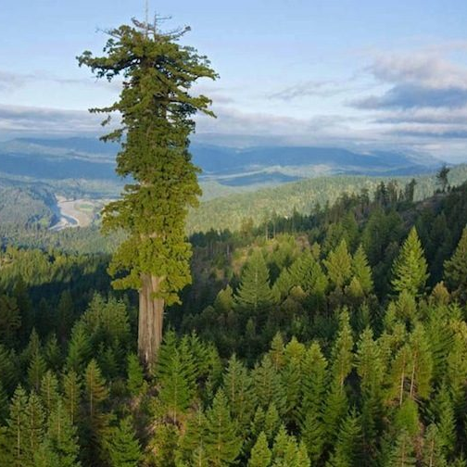
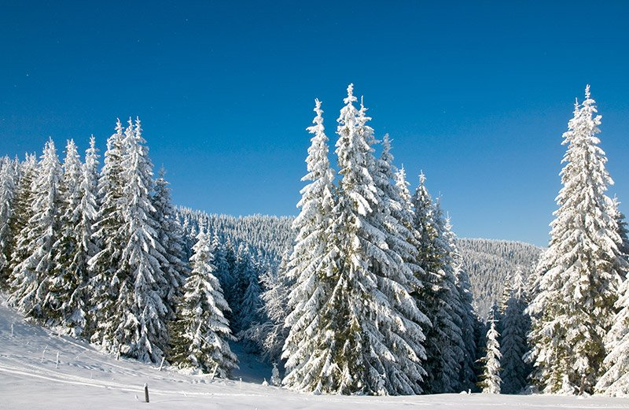
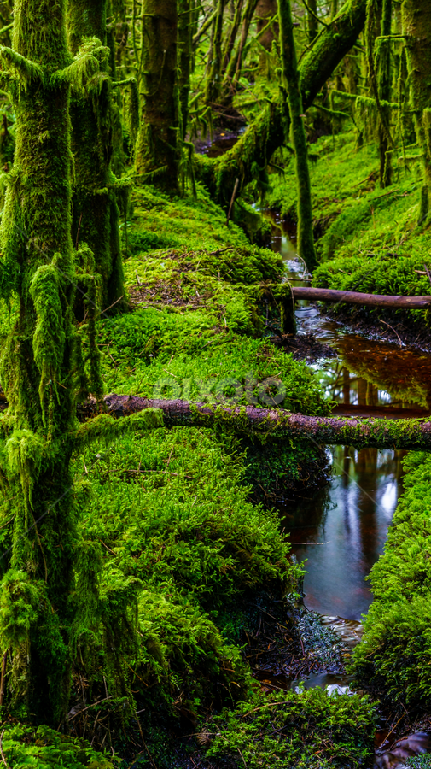
Nature
The glaciers, mountains, waterfalls, fjords, forests, natural wonders such as the northern lights, the midnight sun and quiet national parks highlight Norway's serene qualities. The highest tree in Norway, called Øygardslia is 47 m tall and it is 68 years old. The most interesting animal of Norway is forest cat. It is similar to a wild cat, which we have in Slovakia – rys.

Slide 6
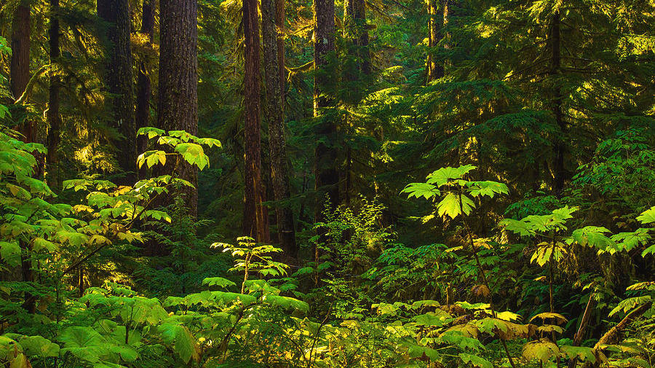
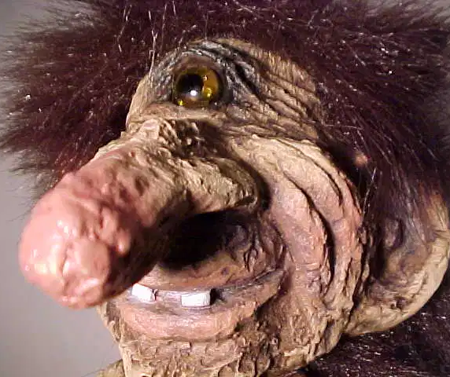
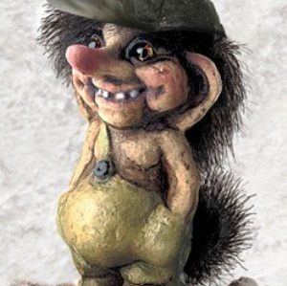
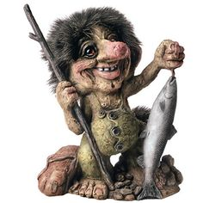
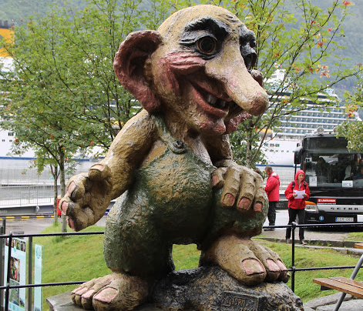
Trolls
I first noticed trolls with my friends on Youtube, but I did not know the real “story“ behind it or where they come from. I first found out during geography class at school. These little beings described as trolls dwell in isolated rocks, mountains, or caves, live together in small family units, and are occasionally helpful to human beings.

Slide 7
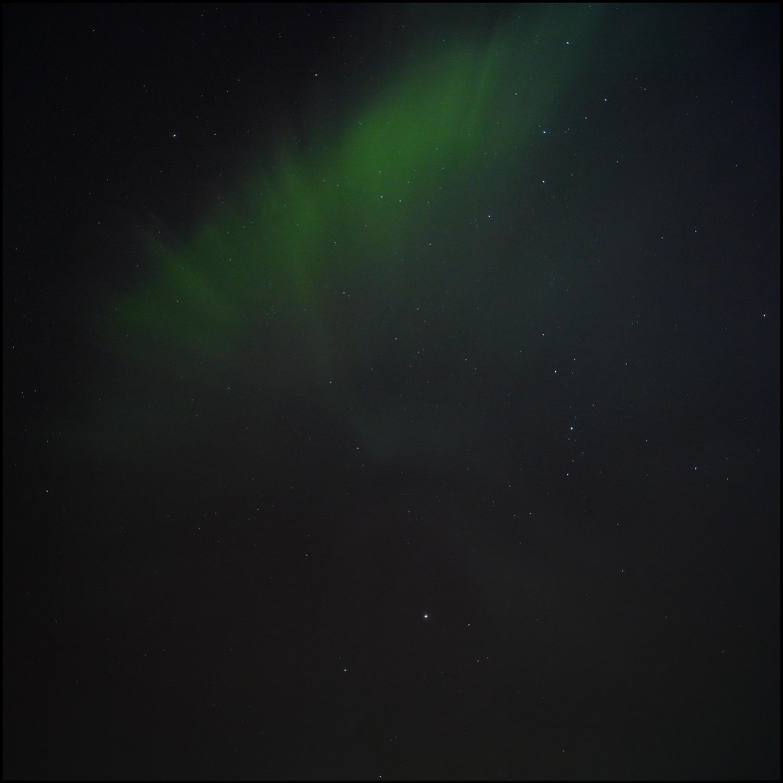
Thanks for your attention
Sources : Google – images, Wikipedia, Kids world travel guide, Fjord tours, The Nordic page, National geographic

