Slide 1
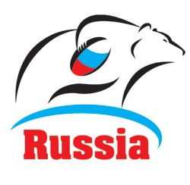
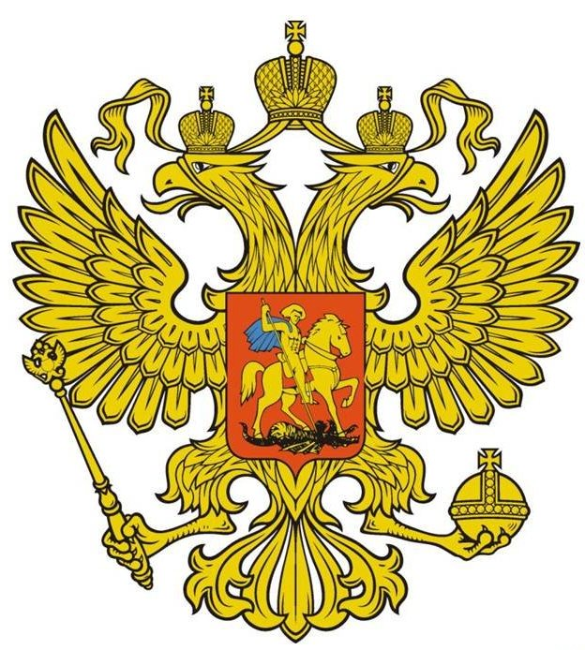
Russia
By Lukas Hyross
Táto fotografia od autora Neznámy autor, chránené licenciou CC BY-SA

Slide 2
Location
Russia is a transcontinental country located in Eastern Europe and Northern Asia. It covers over 17,125,200 square kilometres, and bordering 16 sovereign nations. Moscow is the country's capital and largest city, other major cities include Saint Petersburg, Novosibirsk, Yekaterinburg, Kazan, Nizhny Novgorod, Chelyabinsk and Samara.
Táto fotografia od autora Neznámy autor, chránené licenciou CC BY-SA
Notes:
Located in eastern Europe andf north Asia
Capital /Moscow
Population 144 million
Currency Russian ruble 1 USD equals 77,43 rubles
Language Russian language
National colors blue red white
Eurasian brown bear national animal

Slide 3
Capital
the capital and largest city of Russia. The city stands on the Moskva River in Central Russia, with a population estimated at 12.4 million residents within the city limits, while over 17 million residents in the urban area, and over 20 million residents in the Moscow Metropolitan Area.The city covers an area of 2,511 square kilometres (970 sq mi), while the urban area covers 5,891 square kilometres
Táto fotografia od autora Neznámy autor, chránené licenciou CC BY-SA

Slide 4
Population
144.5 milion
Táto fotografia od autora Neznámy autor, chránené licenciou CC BY-SA

Slide 5
Currency
Russian ruble is the currency of the Russia, the two partially recognised republics of Abkhazia and South Ossetia and the two unrecognised republics of Donetsk and Luhansk. The ruble is subdivided into 100 kopeks
Táto fotografia od autora Neznámy autor, chránené licenciou CC BY-SA

Slide 6
Language
Russian is an East Slavic language native to the Russians in Eastern Europe. It is an official language in Russia, Belarus, Kazakhstan, Kyrgyzstan, as well as being widely used throughout the Baltic states, the Caucasus and Central Asia
Táto fotografia od autora Neznámy autor, chránené licenciou CC BY-SA-NC

Slide 7
Eurasian brown bear/national animal
The Eurasian brown bear is a national animal of Russia. It lives in the parts of Europe and Asia. The Eurasian brown bear stands 1.70 to 2.20 metres (5.57ft to 7. 21ft) tall. Depending on the distribution region its weight can vary between 100 and 350 kilos. In all populations the males are heavier than the females
Táto fotografia od autora Neznámy autor, chránené licenciou CC BY-SA

Slide 8
Nature
Russian nature is diverse. The territory of Russia consists of different natural zones. Russian nature is famous for its diversity in the world of plants and animals. Russian nature has a lot of unique animals like the Baikal seal.I would really like to visit the Baikal river and especially the Baikal seal
Táto fotografia od autora Neznámy autor, chránené licenciou CC BY-NC-ND

Slide 9
Culture
Russian culture is very rich. I really like their folklore dancing groups and I think that they are worth seeing. Russian nesting dolls are well-known symbols of the country. These sets of dolls, known as matrioshka dolls, consist of a wooden figure that can be pulled apart to reveal another smaller version

Slide 10
Food
The main feature of Russian cuisine is considered to be an abundance and variety of products used for cooking occasions. One of the most popular food in our country that has the origin in Russia is the sour cream or Smotana. But I would really like to try the Borscht
Táto fotografia od autora Neznámy autor, chránené licenciou CC BY-SA

Slide 11
Sports
Russia, like any other big country excels at almost every sport. My favorite one is the ice Hockey.I have to say that I had the opportunity to meet the Russian VHL team the “Chelmet Chelyabinsk”. It was a very great experience and I would like to meet them again. One traditionally popular sport is Hockey. It is considered a national sport, and is one of the biggest spectator sports. According to one survey, it is the third most popular sport in Russia.
Táto fotografia od autora Neznámy autor, chránené licenciou CC BY-SA

Slide 12
Me meeting Chelmet Chelyabinsk in Slovakia

Slide 13
Спасибо for your attention

