Slide 1
SPAIN
Katarína Kalinčíková

Slide 2
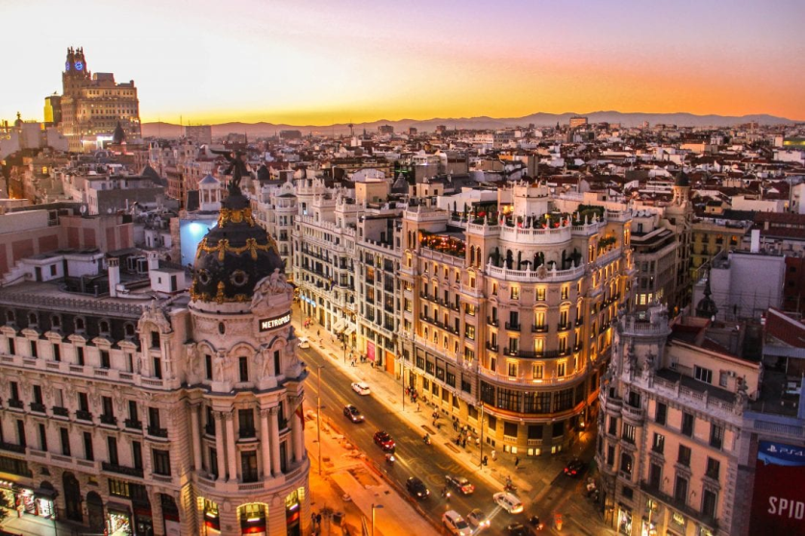
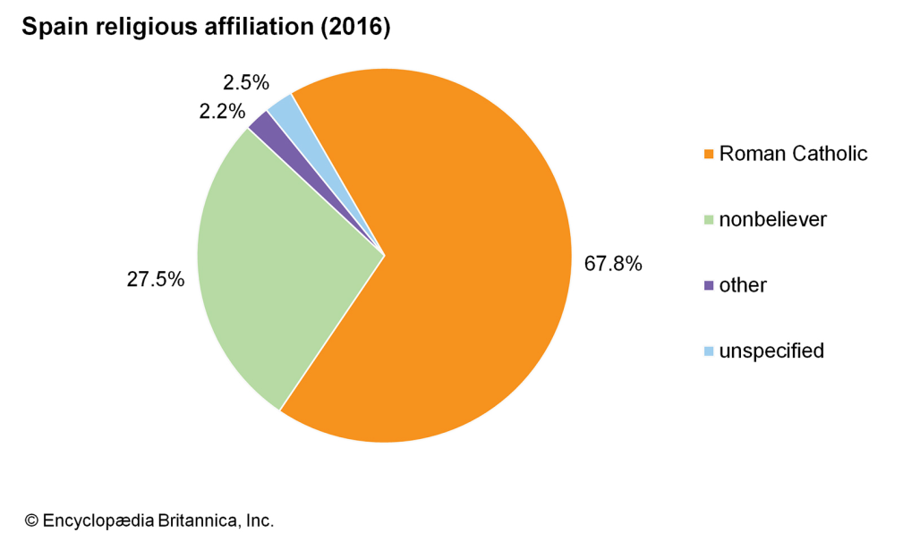
Basic facts
capital: Madrid, with 3.3 million inhabitants, is Spain’s biggest city
population: 48 million people live in Spain
currency: euro
religion: mainly Christians (Roman Catholics)
languages: Castilian Spanish 74%, Catalan 17%, Galician, Basque

Slide 3
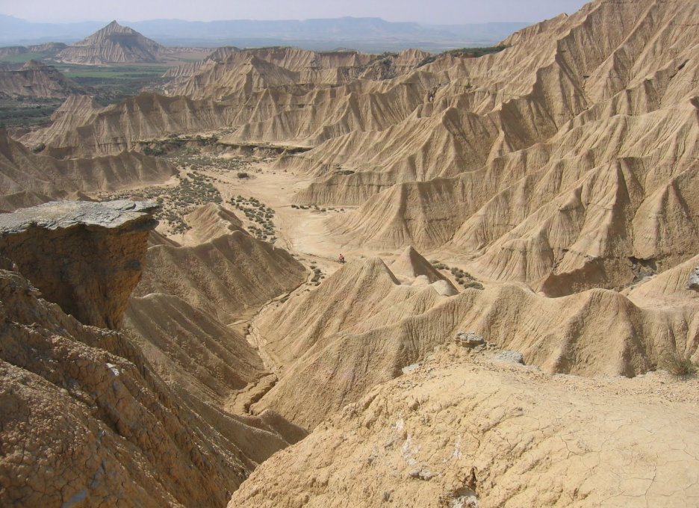
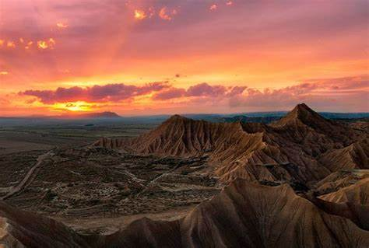
Landscapes
Bardenas Reales, Navarra – The Bardenas Reales is a semi-desert natural region, or badlands, of some 420 km² in southeast Navarre. I would love to visit this place because here in Slovakia, there’s no deserts or semi-deserts. It’s also very interesting because the soils are made up of clay, chalk, sandstone and have been eroded by water and wind creating surprising shapes, canyons, plateaus, tabular structures and isolated hills.

Slide 4
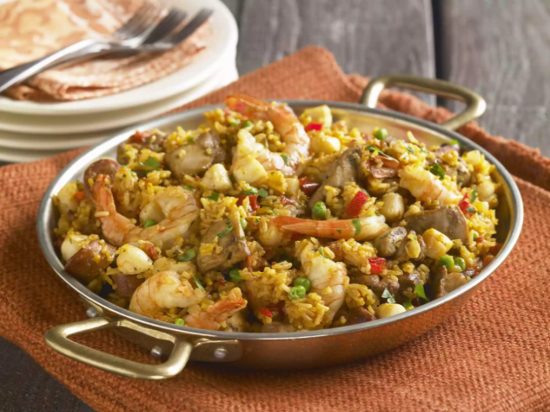
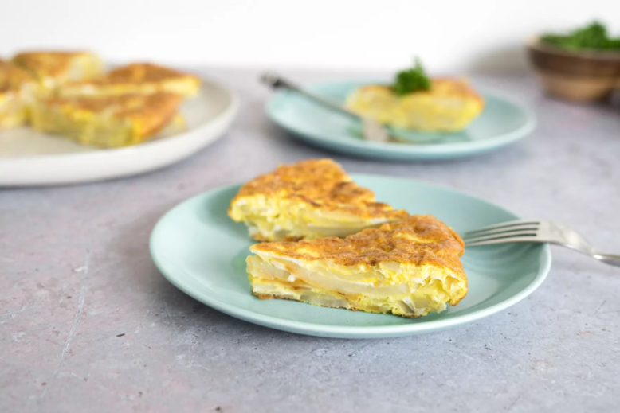
Food
The most commonly served dish, tortilla Espanola is the Spanish version of omelet. It’s made with potatoes and eggs, along with onion for flavor. I don’t know if I would try this one, because I don’t like eggs. However paella de marisco seems pretty interesting. It’s rice mixed with rabbit, snails, and vegetables and cooked over an open fire. I would try this meal because I’ve never had anything similar to this, for example I’ve never had snails. It has evolved into Spain’s most well-known dish, in which fish, shellfish, meat, pork, and chicken might be variously used. No matter what protein is added, no paella de marisco would be complete without its signature seasoning of saffron.

Slide 5
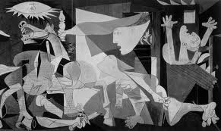
Art
Art is a great way of expressing your inner feelings and emotions. Did you know that many painters used their works a protest against certain events in Spanish history? Picasso showed his outrage at the bombing at the small town Guernica during the Spanish civil war by painting Guernica. What surprised me was that a large number of Spanish painters spent time in France, especially Paris, for example Pablo Picasso spent a lot of his time in there.
“art is a lie that makes us realize the truth” - Pablo Picasso

Slide 6
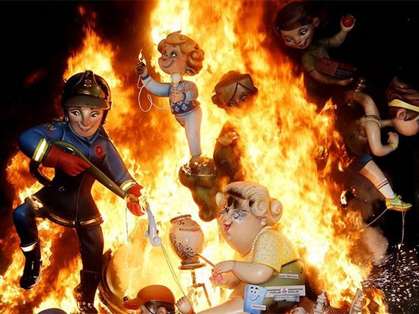
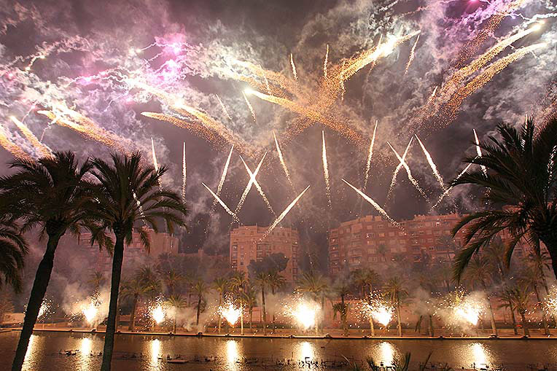
culture
When I think of stereotypical Spanish culture, I imagine flamenco dancing and bullfighting. But apparently these traditional elements of Spanish society are essentially regional in nature and are barely part of daily life on a national scale.
Las Fallas festival – Valencia: I have never been to a festival, but I would love to visit this one. The crazy amount of firecrackers being set off, the strong rhythm that is created, the biggest firework show during Las Fallas on 18th March called night on fire seems very interesting to me and if I ever come to Valencia I would definitely visit this festival.

Slide 7
thanks for your attention
Sources: wikipedia, https://www.kids-world-travel-guide.com

