Slide 1
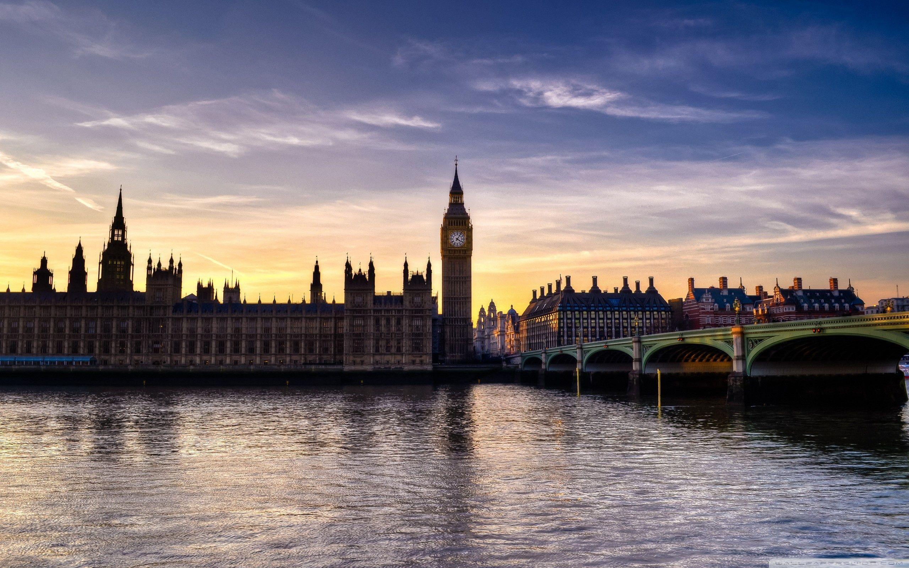
The United Kingdom

Slide 2
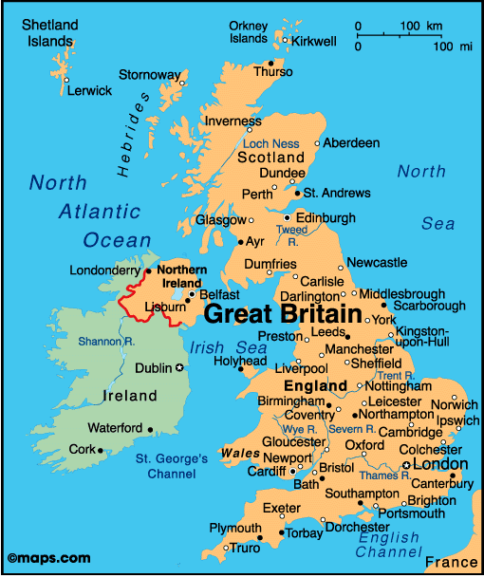
ABOUT THE UK
The UK consists of 4 states : England, Wales, Scotland and Northern Ireland.
The capital city of England is London, of Wales it's Cardiff , of Scotland it's Edinburgh and of Nothern Ireland it's Belfast.
The population of the UK is approximately 66,5 milions.
The national colours are: red, white and blue.
The currency is the British pound which is divided into 100 pence.

Slide 3
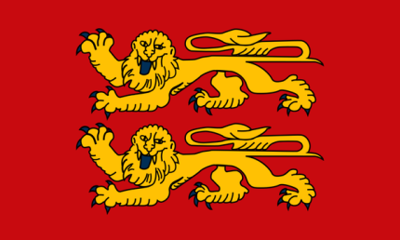
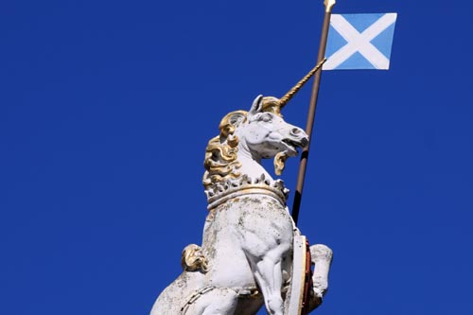
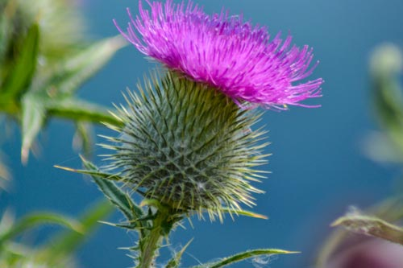
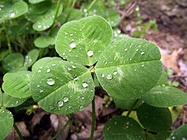
NATIONAL SYMBOLS
England 's national animal is a lion but it also another national symbol - a red rose.
Wales' national animal is a red dragon.
While Northern Ireland does'nt have any national animal, it has the shamrock as it 's national symbol.
And Scotland 's national animal is a unicorn as well as the thistle.
All of these symbols have a deep connections yith history and are known all over the world!

Slide 4
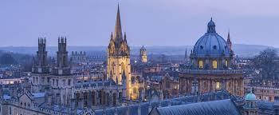
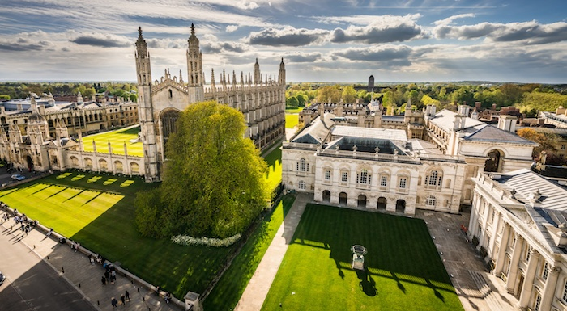
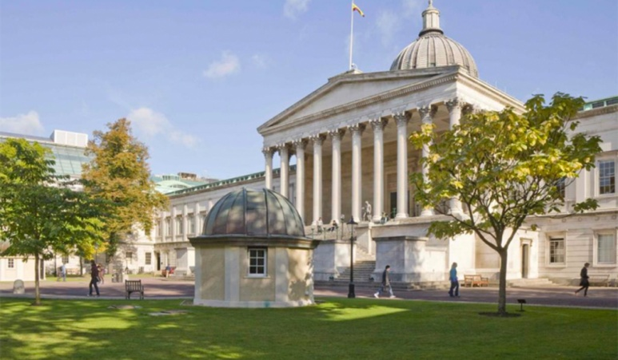
UNIVERSITIES
In the UK, there are so many universities, which are considered to be one of the best in the world- such as Oxford, university of Cambridge, UCL and many more.
Not only they offer great education programmes, they also have really relaxing vibes on campuses, as well as the most gorgeous buildings.
I hope that one day I will be able to attend one of these universities to become a surgeon with such an excellent education.

Slide 5
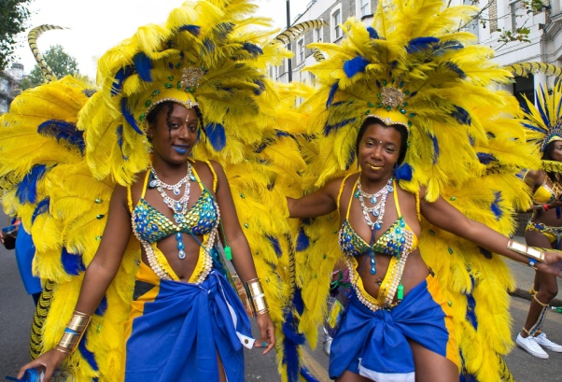
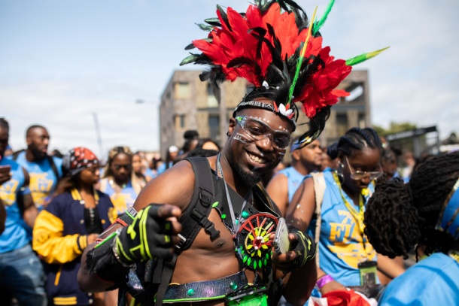
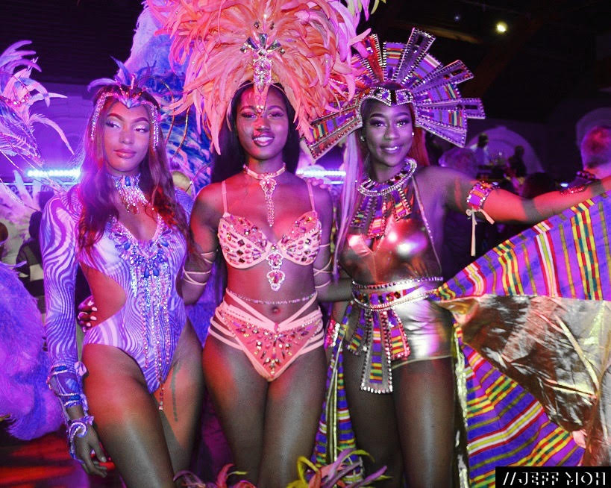
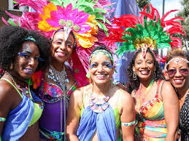
NOTTING HILL CARNIVAL
I absolutely love learning about new cultures, trying new types of food and listening to all kinds of music and since London is home to one of the most ethnically diverse populations in the world, there is no way I wouldn't mention this carnival.
It is a huge street festival which has taken place in London since 1966.
It 's about celebrating diversity – mostly West Indian arts and culture including music ( all kinds of music – as well as steel bands, reggae and salsa), different kinds of traditional food and dancing.
People show off their beautiful costumes in the huge parade, which is absolutely stunning and colourful.
There is more and more attendees every year and I wish, one day I could be one of them!

Slide 6
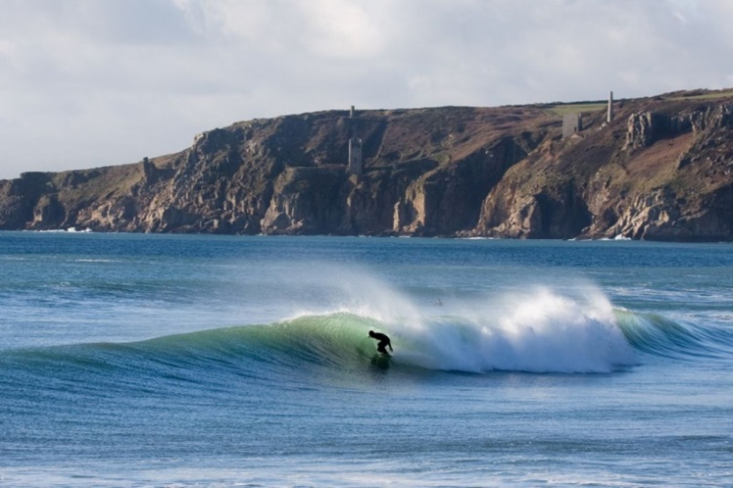
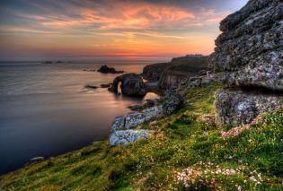
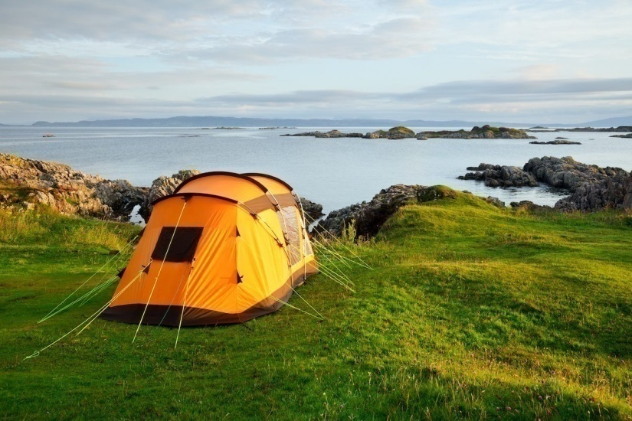
CORNWALL
Cornwall is a beautiful peninsula in the south of England which is known for being an amazing place for camping and its calm atmosphere.
Since I'm a big fan of nature and I adore camping,
Cornwall is on the list of my dream places!
Not only that, but there are offered surfing courses as well as yoga courses, which is something I can only dream of - on such a magnificent place.

Slide 7
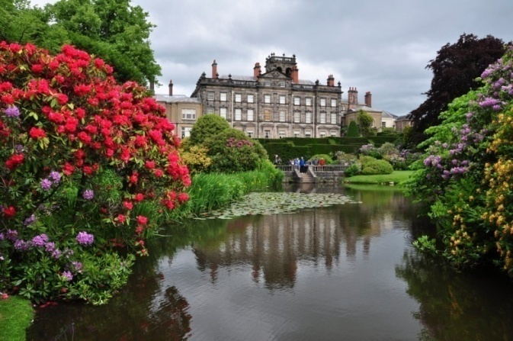
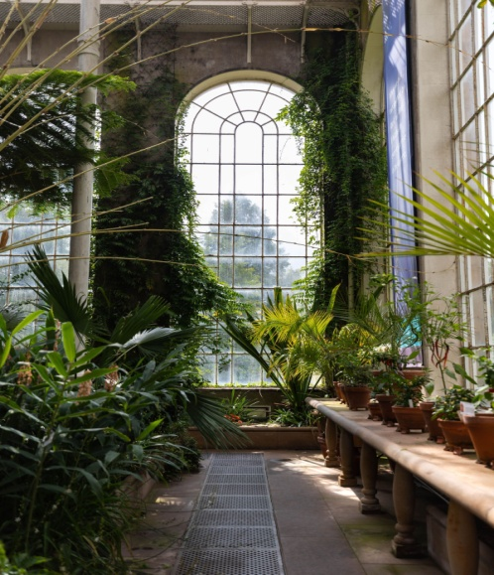
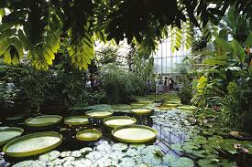
GARDENS
As I have already mentioned, I really like nature – including all plants and all flowers in all possible shapes and colours.
In the UK, there is so many beautiful gardens and parks, so It was quite hard to choose just a few of them (I sadly can't visit all of them).
The ones that caught my eye the most were the Biddulph Grange, and Royal Botanic Garden in Edinburgh.
The Biddulph Grange is located in Egland, with such admirable design and a lot of colourful flowers.
And the Royal Botanic Garden in Edinburgh is in Scotland and I chose it not just because it is aesthetically pleasing and has lots of plants but also because the environment must be so good there.

Slide 8
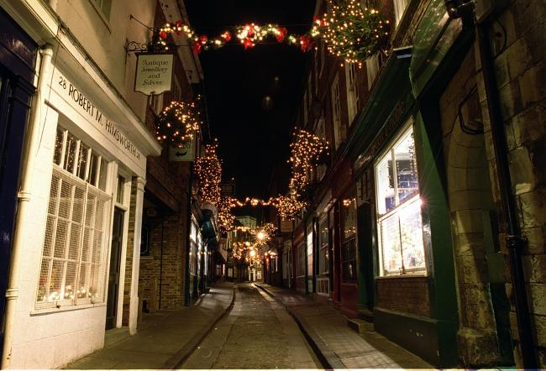
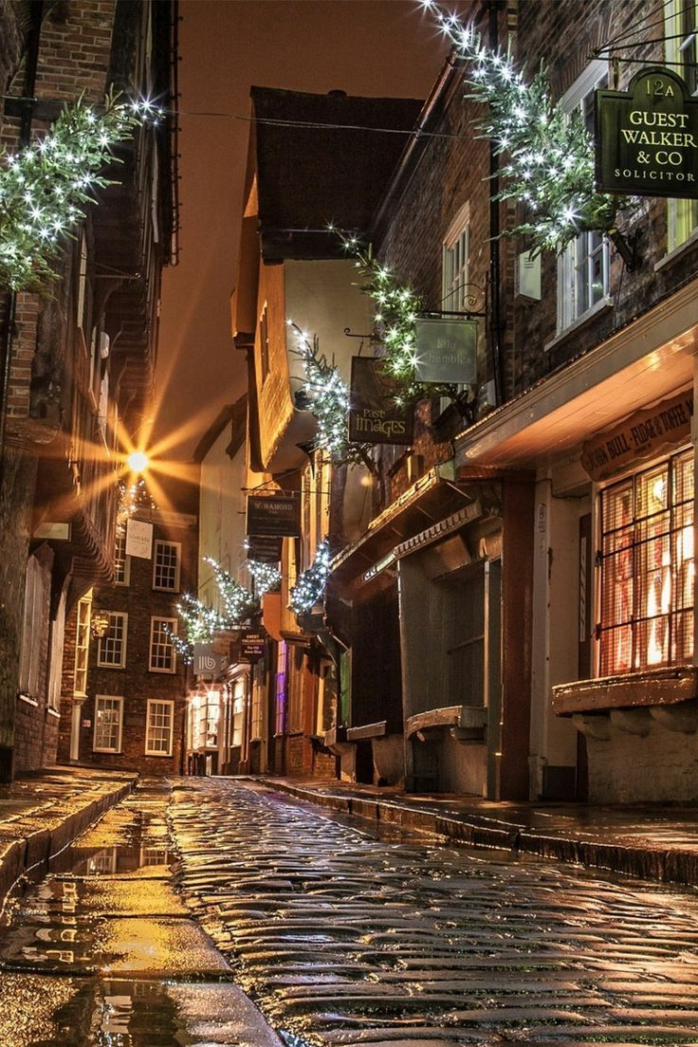
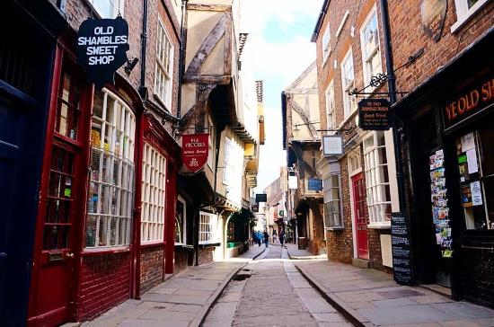
THE SHAMBLES - YORK
I would like to visit this medieval street because I think it is a fantastic place to combine a bit of shopping and sightseeing (It is one of the oldest streets in the UK).
While walking down the old cobbled road beneath the overhanging timber-framed buildings you can take in York's fascinating past while shopping in a lot of different shops.
There's plenty of shops – from vintage (my favourite ones) boutiques to delicious chocolatiers and a lot more!

Slide 9
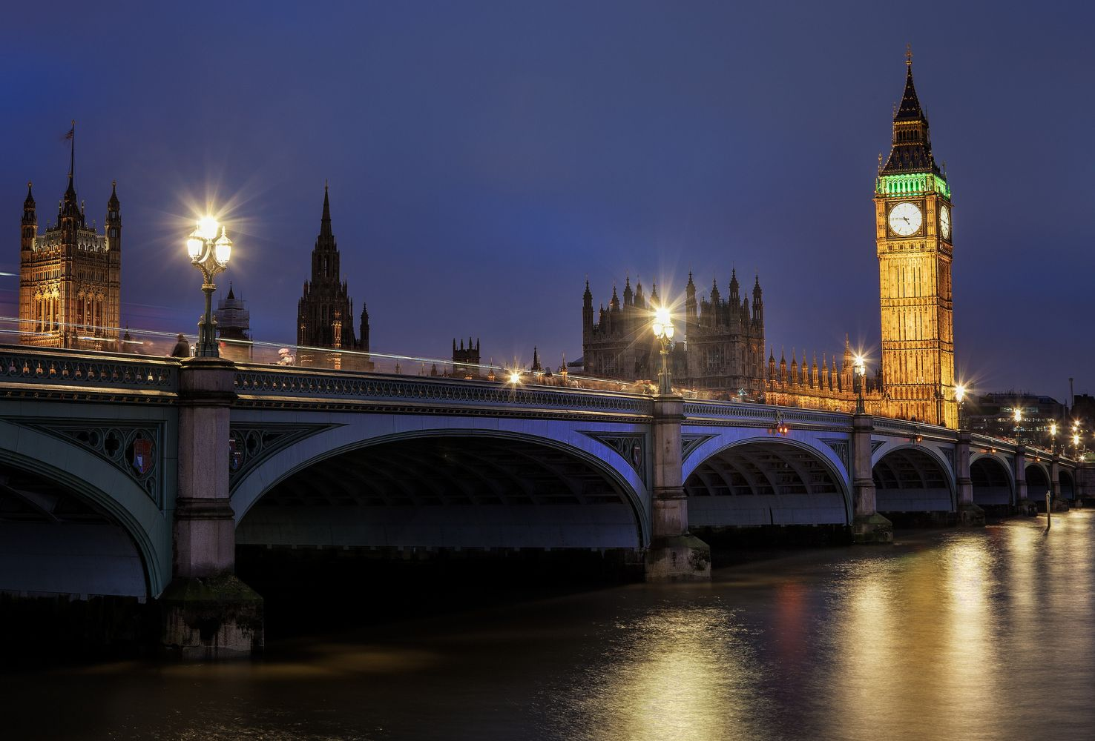
Thank you for paying attention :)

