Slide 1
Switzerland
Adamcova, Srnakova

Slide 2
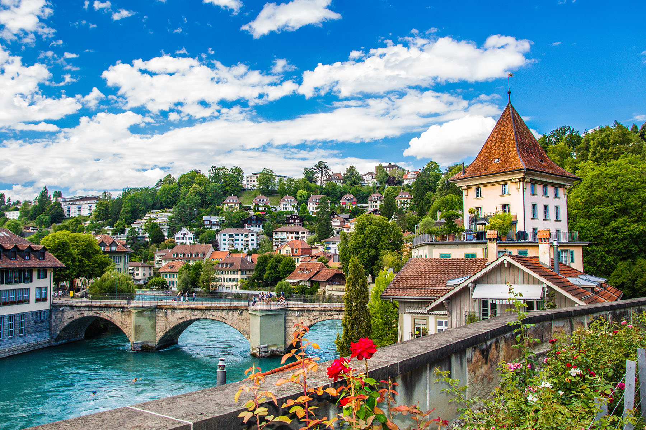
Geographical location
Landlocked country
Central Europe
41 293 km²
Alps
Border with: German, Austria, Lichtenstein, France, Italy
Lakes: Geneva, Constance
River: Rhine

Slide 3
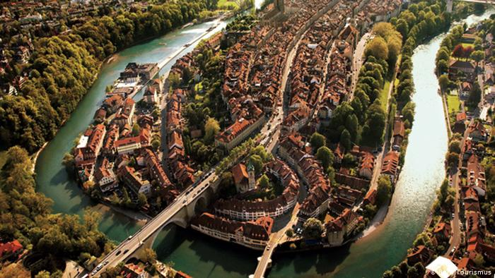
Bern
Origins in 12th century
Area - 51,6 km²
137 000 inhabitants
Build around a bend of Aare River
Old Town – UNESCO,1983
In Bern we would like to see the old town and experience its atmosphere, we would also like to see a Cathedral of Bern and the Parlament Puilding

Slide 4
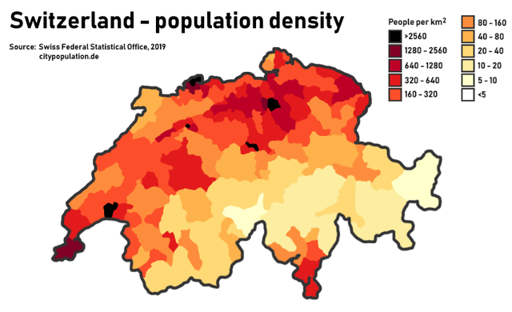
Population
8,67 milions
Religions – Catholics
26 cantons

Slide 5
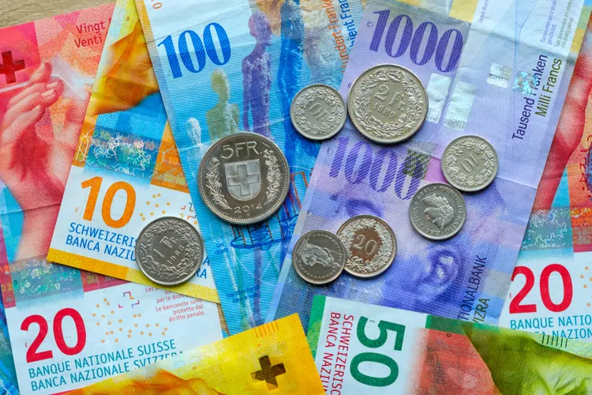
Currency
The Swiss franc
1 franc = 0,93 euro
Comes from 19th century

Slide 6
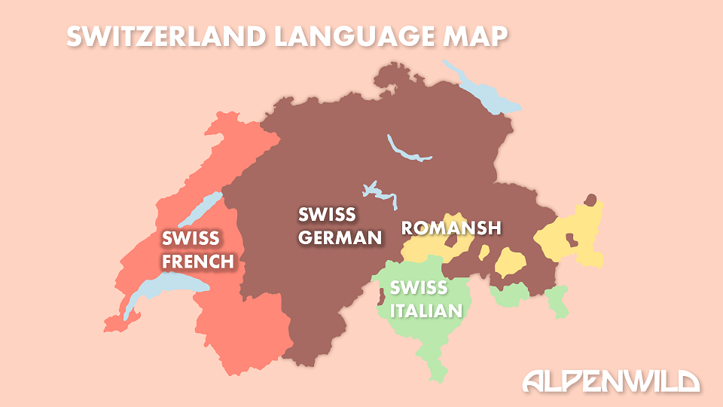
Language
Official languages: French, German, Italian, Romansh
Swiss - German – 60%
We want to improve German, because it is our second language at school

Slide 7
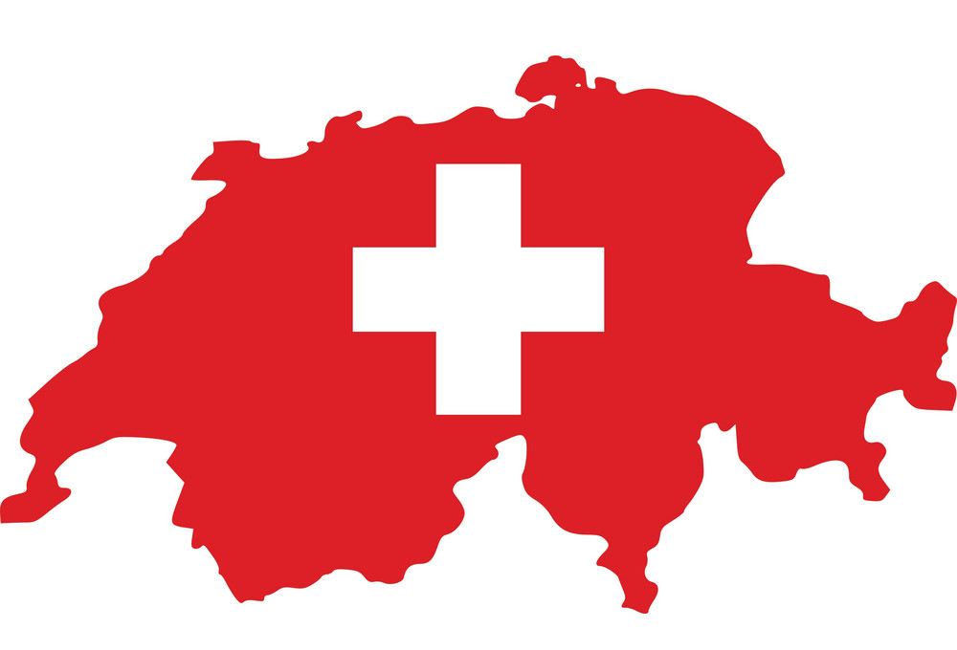
Flag
White, red
Wite cross in the central of a square red field
12th December 1889 (inspired by flag of Schwyz carton)

Slide 8
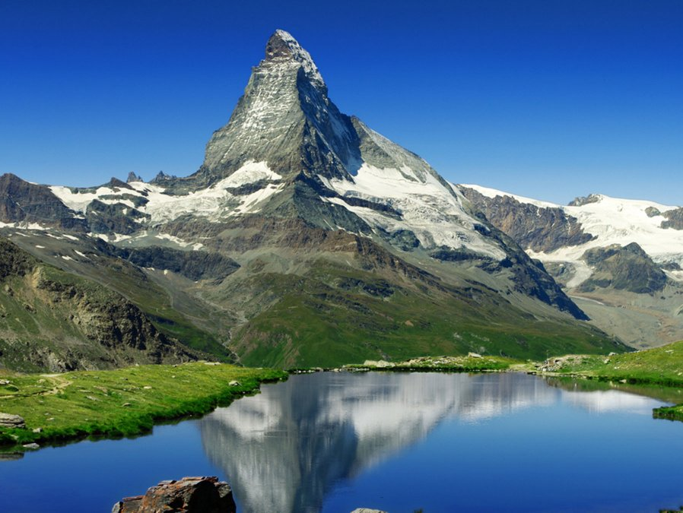
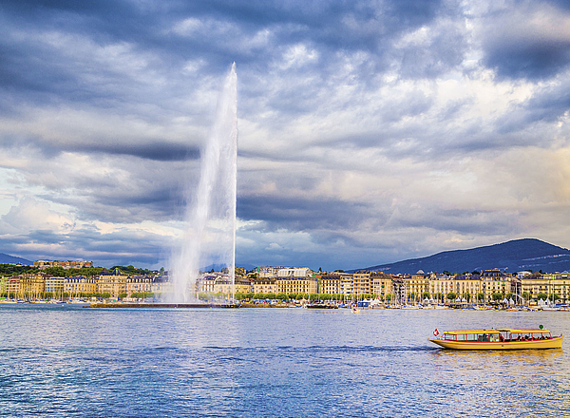
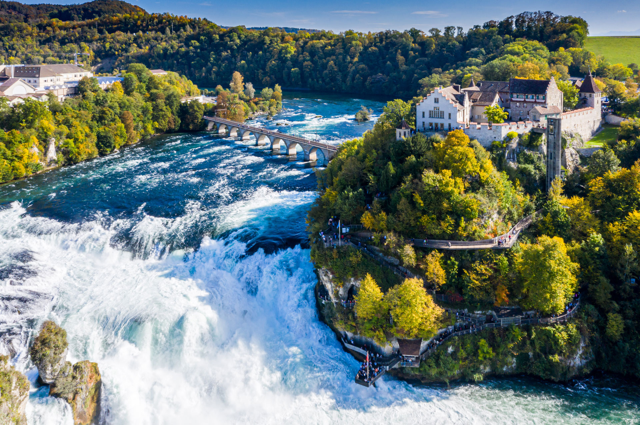
Nature
Geneva
Area – 580 km²
Long – 73 km
Largest lake in western Europe
Fountain Jet dÉau
The Rhine waterfall
23 m height
Largest waterfall in Europe
15 000 years old
Matternhorn
One of the largest peak in Alps
4478 high
First ascent – 14.7.1865
We would like to go on boat trip on Geneva Lake, see Jet dÉau fountain, go hiking along Matternhorn, during the climbe we would like to visit a hut and if we were lucky we may see a marmot or a golden eagle

Slide 9
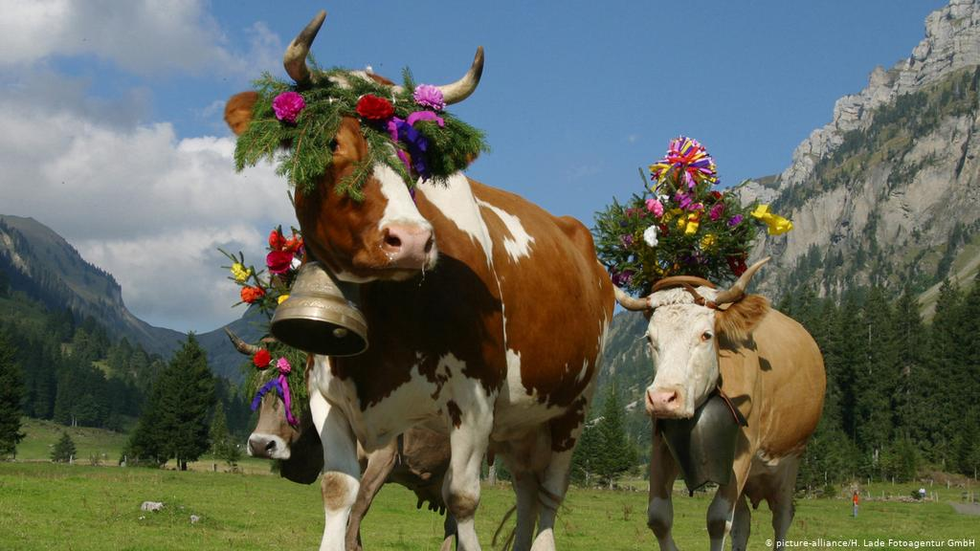
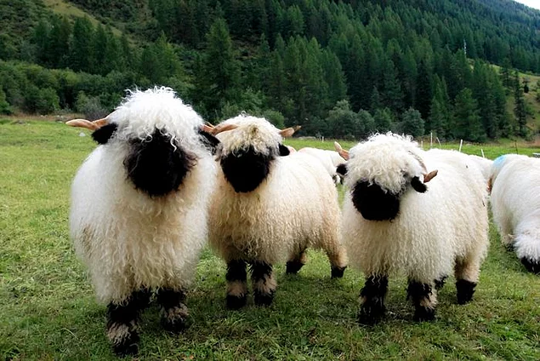
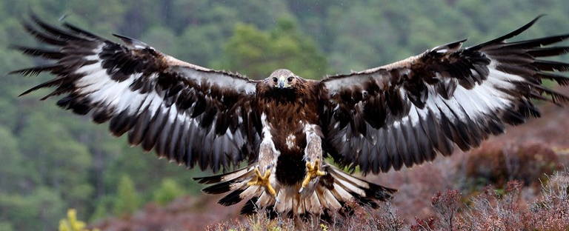
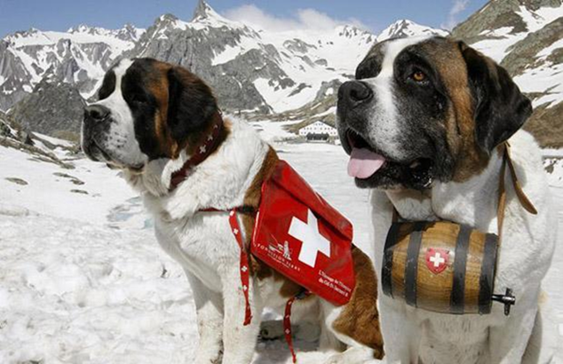
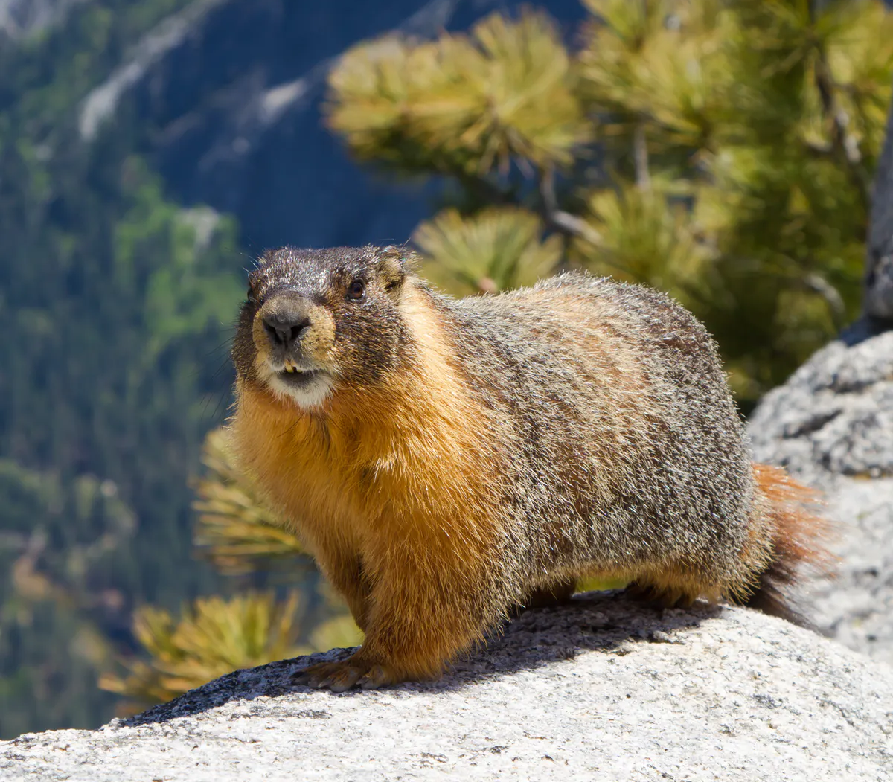
Traditional animals
Cow
Milk products
St Bernardin
Working dogs on farms
Rescue wok
Marmot
Groups of 15 family members
Black Nose Sheep - wool
around Zermatt, the domesticated Valais Blacknose sheep
Golden Eagle
the biggest birds in Switzerland
grow up to 2 m

Slide 10
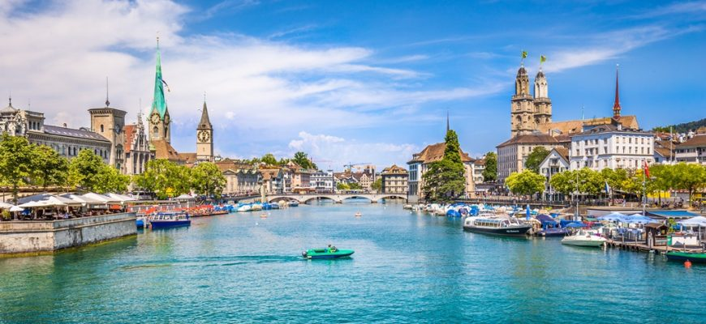
Zürich
Important financial and banking centre
Largest city in Switzerland
87,88 km²
Place to visit in Zürich: Old Town, Zürich Lake
In Zürich we would like to sightseeing the old town, do to the Swiss National Museumand see Banhofstrasse

Slide 11
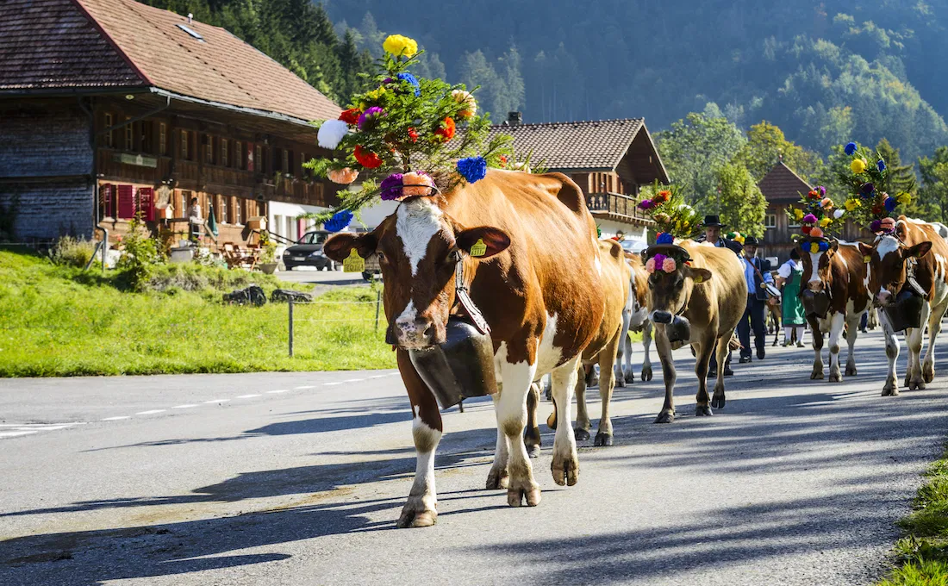
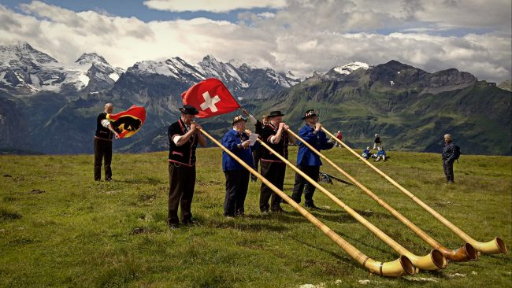
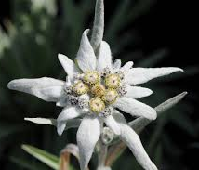
Traditions
We want to expierence the atmosphere of Alpazug, go in a procession and try on tradiotonal costume
we would like to try alphorn blowing and listening to live yodelling
Aplhorn blowing
Made from pine wood, takes up 70 hours
International festival in Nendaz
Known since 1595
Yodelling
Developed in 19th century
Communicate
Alpabzug
Fall celebration
Procession of beautifully decorated herd
Typical entertainment and a markets
Edelweiss
National flower
Symbol of the country

Slide 12
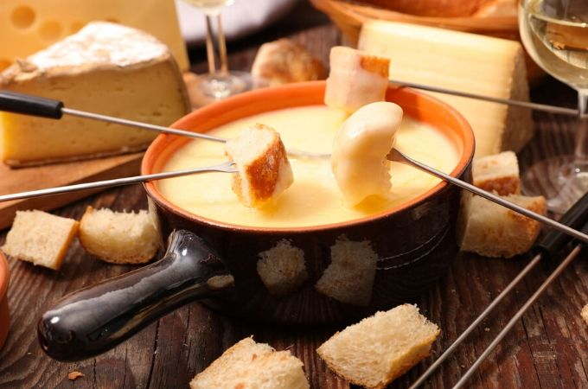
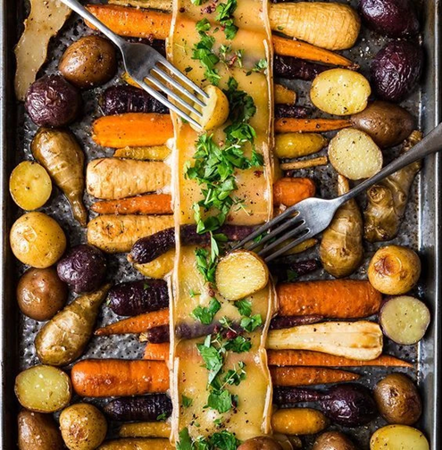
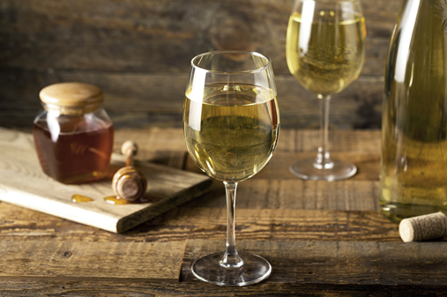
Food and drinks
Fondue
From Zürich, 1699
Main dish
Raclette
Salt, milk cheese
White wine
Add to their traditional dish
Black beer
Milk chocolate

Slide 13
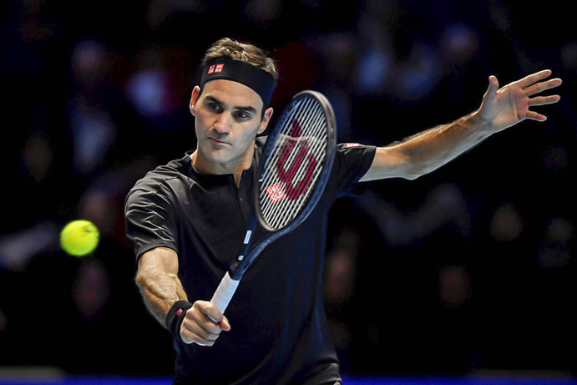
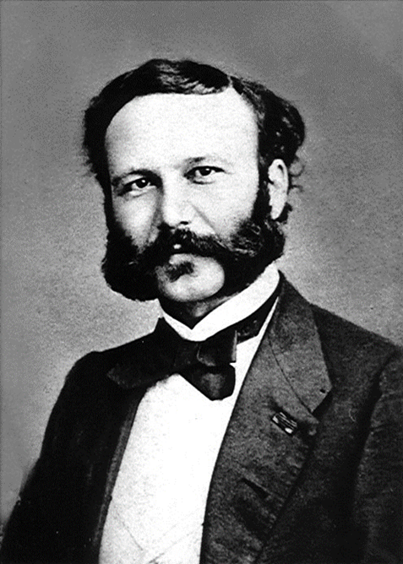
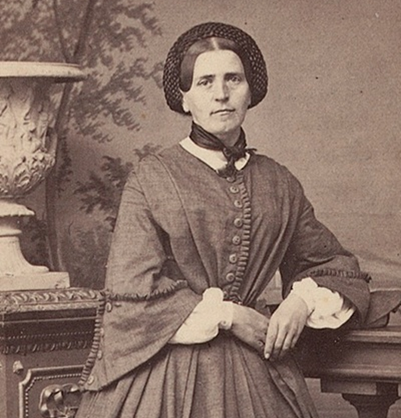
Famous person
Roger Federer
Basilej, 1981
Best tennis player in history
Won 20 Grand Slam
Highest –paid athlete ($106 mil.)
Henri Dunant
Geneva, 1828 - 1910
Humanitarian, businessman, social activist
Funder of the Red cross
The first Nobel Peace, 1901
Johanna Spyri
Hirzel,1827 – 1901
She wrote Novels
Autor of book for children – Heidi

Slide 14
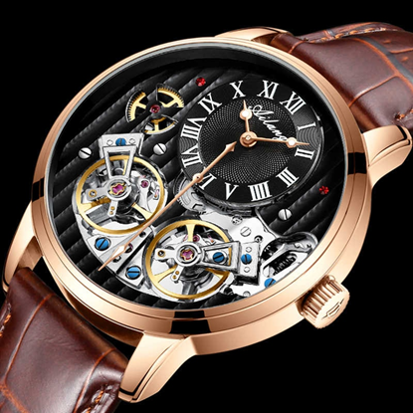
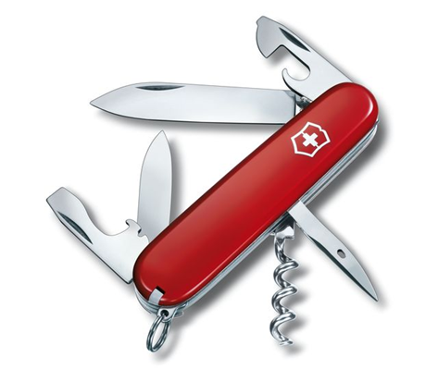
They are known for their:
Swiss watches
Hight quality, more expensive
Famous brands: Rolex, Patek Philippe
Swiss knives
Hight quality
Famous brand: Victorinox
Producing more than 200 years

Slide 15
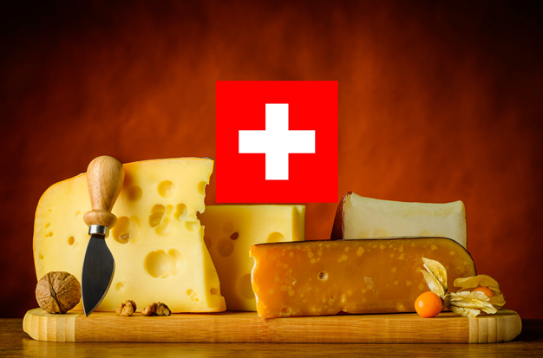
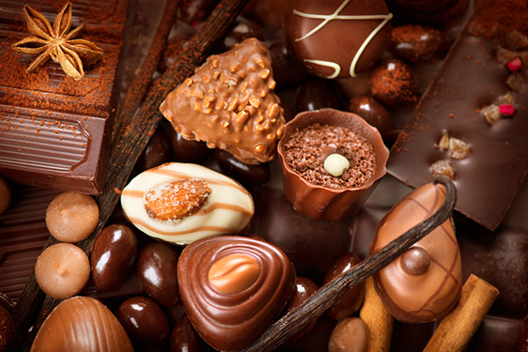
And others:
Swiss cheese
About 450 kinds
Emmental cheese
Traditional dish is made from cheese
Swiss chocolate
Milk chocolate
Produce about 180 000 tons of chocolate per year
61% is exported aboard
Famous brands of chocolate: Lind, Toblerone, Nestle
We would like to try national food, especially cheese and chocolate – see the process of making chocolate

Slide 16
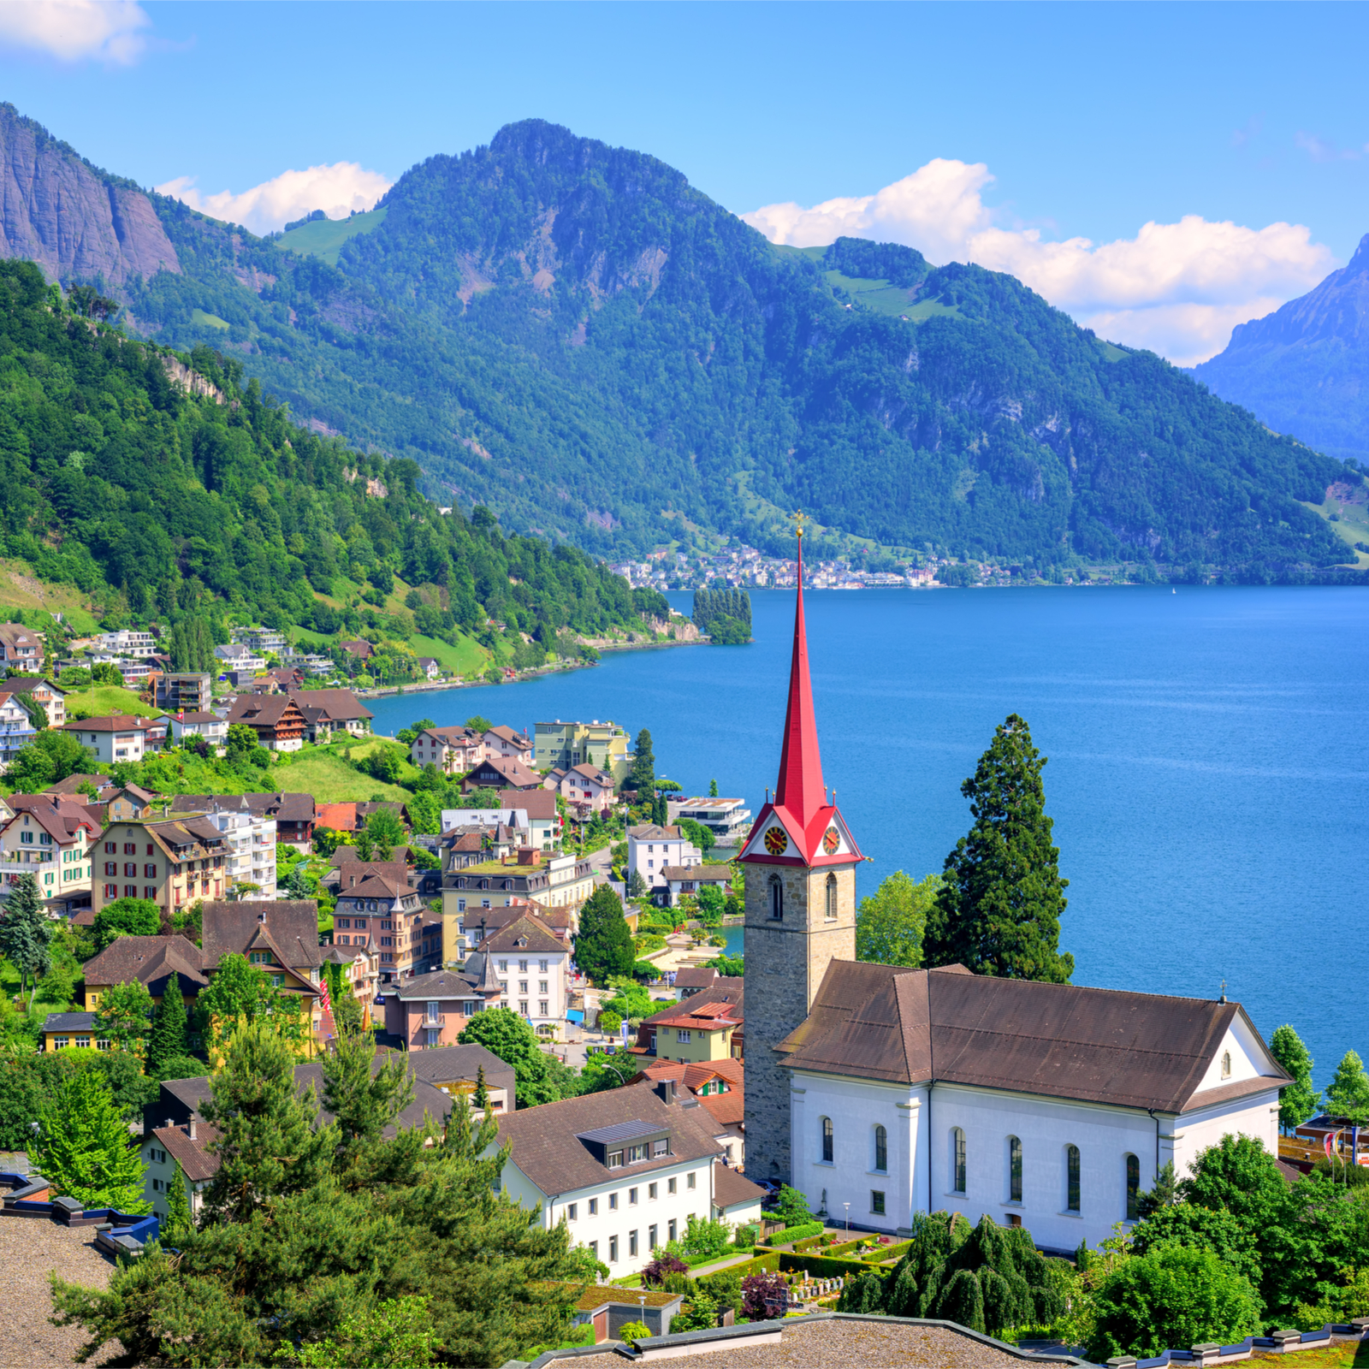
Thanks for watching!

